Slide 1
UIL Accounting
The Early Years

Slide 2
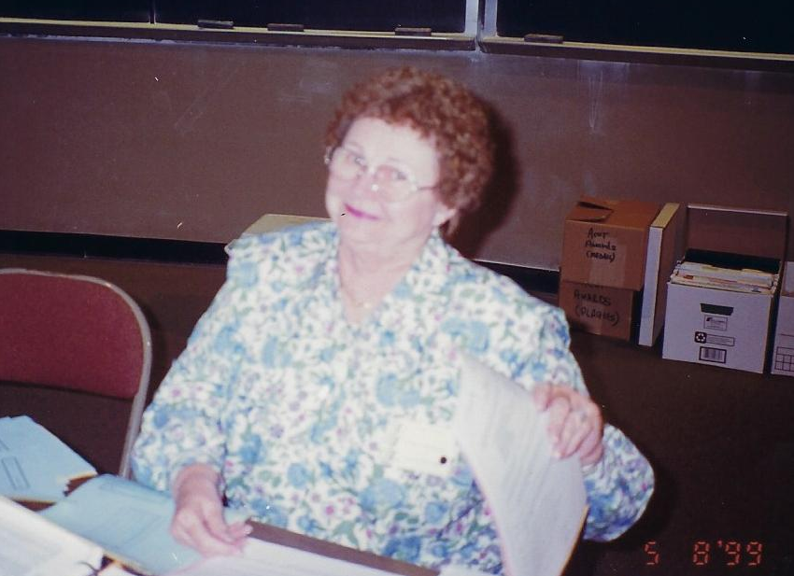
In Loving Memory of
Dolores Brotzman
Who Served as UIL Accounting
Assistant Contest Director for 20 Years from 1987 through 2006
1936-2018

Slide 3
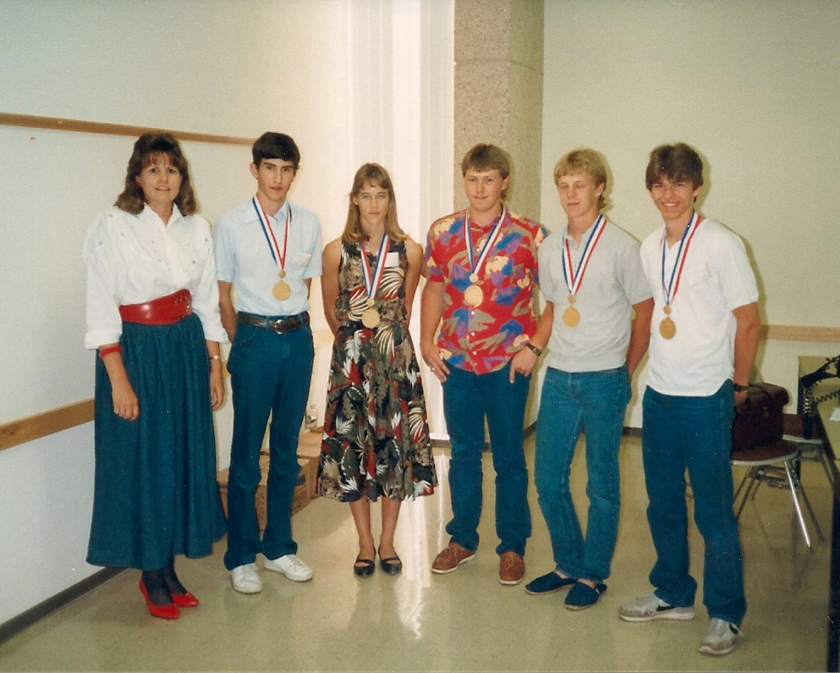
1987 State Gold Medalists
(In the early years there were no teams)

Slide 4
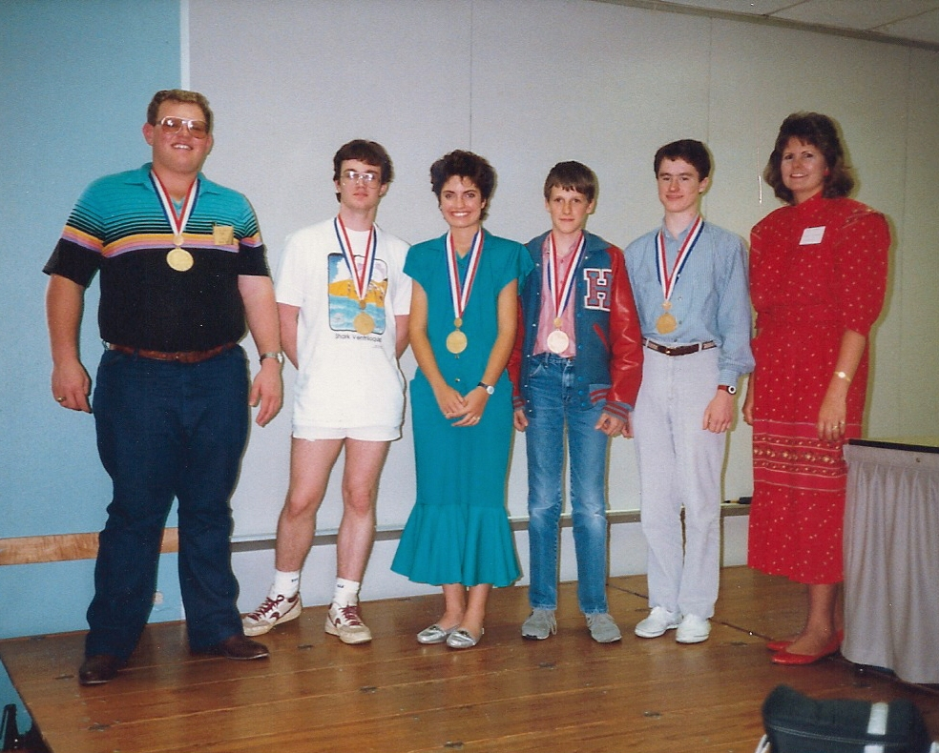
1988 State Gold Medalists

Slide 5
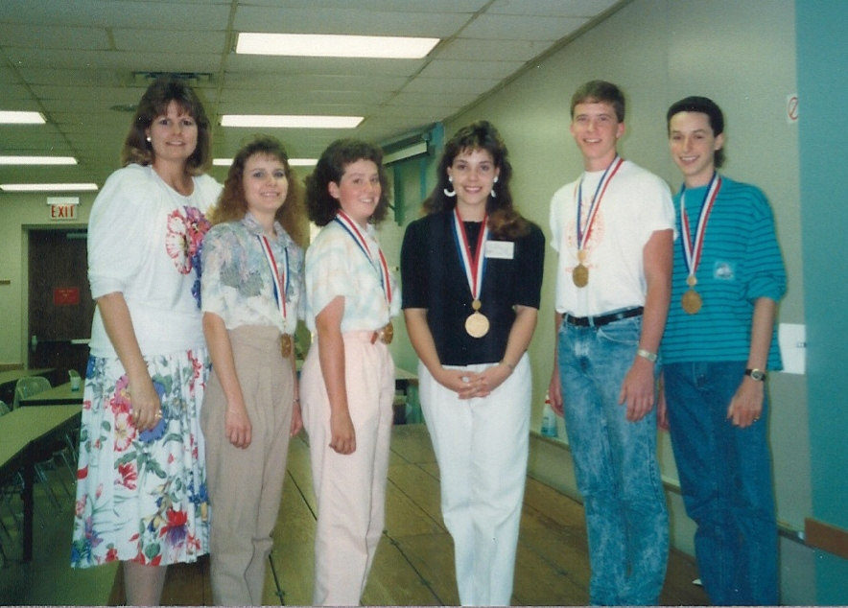
1989 State Gold Medalists

Slide 6
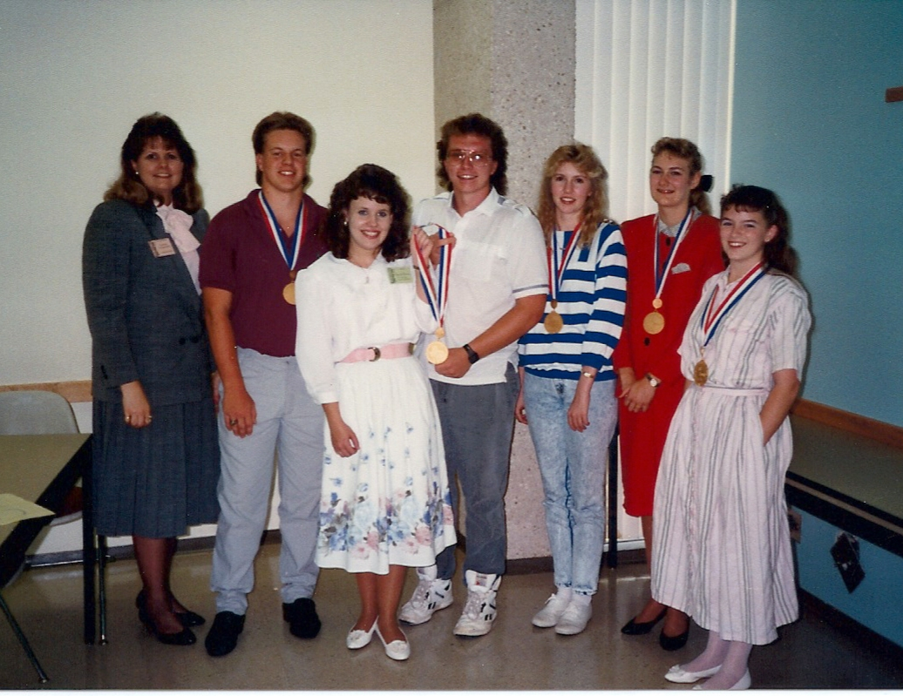
1990 State Gold Medalists

Slide 7
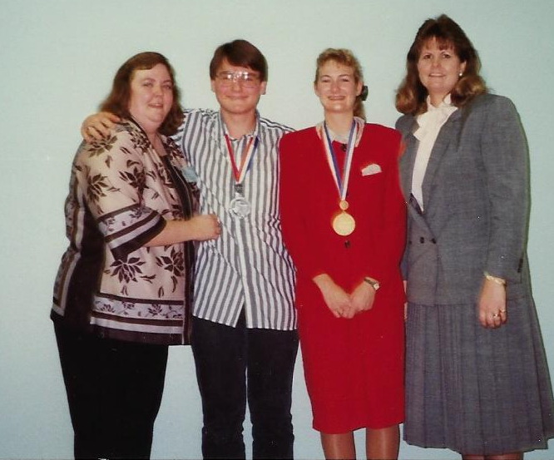
First Ever State Perfect Score
Susan Beavers
4A Midlothian HS
Coach Marilyn Rollins
Danny Morris
Susan Beavers
LaVerne Funderburk

Slide 8
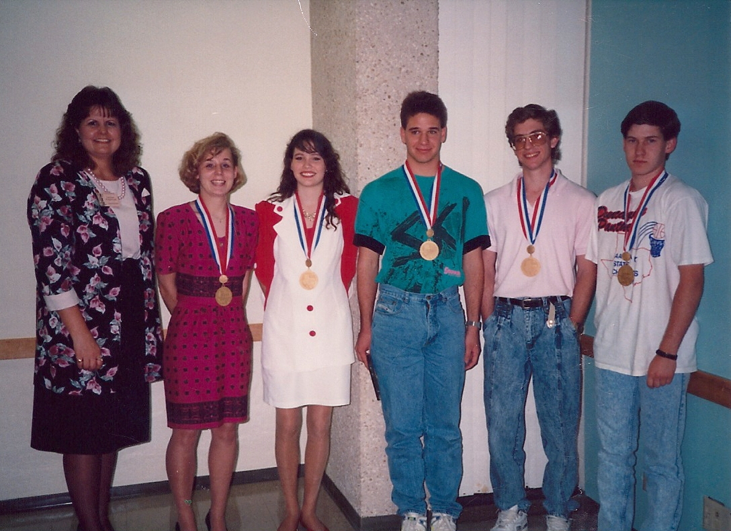
1991 State Gold Medalists

Slide 9
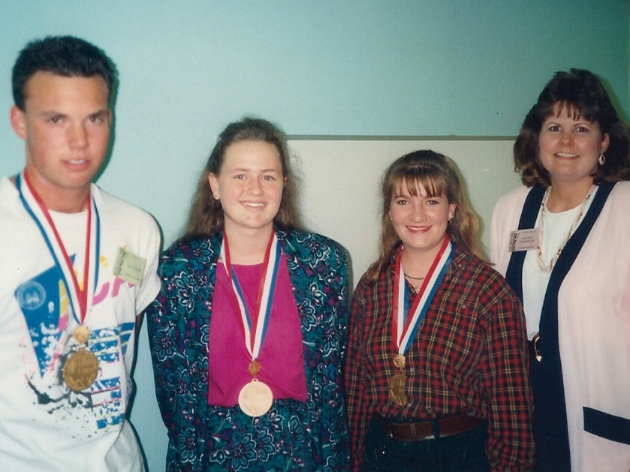
1992 State Gold Medalists

Slide 10
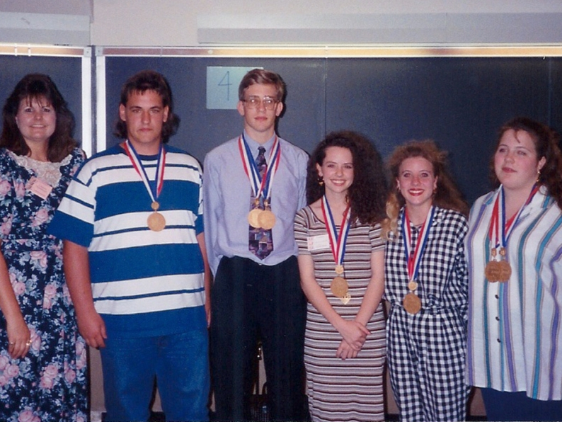
1993 State Gold Medalists

Slide 11
UIL Accounting
1993 First Year for Teams

Slide 12
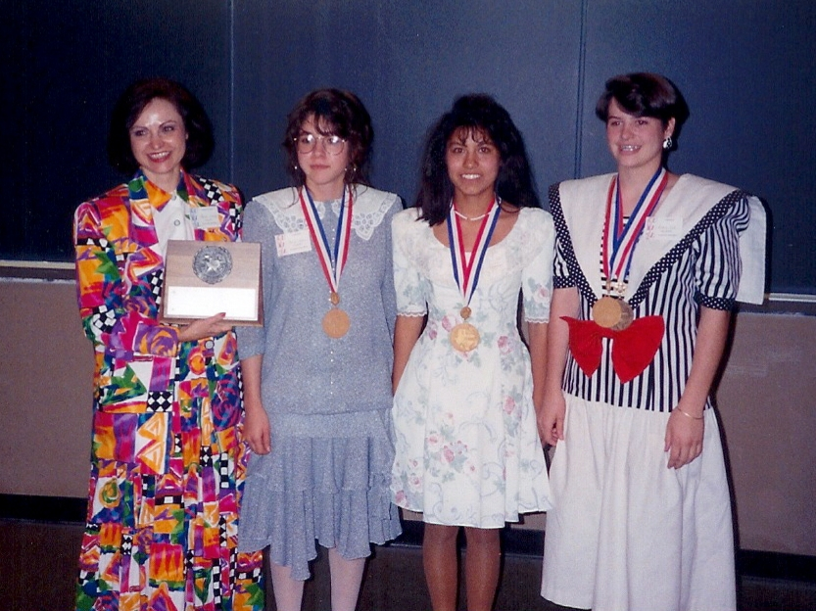
1993 State 1A Team Gold
Lazbuddie
Coach: Marsella Jennings

Slide 13
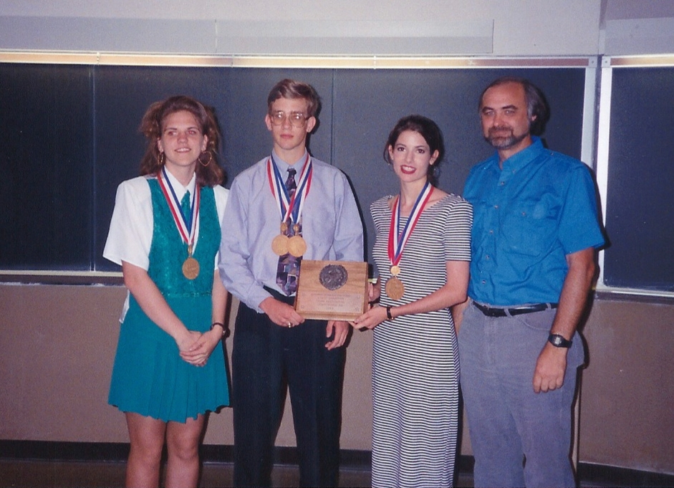
1993 State 2A Team Gold
Rosebud-Lott
Coach: Alan Barkemeyer

Slide 14
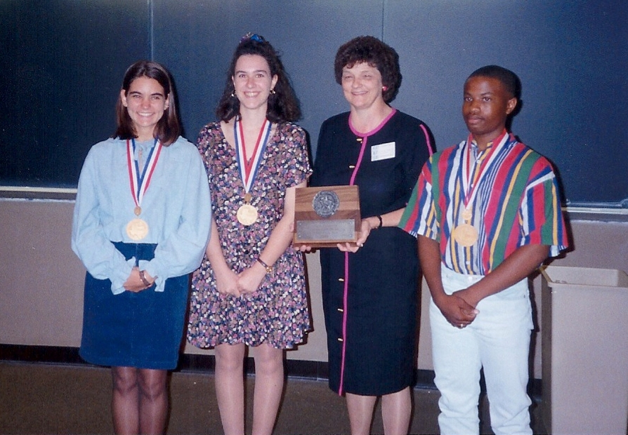
1993 State 3A Team Gold
Cameron: Yoe HS
Coach: Linda Morgan

Slide 15
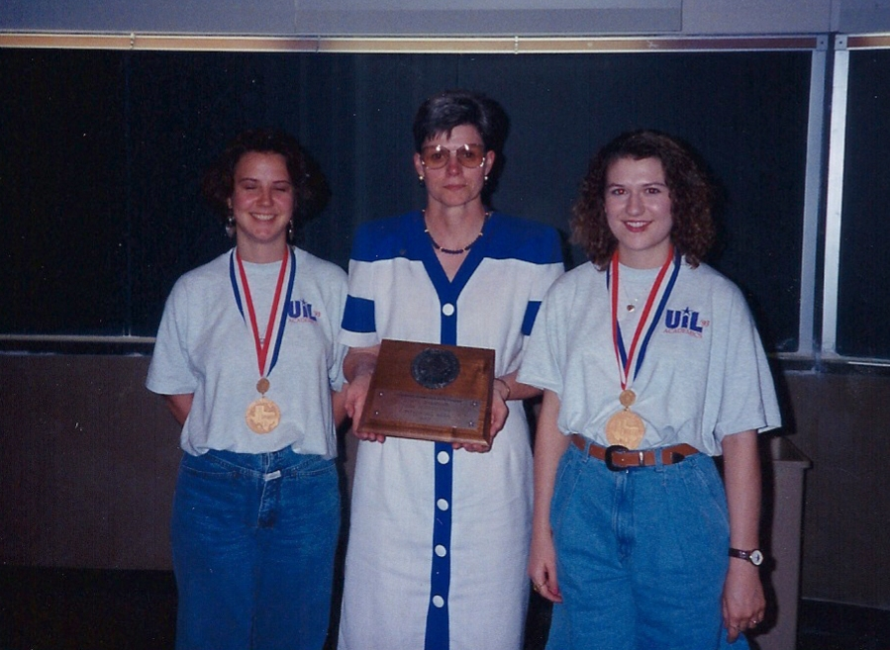
1993 State 4A Team Gold
Dayton
Coach: Carolyn Florus

Slide 16
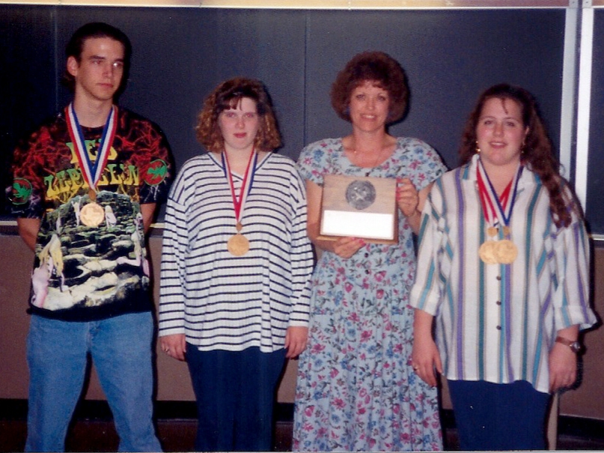
1993 State 5A Team Gold
Abilene
Coach: Jo Damron

Slide 17
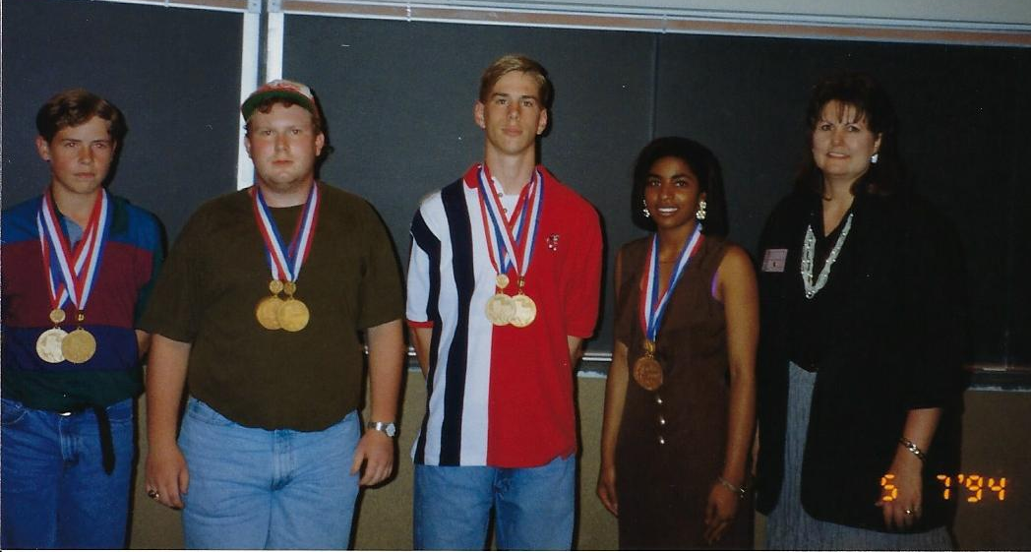
1994 State Gold Medalists

Slide 18
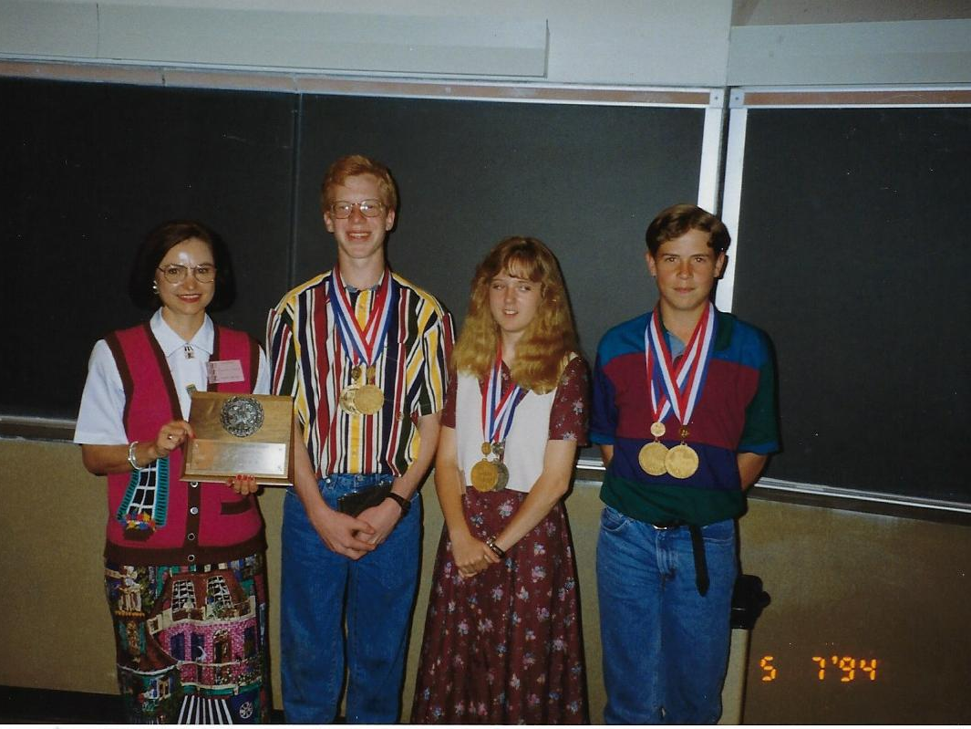
1994 State 1A Team Gold
Lazbuddie
Coach: Marsella Jennings

Slide 19
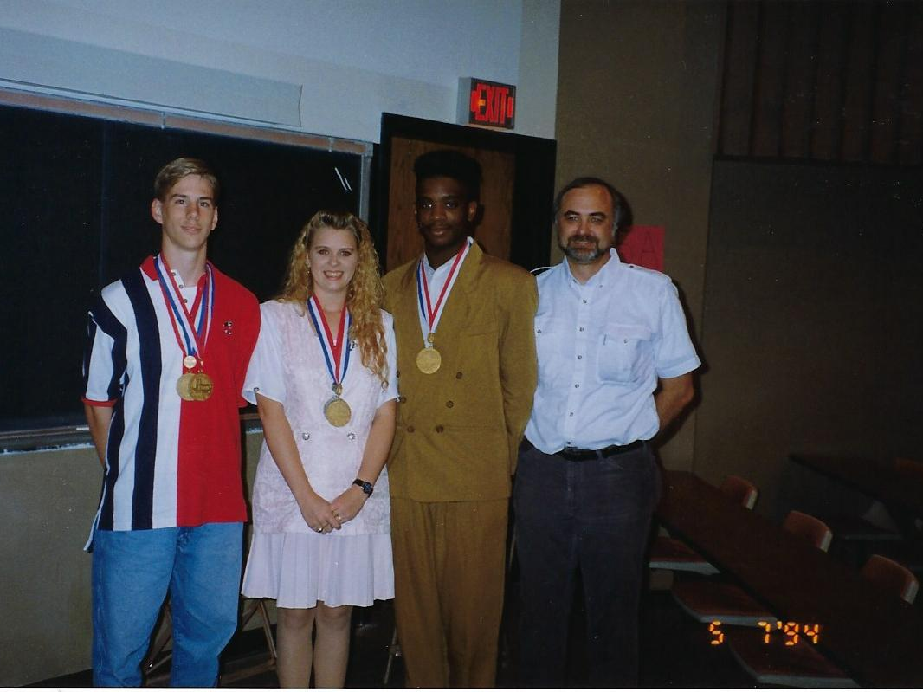
1994 State 2A Team Gold
Rosebud-Lott
Coach: Alan Barkemeyer

Slide 20
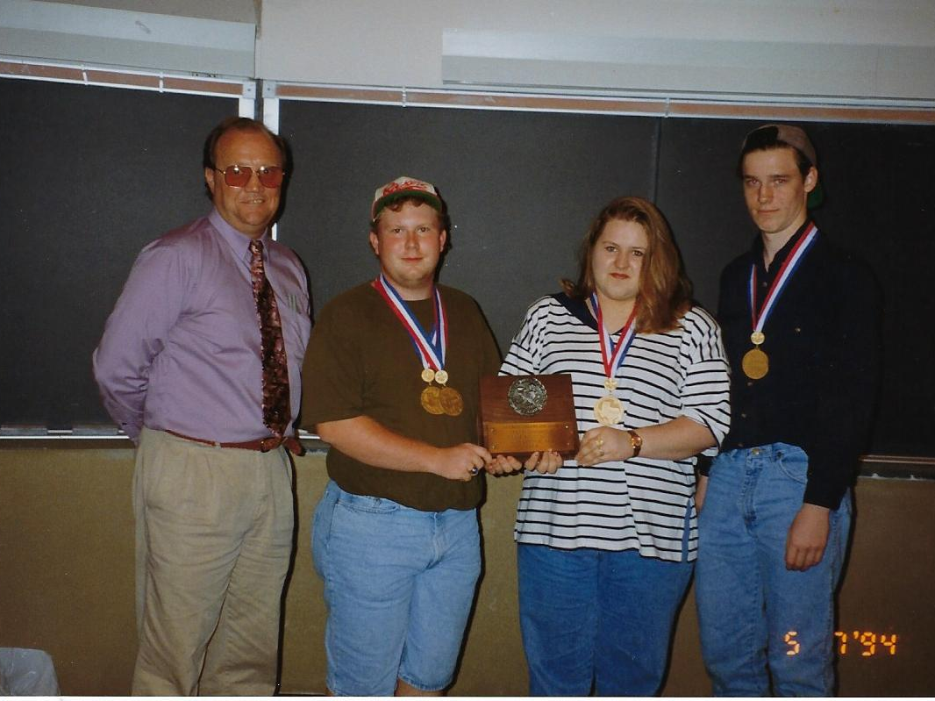
1994 State 3A Team Gold
Mont Belvieu: Barbers Hill HS
Coach: Carl Payne

Slide 21
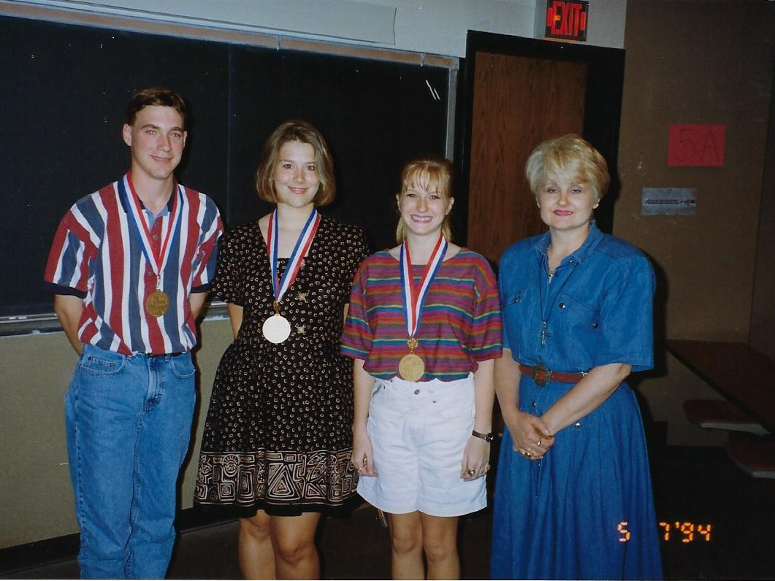
1994 State 4A Team Gold
Sulphur Springs
Coach: Medina Thurman

Slide 22
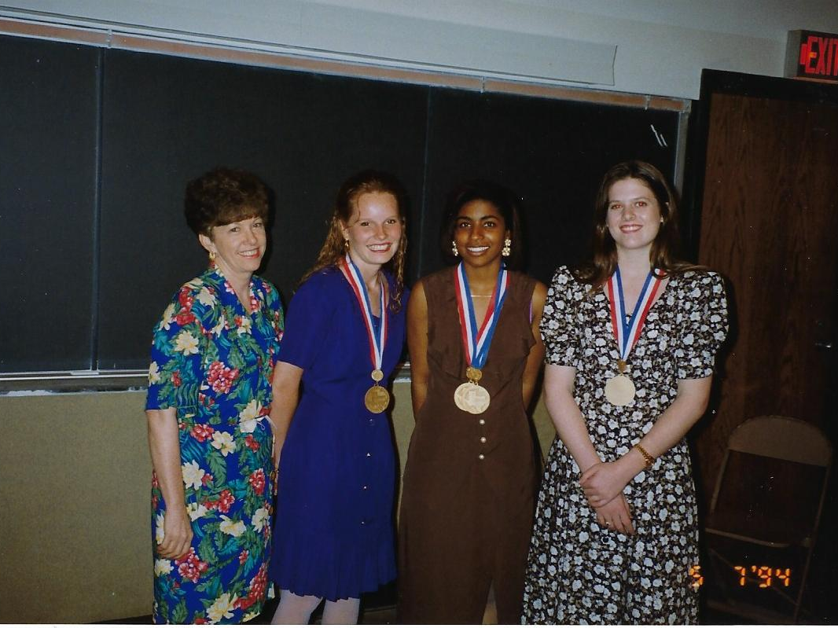
1994 State 5A Team Gold
Duncanville
Coach: Bettie Reichert

Slide 23
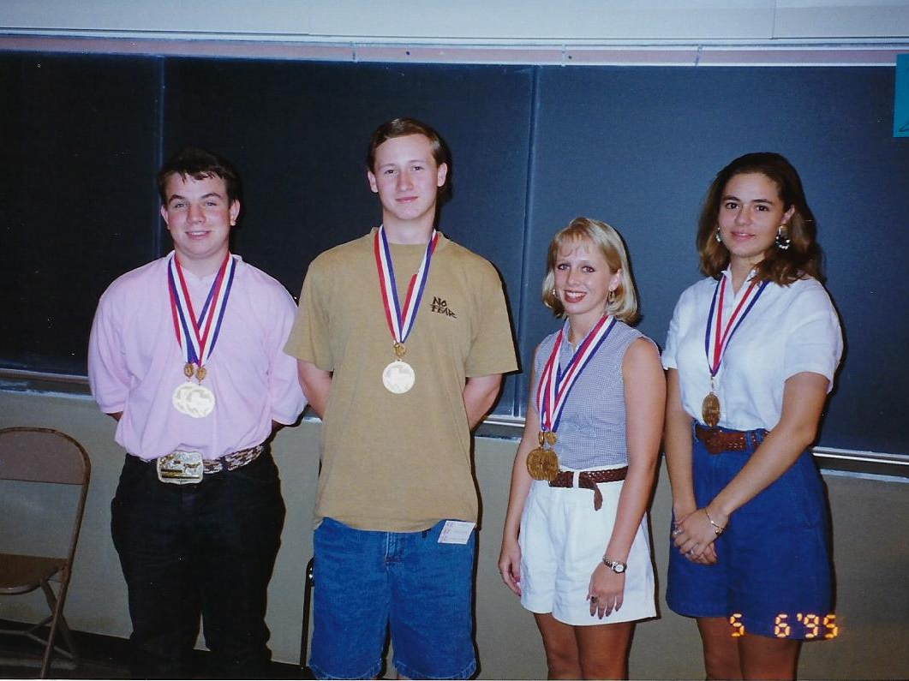
1995 State Gold Medalists

Slide 24
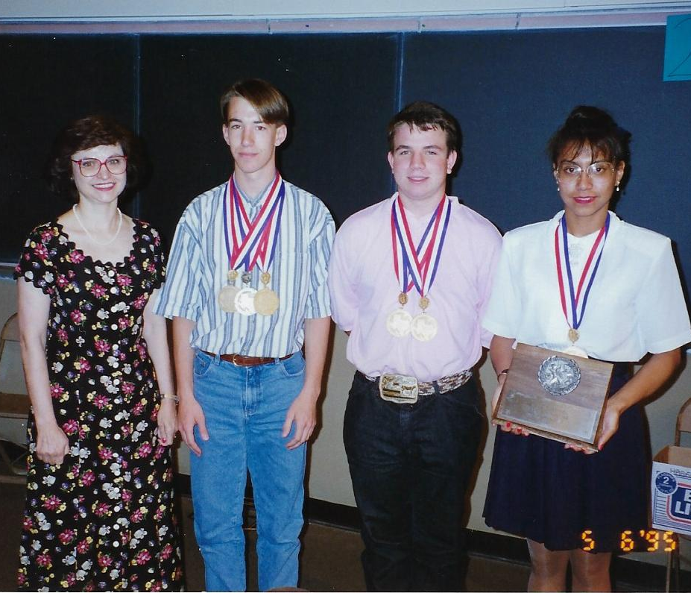
1995 State 1A Team Gold
Lazbuddie
Coach: Marsella Jennings

Slide 25
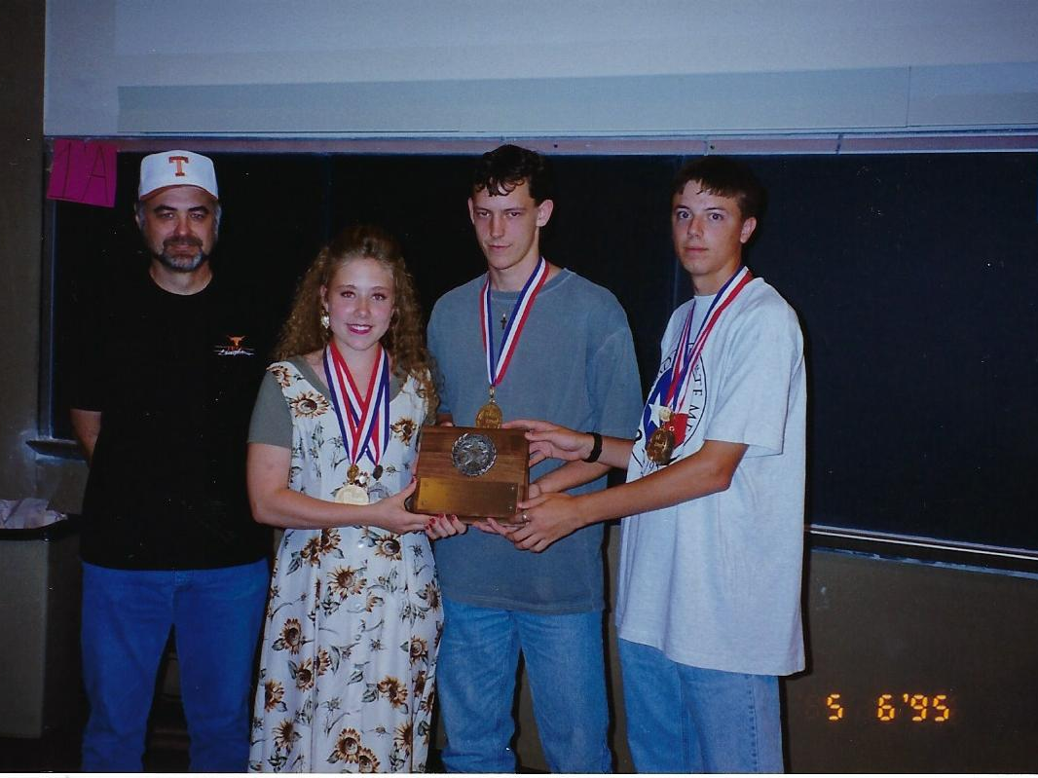
1995 State 2A Team Gold
Rosebud-Lott
Coach: Alan Barkemeyer

Slide 26
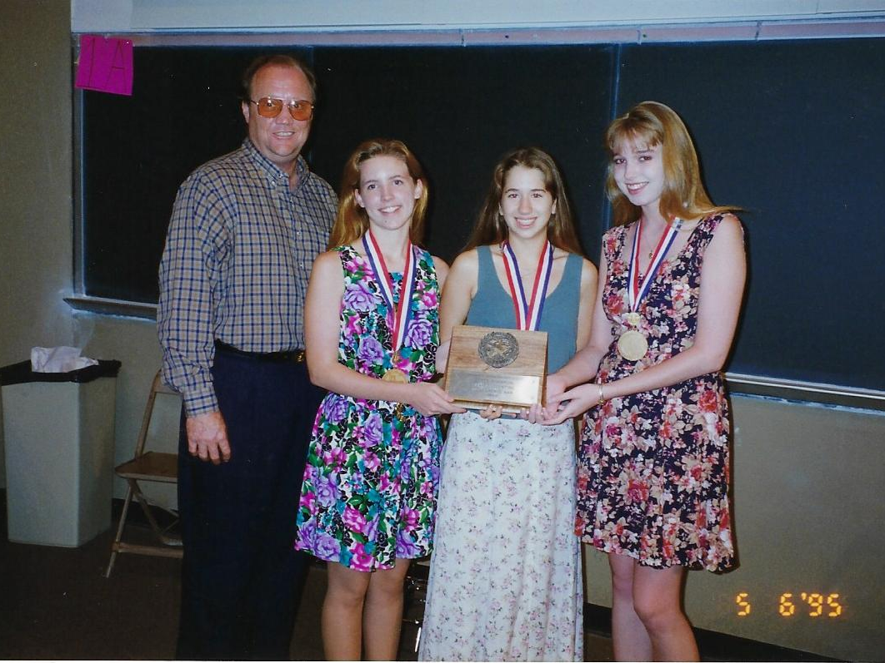
1995 State 3A Team Gold
Mont Belvieu: Barbers Hill HS
Coach: Carl Payne

Slide 27
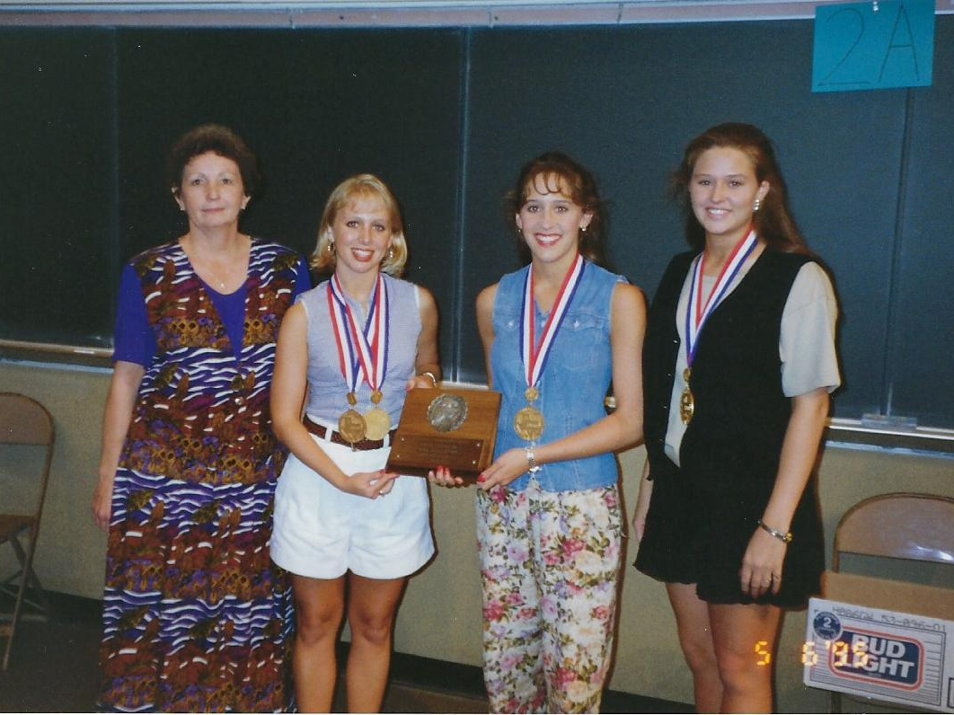
1995 State 4A Team Gold
Rockwall HS
Coach: Sarah Merritt

Slide 28
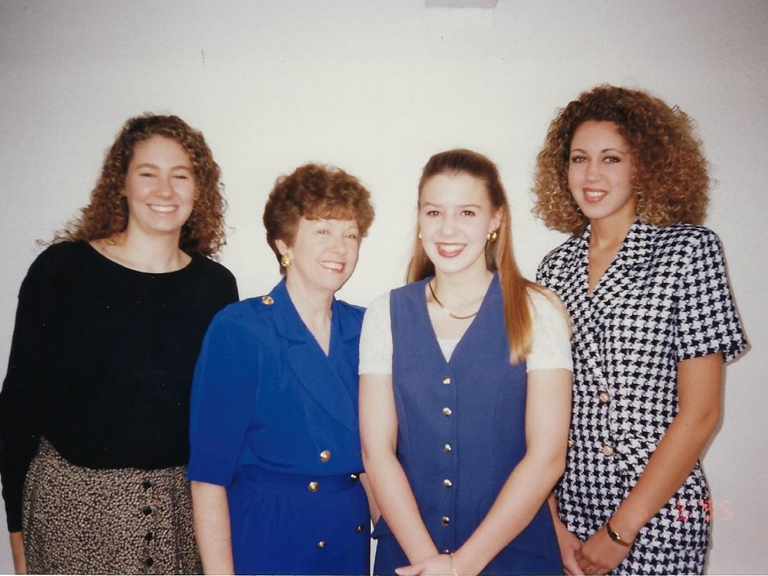
1995 State 5A Team Gold
Duncanville HS
Coach: Bettie Reichert

Slide 29
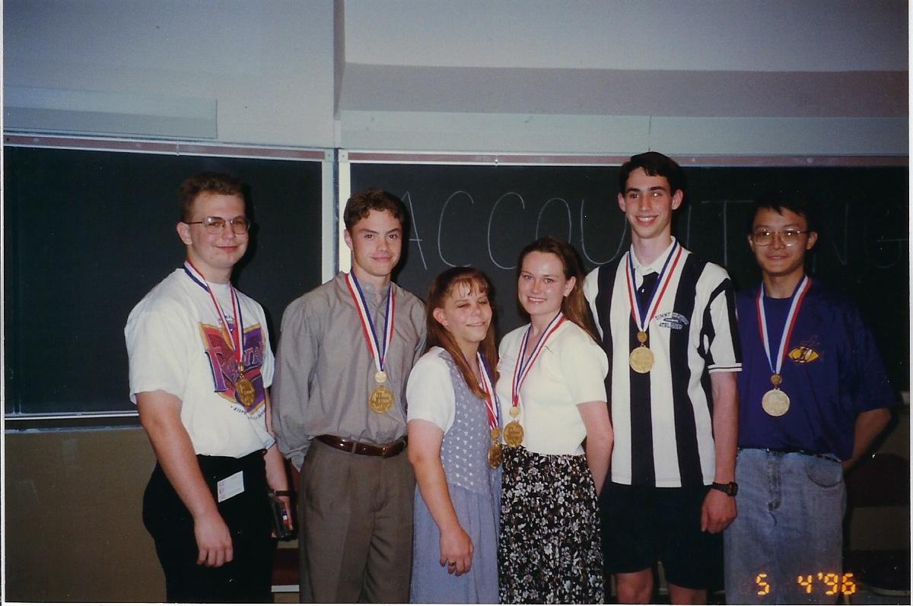
1996 State Gold Medalists

Slide 30
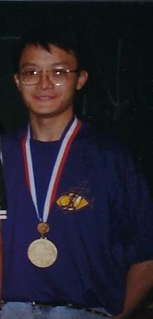
State Perfect Score #2
Owen Cheng
5A Humble:
Kingwood HS
From 1987
through 1996,
there have been only TWO
perfect scores at
State Meet!

Slide 31
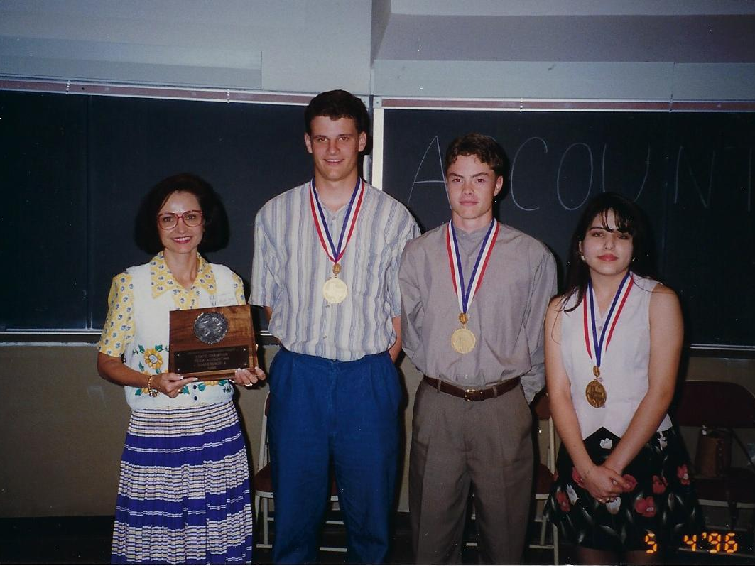
1996 State 1A Team Gold
Lazbuddie HS
Coach: Marsella Jennings

Slide 32
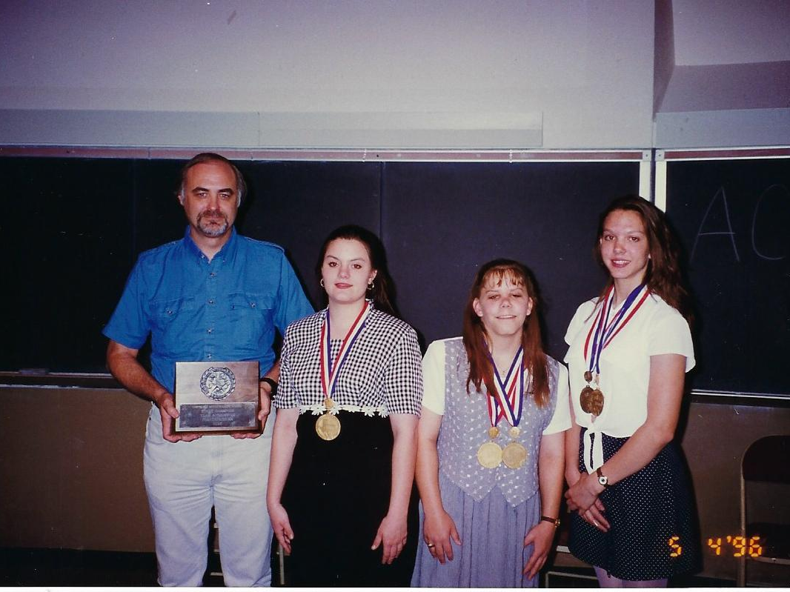
1996 State 2A Team Gold
Rosebud-Lott HS
Coach: Alan Barkemeyer

Slide 33
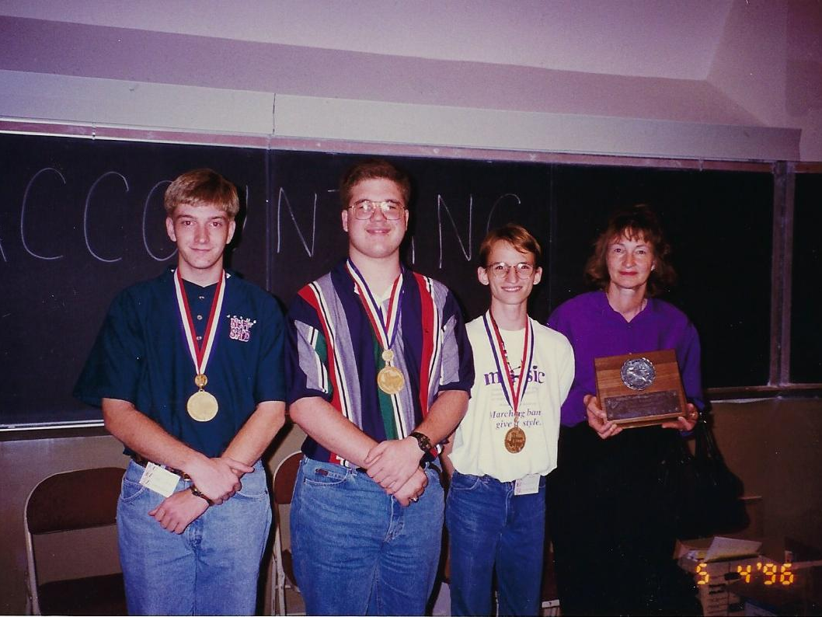
1996 State 3A Team Gold
Mount Vernon HS
Coach: Deloris Robinson

Slide 34
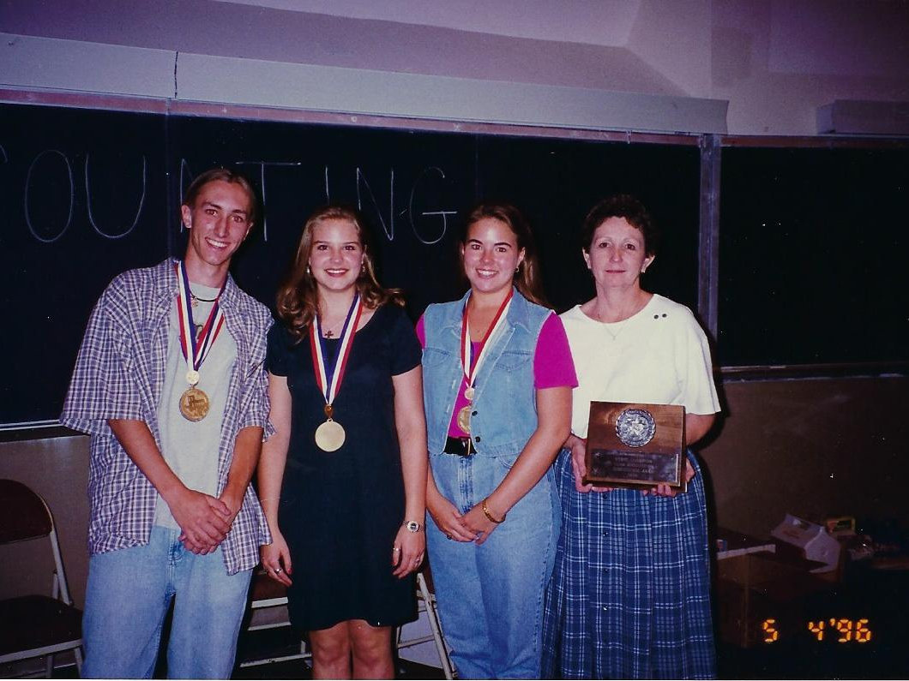
1996 State 4A Team Gold
Rockwall HS
Coach: Sarah Merritt

Slide 35
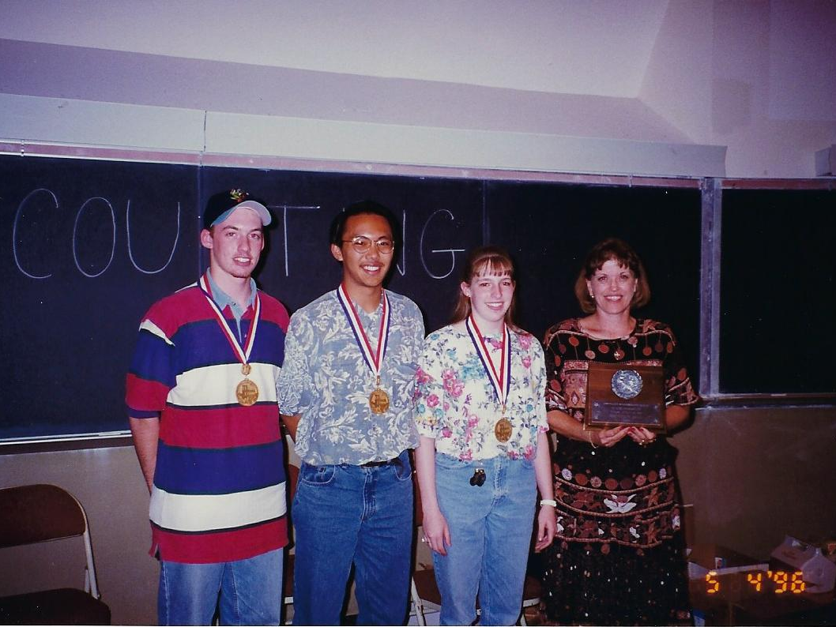
1996 State 5A Team Gold
Abilene HS
Coach: Jo Damron

Slide 36
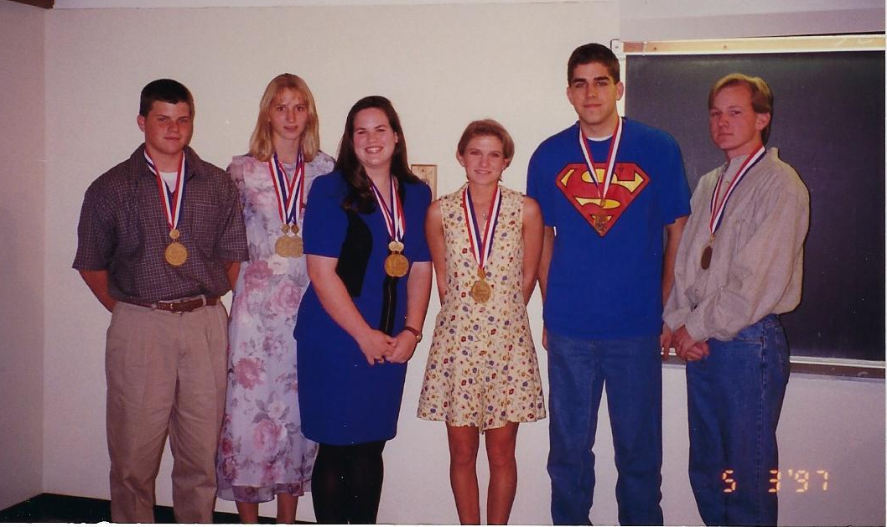
1997 State Gold Medalists

Slide 37
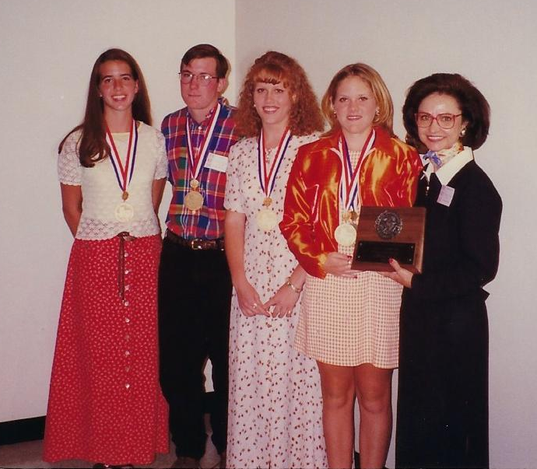
1997 State 1A Team Gold
Lazbuddie HS
Coach: Marsella Jennings

Slide 38
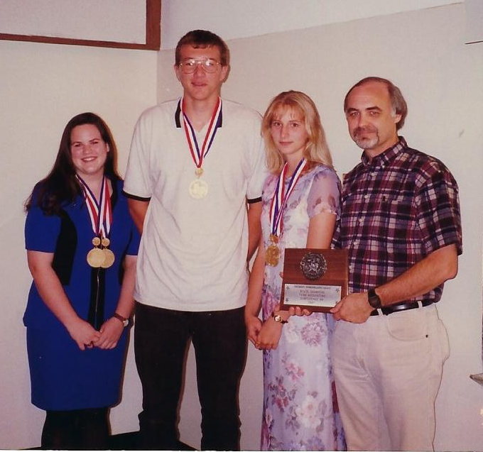
1997 State 2A Team Gold
Rosebud-Lott HS
Coach: Alan Barkemeyer

Slide 39
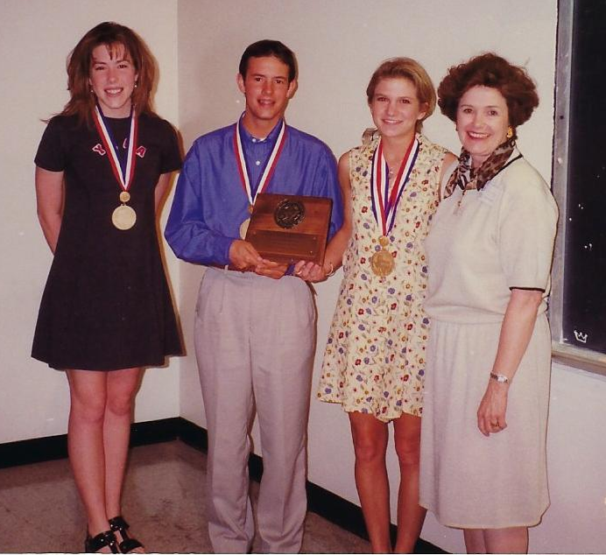
1997 State 3A Team Gold
Dalhart HS
Coach: Carole Farris

Slide 40
1997 State 4A Team Gold
Sherman HS
Coach: Patti Cook
Sorry, no photo available.

Slide 41
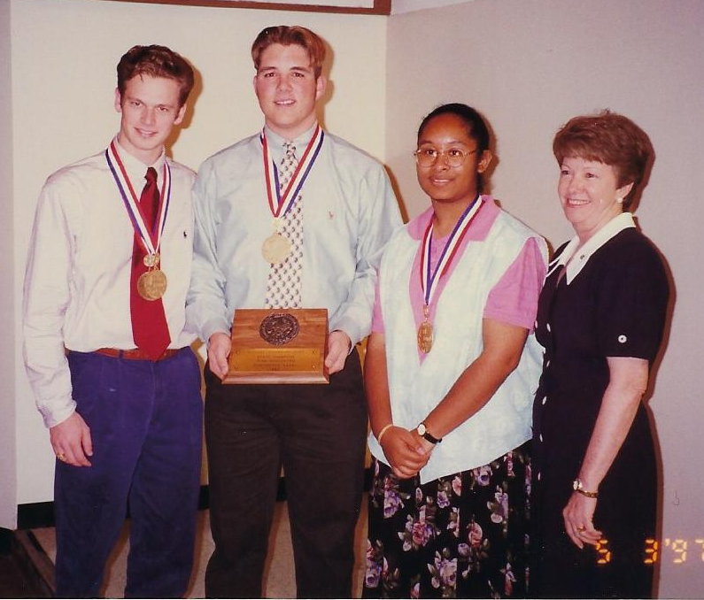
1997 State 5A Team Gold
Duncanville HS
Coach: Bettie Reichert

Slide 42
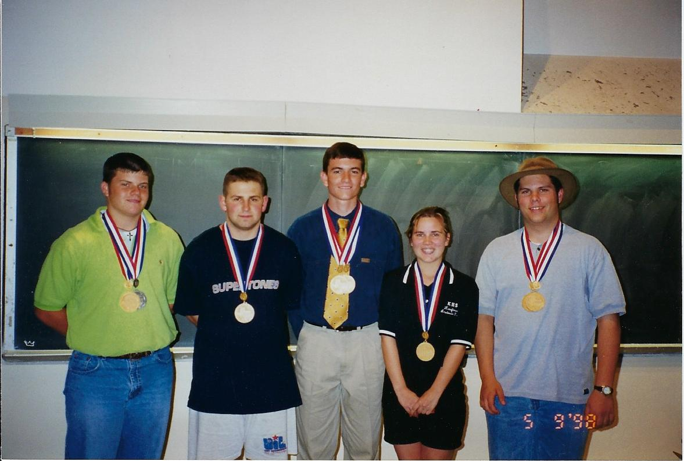
1998 State Gold Medalists

Slide 43
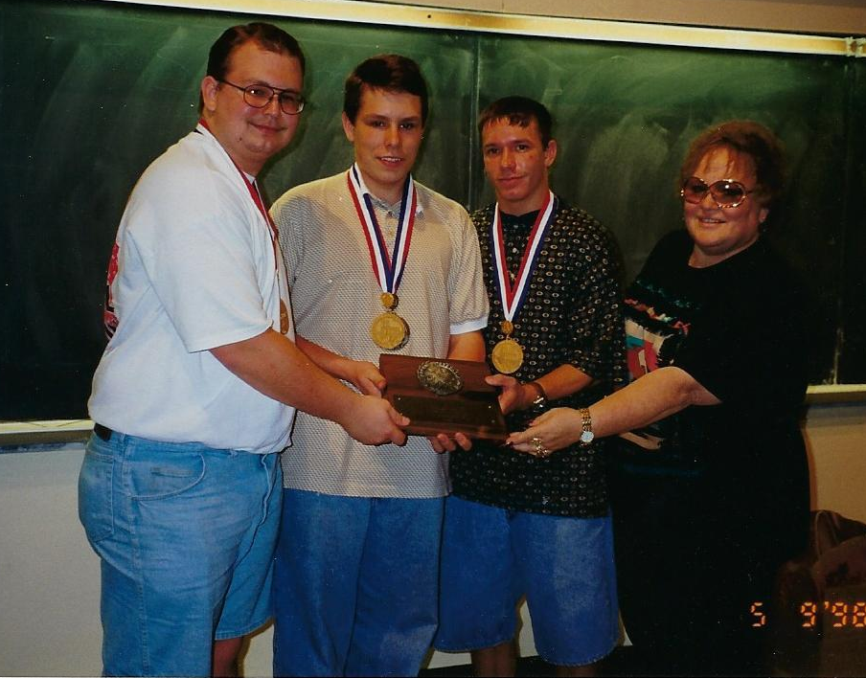
1998 State 1A Team Gold
Trenton HS
Coach: Dortha Rounsaville

Slide 44
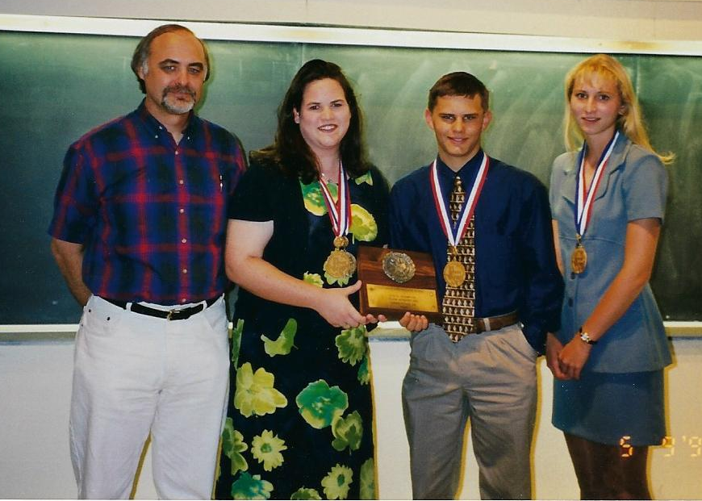
1998 State 2A Team Gold
Rosebud Lott HS
Coach: Alan Barkemeyer

Slide 45
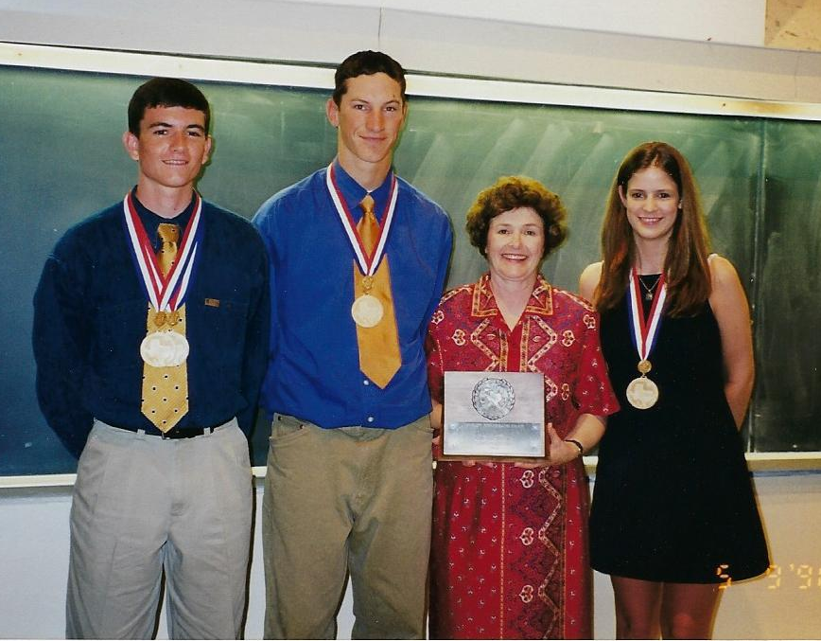
1998 State 3A Team Gold
Dalhart HS
Coach: Carole Farris

Slide 46
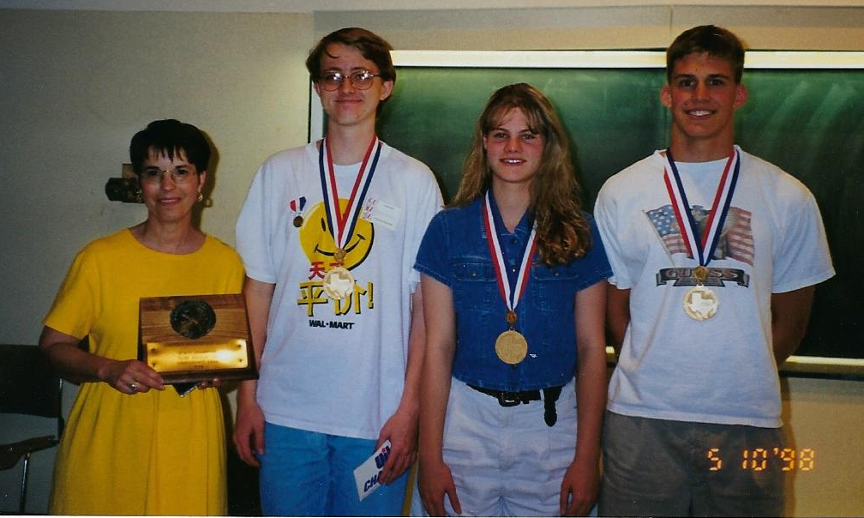
1998 State 4A Team Gold
Snyder HS
Coach: Phyllis Smith

Slide 47
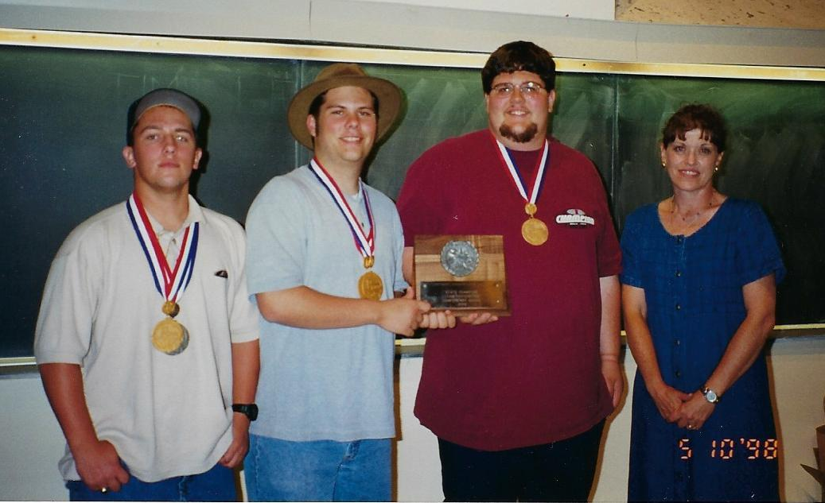
1998 State 5A Team Gold
Abilene HS
Coach: Jo Damron

Slide 48
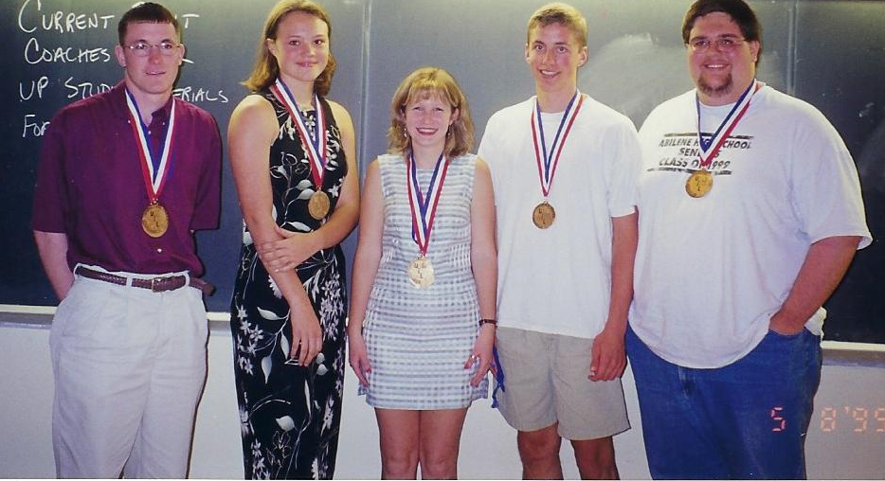
1999 State Gold Medalists

Slide 49
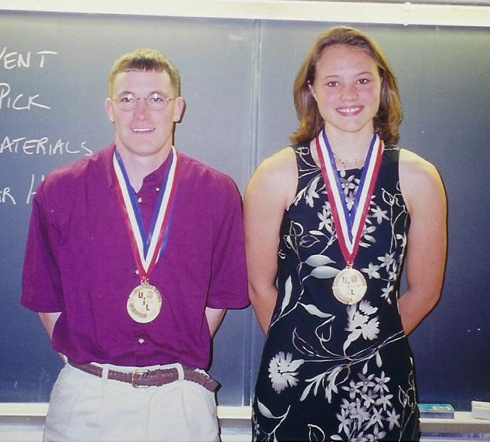
State Perfect Scores #3 and #4
This year
there were TWO
perfect scores at
State Meet!
Josh McDonald
1A Lazbuddie HS
Kaci Fulton
2A Rosebud-Lott HS

Slide 50
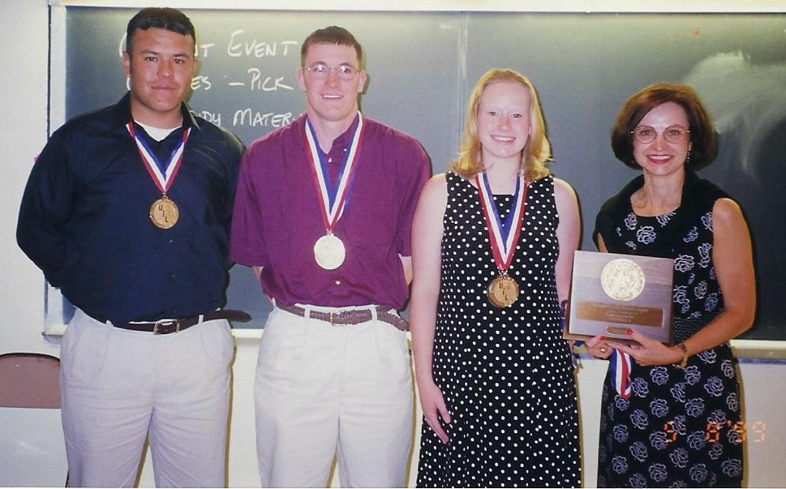
1999 State 1A Team Gold
Lazbuddie HS
Coach Marsella Jennings

Slide 51
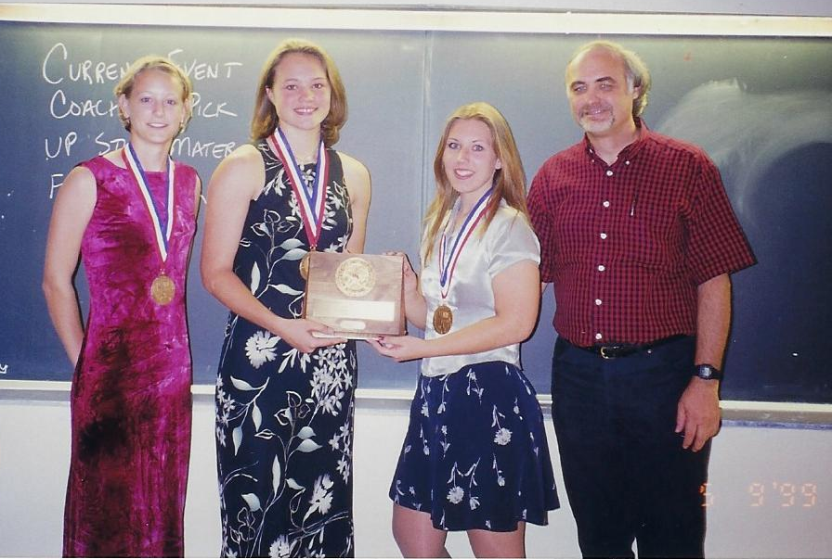
1999 State 2A Team Gold
Rosebud-Lott HS
Coach Alan Barkemeyer

Slide 52
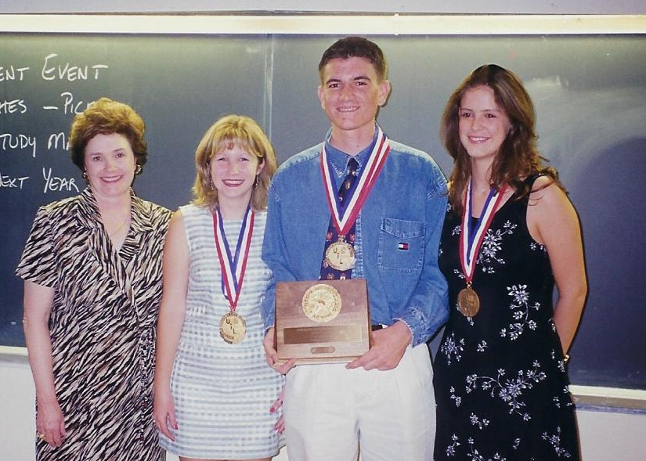
1999 State 3A Team Gold
Dalhart HS
Coach Carole Farris

Slide 53
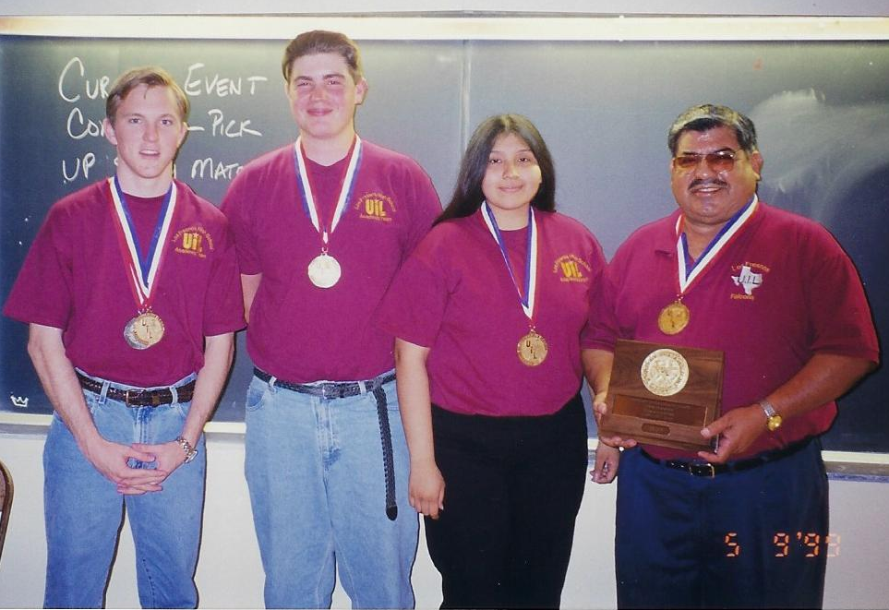
1999 State 4A TIE for Team Gold
Los Fresnos HS
Coach Henry Castillo

Slide 54

1999 State 4A TIE for Team Gold
Sherman HS
(Not Pictured) Coach Patti Cook

Slide 55

1999 State 5A Team Gold
Abilene HS
Coach Jo Damron

Slide 56

2000 State Gold Medalists

Slide 57

2000 State 1A Team Gold
Lazbuddie HS
Coach Marsella Jennings

Slide 58

2000 State 2A Team Gold
Rosebud-Lott HS
Coach Alan Barkemeyer

Slide 59

2000 State 3A Team Gold
Dalhart HS
Coach Carole Farris

Slide 60

2000 State 4A Team Gold
Sulphur Springs HS
Coach Medina Thurman

Slide 61

2000 State 5A Team Gold
Abilene HS
Coach Jo Damron

Slide 62

2001 State Gold Medalists

Slide 63

2001 State 1A Team Gold
Lazbuddie HS
Coach Marsella Jennings

Slide 64

2001 State 2A Team Gold
Rosebud-Lott HS
Coach Alan Barkemeyer

Slide 65

2001 State 3A Team Gold
Cameron: Yoe HS
Coach Linda Morgan

Slide 66

2001 State 4A Team Gold
Snyder HS
Coach Phyllis Smith

Slide 67

2001 State 5A Team Gold
Abilene HS
Coach Jo Damron

Slide 68

2002 State Gold Medalists

Slide 69

2002 State 1A Team Gold
Trenton HS
Coach Dortha Rounsaville

Slide 70

2002 State 2A Team Gold
Rosebud-Lott HS
Coach Alan Barkemeyer

Slide 71

2002 State 3A Team Gold
Giddings HS
Coach (at left) Lisa Gaeke

Slide 72

2002 State 4A Team Gold
Snyder HS
Coach Phyllis Smith

Slide 73

2002 State 5A Team Gold
Laredo: United HS
Coach Sam Sanchez

Slide 74

2003 State Gold Medalists

Slide 75

2003 State 1A Team Gold
Trenton HS
Coach Dortha Rounsaville

Slide 76

2003 State 2A Team Gold
Rosebud-Lott HS
Coach Alan Barkemeyer

Slide 77

2003 State 3A Team Gold
Cameron: Yoe HS
Coach Linda Morgan

Slide 78

2003 State 4A Team Gold
Brownwood HS
Coach Ann Ellis

Slide 79

2003 State 5A Team Gold
Southlake: Carrol HS
Coach Marsella Jennings

Slide 80

2004 State Gold Medalists

Slide 81

2004 State 4-Peat Medalist
Shawndee Nichols from
1A Lazbuddie HS
Is One of Two People to
Place in the Top Three
at State Meet
All Four Years of
High School:
2001—Gold
2002—Bronze
2003—Silver
2004—Gold

Slide 82

2004 State 1A Team Gold
Trenton HS
Coach Dortha Rounsaville

Slide 83

2004 State 2A Team Gold
Rosebud-Lott HS
Coach Alan Barkemeyer

Slide 84

2004 State 3A Team Gold
Hamshire-Fannett HS
Coach Janice Chesson

Slide 85

2004 State 4A Team Gold
Cleburne HS
Coach Jo Damron

Slide 86

2004 State 5A Team Gold
Southlake: Carroll HS
Coach Marsella Jennings

Slide 87


2005 State Gold Medalists

Slide 88

2005 State 1A Team Gold
Trenton HS
Coach Dortha Rounsaville

Slide 89

2005 State 2A Team Gold
Rosebud-Lott HS
Coach Alan Barkemeyer

Slide 90

2005 State 3A Team Gold
Dalhart HS
Coach Carole Farris

Slide 91

2005 State 4A Team Gold
Brownwood HS
Coach Ann Ellis

Slide 92

2005 State 5A Team Gold
Keller HS
Coach Marsella Jennings

Slide 93

2006 State Gold Medalists

Slide 94

State Perfect Score #5
Taylor Thornton
2A Rosebud-Lott HS
From 1987
through 2006,
there have been only FIVE
perfect scores at
State Meet!

Slide 95

2006 State 4-Peat Medalist
Kerry Karaffa from
1A Trenton HS
Is One of Two People to
Place in the Top Three
at State Meet
All Four Years of
High School:
2003—Bronze
2004—Silver
2005—Silver
2006—Bronze

Slide 96

2006 State 1A Team Gold
Trenton HS
Coach Dortha Rounsaville

Slide 97

2006 State 2A Team Gold
Rosebud-Lott HS
Coach Alan Barkemeyer

Slide 98

2006 State 3A Team Gold
Dalhart HS
Coach Carole Farris

Slide 99

2006 State 4A Team Gold
Brownwood HS
Coach Ann Ellis

Slide 100

2006 State 5A Team Gold
Keller HS
Coach Marsella Jennings

Slide 101

2007 State Gold Medalists

Slide 102

2007 State 1A Team Gold
Trenton
Coach Shannon Meyer

Slide 103

2007 State 2A Team Gold
Tuscola: Jim Ned HS
Coach: Kay Whitton

Slide 104

2007 State 3A Team Gold
Hamshire-Fannett
Coach Janice Chesson

Slide 105

2007 State 4A Team Gold
Brownwood
Coach Ann Ellis

Slide 106

2007 State 5A Team Gold
Keller
Coach Melanie Rodges

Slide 107


2008 State Gold Medalists

Slide 108

2008 State 1A Team Gold
Happy
Coach Sara Reinart

Slide 109

2008 State 2A Team Gold
Rosebud-Lott
Coach Alan Barkemeyer

Slide 110

2008 State 3A Team Gold
Hamshire-Fannett
Coach Janice Chesson

Slide 111

2008 State 4A Team Gold
Brownwood
Coach Ann Ellis

Slide 112

2008 State 5A Team Gold
Keller
Coach Melanie Rodges

Slide 113

2009 State Gold Medalists

Slide 114

2009 State 1A Team Gold
Happy
Coach Sara Reinart

Slide 115

2009 State 2A Team Gold
Rosebud-Lott
Coach Alan Barkemeyer

Slide 116

2009 State 3A Team Gold
Snyder
Coach Phyllis Smith

Slide 117

2009 State 4A Team Gold
Magnolia
Coach Susan Mathews

Slide 118

2009 State 5A Team Gold
Sugar Land: Dulles HS
Coach Mary Ann Failla

Slide 119


2010 State Gold Medalists

Slide 120
State Perfect Score #6
Kevin Massey
4A Granbury HS
From 1987
through 2010,
there have been only SIX
perfect scores at
State Meet!

Slide 121
2010 State 1A Team Gold
Happy
Coach Sara Reinart

Slide 122
2010 State 2A Team Gold
Grandview
Coach Marilyn Rollins

Slide 123
2010 State 3A Team Gold
Giddings
Coach Lisa Gaeke

Slide 124
2010 State 4A Team Gold
Granbury
Coach Connie Stone

Slide 125

2010 State 5A Team Gold
Laredo: United HS
Coach Elizabeth Rodriguez

Slide 126

2011 State Gold Medalists

Slide 127

State Perfect Score #7
Neil Rabroker
2A Rosebud-Lott HS
From 1987
through 2011,
there have been only SEVEN
perfect scores at
State Meet!

Slide 128

2011 State 1A Team Gold
Happy
Coach Sara Reinart

Slide 129

2011 State 2A Team Gold
Rosebud-Lott
Coach Alan Barkemeyer

Slide 130

2011 State 3A Team Gold
Giddings
Coach Lisa Gaeke

Slide 131

2011 State 4A Team Gold
Granbury
Coach Connie Stone

Slide 132

2011 State 5A Team Gold
Sugar Land: Dulles HS
Coach Mary Ann Failla

Slide 133

2012 State Gold Medalists

Slide 134

2012 State 1A Team Gold
Happy
Coach Sara Reinart

Slide 135

2012 State 2A Team Gold
Caddo Mills
Coach Jill Richardson

Slide 136

2012 State 3A Team Gold
Argyle
Coach John King

Slide 137

2012 State 4A Team Gold
Granbury
Coach Connie Stone

Slide 138

2012 State 5A Team Gold
Sugar Land: Dulles HS
Coach Mary Ann Failla

Slide 139
2013 State Gold Medalists

Slide 140

2013 State 1A Team Gold
Sabine Pass
Coach Janice Chesson

Slide 141
2013 State 2A Team Gold
Caddo Mills
Coach Jill Richardson

Slide 142
2013 State 3A Team Gold
Giddings
Coach Lisa Gaeke

Slide 143
2013 State 4A Team Gold
Cleburne
Coach Lisa Benson

Slide 144
2013 State 5A Team Gold
Keller
Coach Melanie Rodges

Slide 145
2014 State Gold Medalists

Slide 146
State Perfect Score #8
Blake Hale
4A Magnolia HS
From 1987
through 2014,
there have been only EIGHT
perfect scores at
State Meet!

Slide 147
2014 State 1A Team Gold
Sabine Pass
Coach Janice Chesson

Slide 148
2014 State 2A Team Gold
Caddo Mills
Coach Jill Richardson

Slide 149
2014 State 3A Team Gold
Giddings
Coach Lisa Gaeke

Slide 150
2014 State 4A Team Gold
Cleburne
Coach Colin Yeilding

Slide 151
2014 State 5A Team Gold
Sugar Land: Dulles HS
Coach Mary Ann Failla

Slide 152
2015 State Gold Medalists

Slide 153
State Perfect Score #9 and this is a FIRST
Blake Hale
5A Magnolia HS
This is the FIRST time a contestant has scored a perfect score at State Meet TWO years, and he did it in back-to-back years!!

Slide 154
2015 State 1A Team Gold
Happy HS
Coach Sara Reinart

Slide 155
2015 State 2A Team Gold
Gladewater: Union Grove HS
Coach Gailyn Sutton

Slide 156
2015 State 3A Team Gold
Tuscola: Jim Ned HS
Coach Kay Whitton

Slide 157
2015 State 4A Team Gold
Giddings
Coach Lisa Gaeke

Slide 158
2015 State 5A Team Gold
Magnolia
Coach Susan Mathews

Slide 159
2015 State 6A Team Gold
Humble: Kingwood HS
Coach Rebecca Parish

Slide 160
2016 State Gold Medalists

Slide 161
2016 State 1A Team Gold
Happy HS
Coach Sara Reinart

Slide 162
2016 State 2A Team Gold
Sabine Pass HS
Coach Janice Chesson

Slide 163
2016 State 3A Team Gold
Caddo Mills HS
Coach Amy Sikes

Slide 164
2016 State 4A Team Gold
Giddings HS
Coach Jason Miller

Slide 165
2016 State 5A Team Gold
Hereford HS
Coach Patty Harshey

Slide 166
2016 State 6A Team Gold
Garland: Naaman Forest HS
Coach Jenifer Zihlman

Slide 167
2017 State Gold Medalists
Conference 5A: 3-Way Tie for First Place

Slide 168

State Perfect Score #10
Yesenia Garcia
6A United South HS
Laredo
From 1987
through 2017,
there have been only
TEN
perfect scores at State Meet!

Slide 169

2017 State 1A Team Gold
Happy HS
Coach Sara Reinart

Slide 170

2017 State 2A Team Gold
Sabine Pass HS
Coach Janice Chesson

Slide 171

2017 State 3A Team Gold
Pollok: Central HS
Coach Chad Nash

Slide 172

2017 State 4A Team Gold
Argyle HS
Coach Rashid Rahman

Slide 173

2017 State 5A Team Gold
Hereford HS
Coach Patty Harshey

Slide 174

2017 State 6A Team Gold
Houston: North Shore HS
Coach Casey D. Johnson

Slide 175

2018 State Gold Medalists
Conferences 2 and 4 each had a tie for First Place

Slide 176

State Perfect Score #11
Kyle Wynne
6A Lufkin HS
From 1987
through 2018,
there have been only
ELEVEN
perfect scores at State Meet!

Slide 177

2018 State 1A Team Gold
Happy HS
Coach Sara Reinart

Slide 178

2018 State 2A Team Gold
Sabine Pass HS
Coach Rene Danna

Slide 179

2018 State 3A Team Gold
Pollok: Central HS
Coach Chad Nash

Slide 180

2018 State 4A Team Gold
Atlanta HS
Coach Renee Rosser

Slide 181

2018 State 5A Team Gold
Hereford HS
Coach Patty Harshey

Slide 182

2018 State 6A Team Gold
Lufkin HS
Coach Janice Holcomb

Slide 183

2019 State Gold Medalists
6A Tie (See next slide)

Slide 184

2019 State Gold Medalist
(6A Tie)

Slide 185

State Perfect Score #12
Garrett Bell
5A Hallsville HS
From 1987
through 2019,
there have been only 13
perfect scores at State Meet!

Slide 186

State Perfect Score #13
Michael Byers
2A Gladewater:
Union Grove HS
From 1987
through 2019,
there have been only 13
perfect scores at State Meet!

Slide 187

2019 State 1A Team Gold
Happy HS
Coach Sara Reinart

Slide 188

2019 State 2A Team Gold
Vega HS
Coach Sharon Fangman

Slide 189

2019 State 3A Team Gold
Atlanta HS
Coach Renee Rosser

Slide 190

2019 State 4A Team Gold
Argyle HS
Coach Rashid Rahman

Slide 191

2019 State 5A Team Gold
Lufkin HS
Coach Janice Holcomb

Slide 192

2019 State 6A Team Gold
Cypress Woods HS
Coach Janice Walker

Slide 193

2019 UIL Accounting State Meet Administration
Susan Mathews, Mary Ann Failla, Jacob Buckles, LaVerne Funderburk, Cynthia King, Michelle Wylie

Slide 194
2020
The Year Covid-19
Hit Our Country
No UIL Contests Held

Slide 195
2021
Grateful for Competition
The State Contest(s)
Held in 25 HUBs Across the State
Grading Performed Virtually
No Official State Awards Ceremony

Slide 196


2021 State Gold Medalists
Kenli Johnson
1A Happy HS
Parker Joyce
2A Vega HS

Slide 197


2021 State Gold Medalists
3A Tie
Robert Young
Tuscola: Jim Ned HS
3A Tie
Colten Ellis
Holliday

Slide 198


2021 State Gold Medalists
Nevaeh Galvan
4A Andrews HS
Patrick Tinley
5A Kerrville: Tivy HS

Slide 199

2021 State Gold Medalists
Kenneth Chen
6A Keller HS

Slide 200


State Perfect Score #14
Nevaeh Galvan
4A Andrews HS
From 1987
through 2021,
there have been only 14
perfect scores at State Meet!
Nevaeh’s autograph --->

Slide 201

2021 State 1A Team Gold
Happy HS
Coach Sara Reinart

Slide 202

2021 State 2A Team Gold
Gladewater: Union Grove HS
Coach Gailyn Sutton

Slide 203

2021 State 3A Team Gold
Pollok: Central HS
Coach Chad Nash

Slide 204

2021 State 4A Team Gold
Argyle HS
Coach Rashid Rahman

Slide 205

2021 State 5A Team Gold
Lubbock: Coronado HS
Coach Brent Chamberlain

Slide 206

2021 State 6A Team Gold
Keller HS
Coach Melanie Rodges

Slide 207

2022 State Gold Medalists

Slide 208

2022 State 1A Team Gold
Happy HS
Coach Sara Reinart

Slide 209

2022 State 2A Team Gold
Vega HS
Coach Sharon Fangman

Slide 210

2022 State 3A Team Gold
Pollok: Central HS
Coach Chad Nash

Slide 211

2022 State 4A Team Gold
Argyle HS
Coach Rashid Rahman

Slide 212

2022 State 5A Team Gold
Kerrville: Tivy HS
Coach Shanna Vecchio

Slide 213

2022 State 6A Team Gold
Alief: Kerr HS
Coach Doris Curry

Slide 214

2023 State Gold Medalists

Slide 215

2023 State 1A Team Gold
Happy HS
Coach Sara Reinart

Slide 216

2023 State 2A Team Gold
Sanford-Fritch HS
Coach Brenda Gray

Slide 217

2023 State 3A Team Gold
Pollok: Central HS
Coach Chad Nash

Slide 218

2023 State 4A Team Gold
Giddings HS
Coach Rachel Mahony

Slide 219

2023 State 5A Team Gold
Argyle HS
Coach Rashid Rahman

Slide 220

2023 State 6A Team Gold
Waller HS
Coach Tyler Sullivan

Slide 221

2024
Will
Your
Photo
Be
Here?

Slide 222

2023 UIL Accounting State Meet Administration
Dr. David Stevens, UIL Academic Director
LaVerne Funderburk, Michelle Wylie,
Mary Ann Failla, and Susan Mathews

Slide 223

UIL Accounting NEW LEADERSHIP 2023-24
State Meet Admin Lane Quinney
State Meet Admin Kayla Walker
UIL Accounting State Contest Director Kay Whitton

Slide 224
Coaches, when you retire, please email Kay Whitton if you are interested in volunteering at State Meet for UIL Accounting.

