Slide 1

UIL Accounting
Super Problem
Accounting Cycle Steps 5-7
Worksheet & Financial Statements
Kay Whitton
state contest director

Slide 2
Accounting Cycle
C-A-R-P-T-W-F-A-C-T
Pronounce it CarpetWFact
C – Collect source documents
A – Analyze into Drs and Crs
R – Record in Journal
P – Post to General Ledger
T – Trial Balance
W – Worksheet
F – Financial Statements
A – Adjusting Entries
C – Closing Entries
T – Post-closing Trial Balance

Slide 3
In this lesson, we’ll continue the accounting cycle …
Accounting Cycle – Steps 5-7
5) Review the Trial Balance previously done
6) Complete the Worksheet
7) Prepare Financial Statements

Slide 4
Step #6
Worksheet
(my fave!)
Working paper
Make adjustments
Correct errors
Calculate Net Income (IS cols)
Statement of Position (Bal Sht)

Slide 5
Now, using the Trial Balance we did at the end of the previous lesson…
Trial Balance
DR CR
Cash 2,755
A/R 0
Supplies 160
PPI 200
Ofc.Furn. 75
Comp.Eqp. 3,000
Drawing 50
Cell Exp 35
Internet Exp 25
Total DRs 6,300
A/P 1,100
Capital 4,800
Fees Rev 400
Total CRs 6,300

Slide 6
Worksheet:
Completing the
Trial Balance columns
List accounts & #s in TB cols.
Make sure that DRs = CRs in TB
Calculate adjustments
Extend (move over) to IS & BS
Calculate column totals
Calculate Net Income

Slide 7
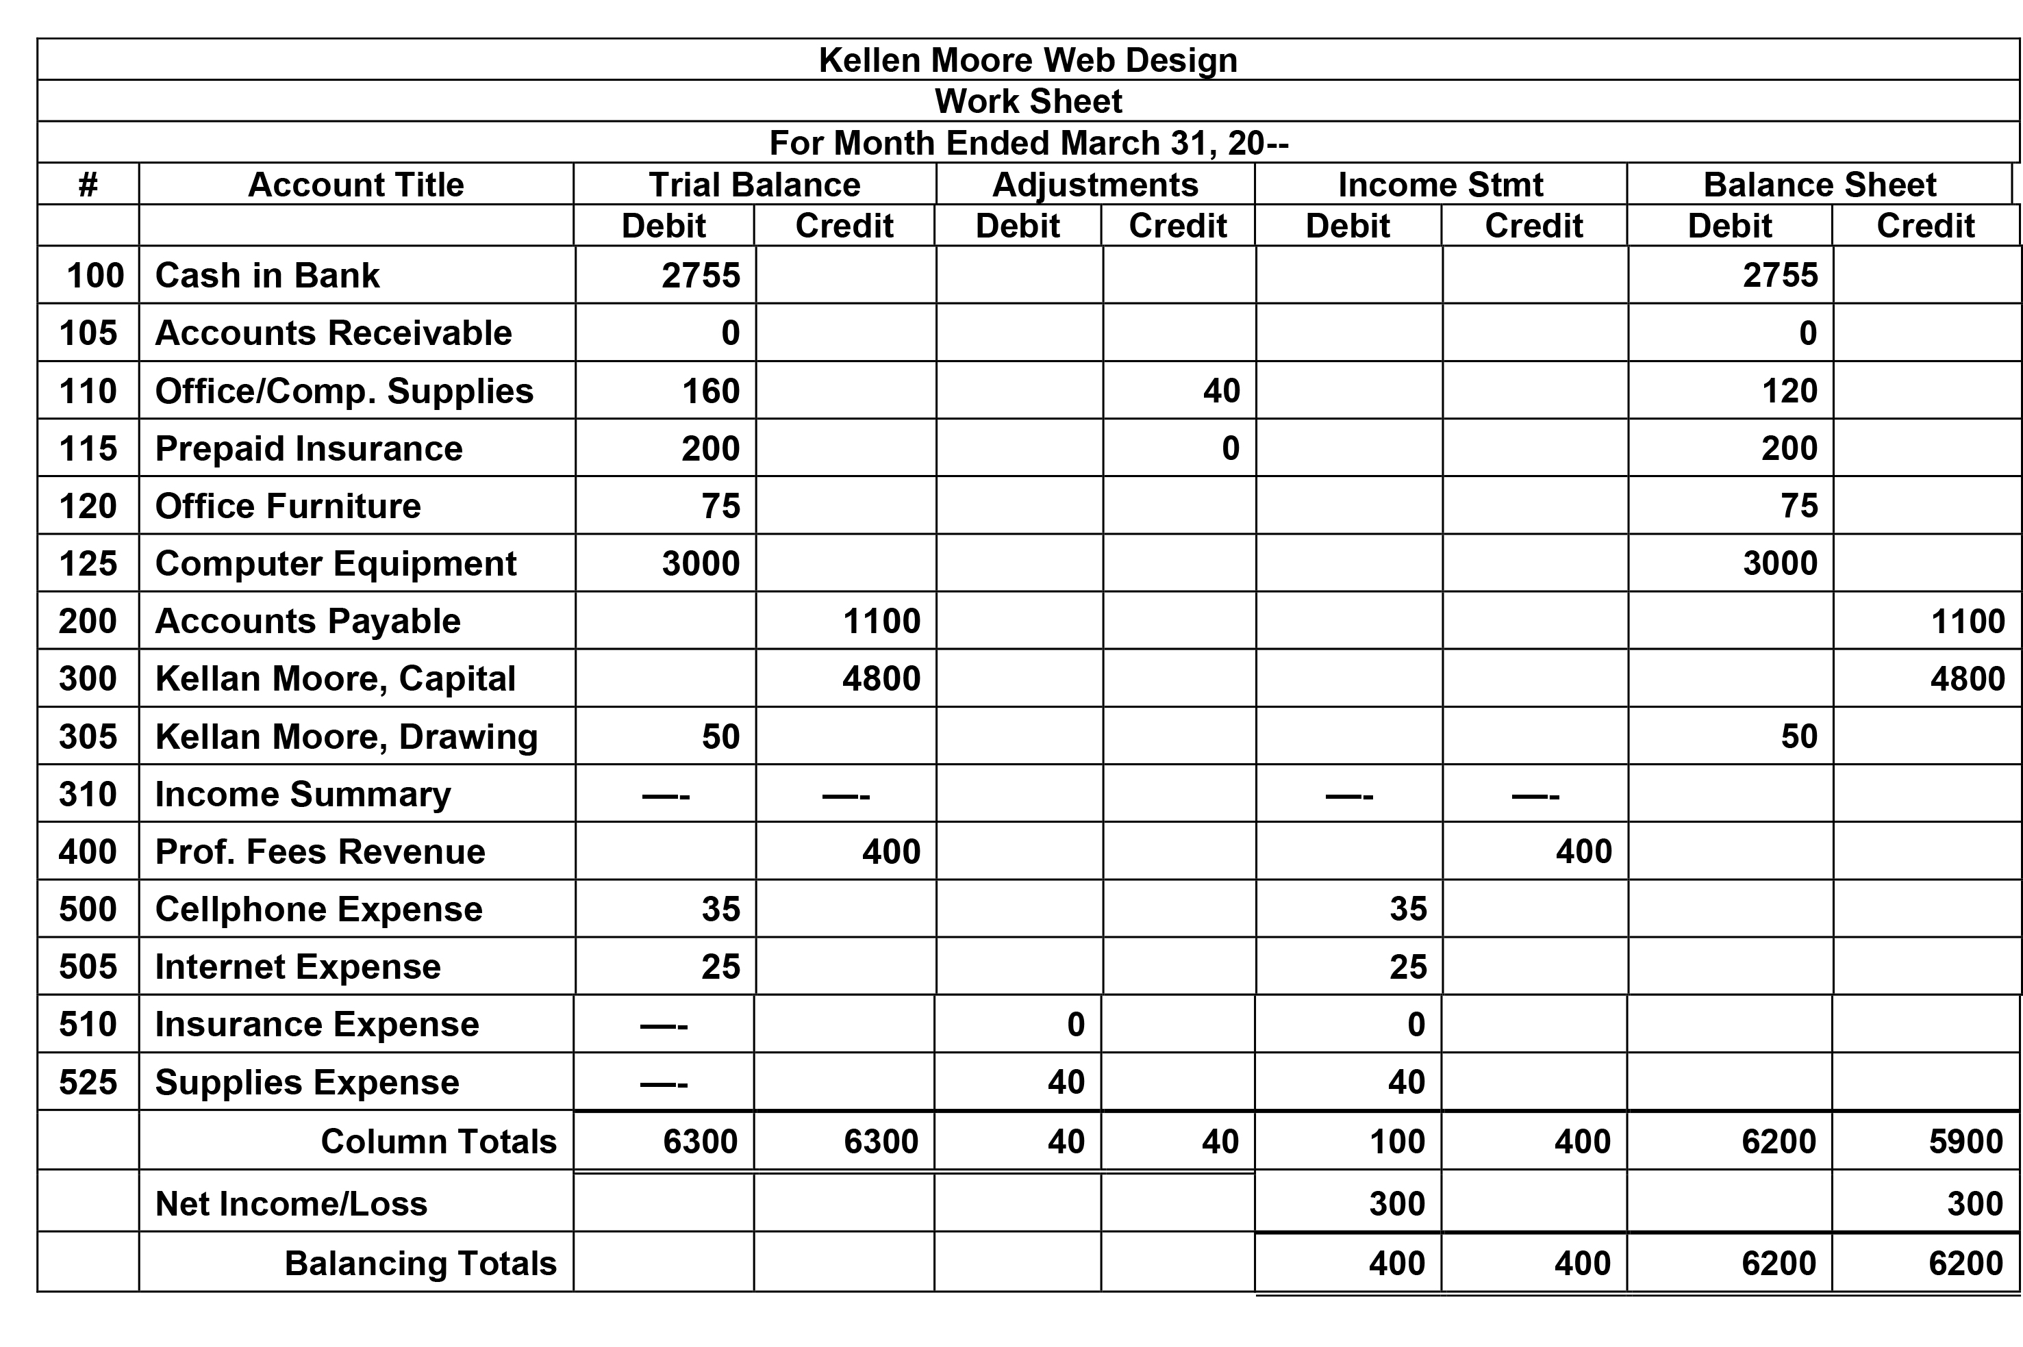
B
40
I
40

Slide 8
Worksheet:
Calculate needed adjustments
List accounts & #s in TB cols.
Make sure that DRs = CRs in TB
Calculate adjustments
Extend (move over) to IS & BS
Calculate column totals
Calculate Net Income

Slide 9
The adjustments columns are used to bring balances up to date…
In the practice working papers, information is given that indicates that the ending balance of the Supplies account is $120, down from $160.
As prepaid expenses (assets) are used up, the amount used is DR’d to an expense account.
So we CR Supplies $40 and DR Supplies Exp. $40.

Slide 10
The adjustments columns are
used to bring balances up to date…
On the last day of March, the owner purchased six months of insurance, also a prepaid expense, which was DR’d to an asset account: Prepaid Insurance.
Since the insurance went into effect on April 1, no adjustment is needed for expired insurance in March.

Slide 11
Fun fact about adjustments…
Every adjustment affects a permanent account
and a temporary (capital) account:
In our example for this problem,
Office & Computer Supplies is a Permanent Account
Supplies Expense is a Temporary account

Slide 12
B
40
I
40

Slide 13
Worksheet:
Extend amounts to the IS & BS columns
List accounts & #s in TB cols.
Make sure that DRs = CRs in TB
Calculate adjustments
Extend (move over) to IS & BS
Calculate column totals
Calculate Net Income

Slide 14
Extending amounts…
Start by extending the amounts of the
Assets, Liabilities & OE to the Balance Sheet Columns.
(Since it doesn’t affect Net Income, Drawing
extends to the BS DR column.)
When you get to ‘INCOME’ summary, extend it and the remaining balances to the INCOME Statement columns.

Slide 15
B
I

Slide 16
Worksheet
Calculate
Net Income
List accounts & #s in TB cols.
Make sure that DRs = CRs in TB
Calculate adjustments
Extend (move over) to IS & BS
Calculate column totals
Calculate Net Income

Slide 17
B
I

Slide 18


Net Income in the Income Statement columns must = NI in the Balance Sheet columns
Accounting ‘Rock’:
NI
NI

Slide 19
#7 Financial
Statements
Income Statement
SOCIOE
Balance Sheet
Income Statement
NI feeds to SOCIOE
(Statement of Changes in O/E)
End. Capital on SOCIOE feeds to
Balance Sheet

Slide 20
Income Statement
(statement of earnings)
(Remember the 2nd Equation?)
Basic Income Equation REN
Revenue
- Expenses
= Net Income (Loss)

Slide 21
Income Statement
Revenue
- Expenses
= Net Income
(matches WS NI)
Kellen Moore Web Design
Income Statement
For the Month Ended March 31, 20--
Revenue:
Prof. Fees Revenue |  |  |  | 400
Expenses:
Cellphone Expense | 35
Internet Expense | 25
Insurance Expense | 0
Supplies Expense | 40
Total Expenses |  |  |  | 100
Net Income |  |  |  | 300

Slide 22
Supporting document:
Statement of Changes in OE
Statement of Changes in Owner’s Equity
(SOCIOE) is just a prettier version of the
Owner’s Capital account

Slide 23
CAPITAL FORMULA
(becomes the SOCIOE)
300 K.M., Capital - OE
— B+
0 Beg.
Cap
3,000 + Inv.
1,800 + Inv.
4,800 = COW
300 + NI
5050 End.
Cap.
- DRAW 50
- NL

Slide 24
Statement of Changes in Owner’s Equity
(Net Income feeds from the Income Statement)
Kellen Moore Web Design
Statement of Changes in Owner’s Equity
For the Month Ending March 31, 20--
OWNER’S EQUITY
Kellan Moore, Capital, March 1For | 0
Add: Investments | 4,800
Add: Net Income | 300
Less: Withdrawals | (50)
Kellen Moore, Capital, March 31 |  | 5,050
— B+

Slide 25
Balance Sheet
(statement of position)
(Remember the 1st Equation?)
Basic Accounting Equation ALOE
Assets
= Liabilities
+ Owner’s Equity

Slide 26
Now, we’ll prepare the Balance Sheet
Ending Capital feeds from the SOCIOE
Kellen Moore Web Design
Balance Sheet
March 31, 20--
ASSETS
Cash in Bank | 2,755
Accounts Receivable | 0
Office/Comp. Supplies | 120
Prepaid Insurance | 200
Office Furniture | 75
Computer Equipment | 3,000
Total Assets |  | 6,150
LIABILITIES
Accounts Payable |  | 1,100
OWNER’S EQUITY
Kellen Moore, Capital, Mar. 31 |  | 5,050
Total Liabilities & Owner’s Equity |  | 6,150

Slide 27

SUCCESS!
(Go to Super Problem
Adjusting, Closing, PCTB
PowerPoint presentation to continue the accounting cycle for
this problem!)

