Slide 1

UIL Accounting
Super Problem
Accounting Cycle Steps 8-10
Adjusting & Closing Entries
Post-Closing Trial Balance
Kay Whitton
state contest director

Slide 2
Accounting Cycle
C-A-R-P-T-W-F-A-C-T
Pronounce it CarpetWFact
C – Collect source documents
A – Analyze into Drs and Crs
R – Record in Journal
P – Post to General Ledger
T – Trial Balance
W – Worksheet
F – Financial Statements
A – Adjusting Entries
C – Closing Entries
T – Post-closing Trial Balance

Slide 3
In this lesson, we’ll complete the accounting cycle …
Accounting Cycle – Steps 8-10
8) Prepare Adjusting Journal Entries (AJE)
9) Prepare Closing Entries (CE)
10) Prepare Post-Closing Trial Balance

Slide 4
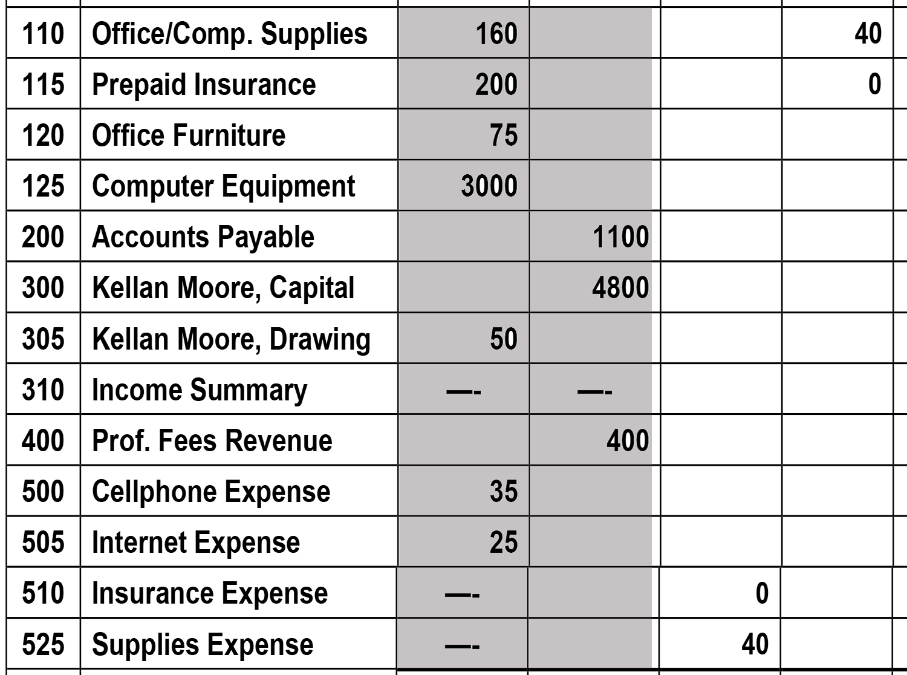
Worksheet Adjustments require
#8 Adjusting Entries …
Amounts in the the adjustments columns have to be journalized and posted to bring account balances up to date…

Slide 5
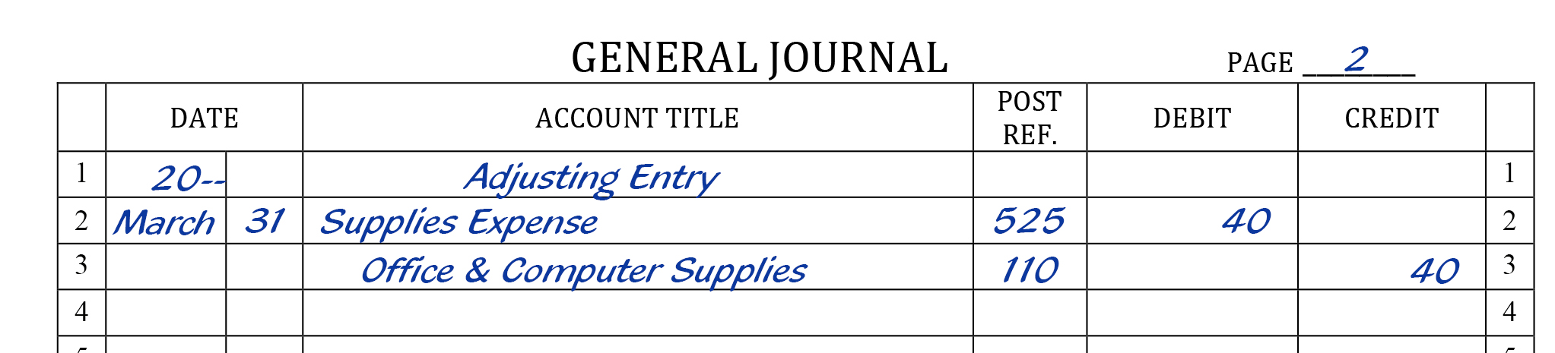
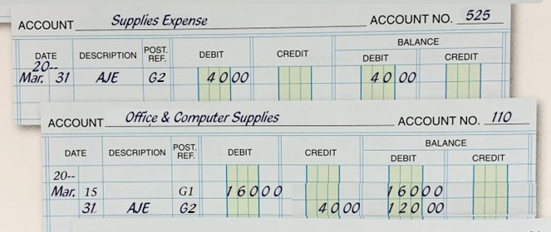
8) Prepare Adjusting Journal Entries (AJE)
Record in the General Journal (above)
Post to the General Ledger (right)

Slide 6
Remember the fun fact from the last lesson:
Every adjustment (and adjusting entry)
affects a permanent account
and a temporary (capital) account:
In our example for this problem,
Office & Computer Supplies is Permanent
Supplies Expense is Temporary

Slide 7
#9 Closing Entries …
The temporary capital accounts (RED) have to be zeroed out and their balances returned “Home” to the Capital account…

Slide 8
#9 Closing Entries …
Revenue and Expense accounts ‘fly home’ through an ‘airport’ account called
Income Summary.
(Income Summary is a simple Income Statement)

Slide 9
CE#1, close out the Revenue account and any other CR balances (later) send to Income Summary (airport)
Closing Entry #1 – Close credit balances; transfer to Income Summary account
Income Summary – OE
‘Airport’
Prof. Fees - Rev
— B+
No normal bal.
CE#1 400
(10)
300 (11)
________
0
400 (CE#1)

Slide 10
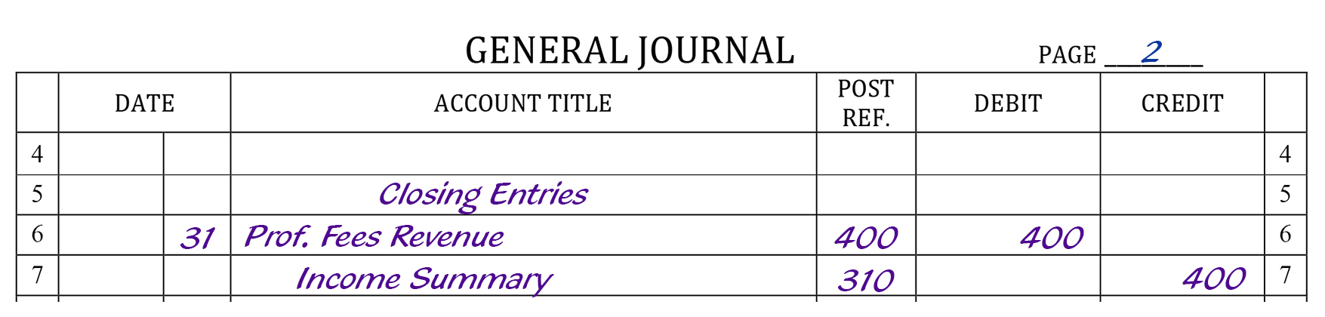
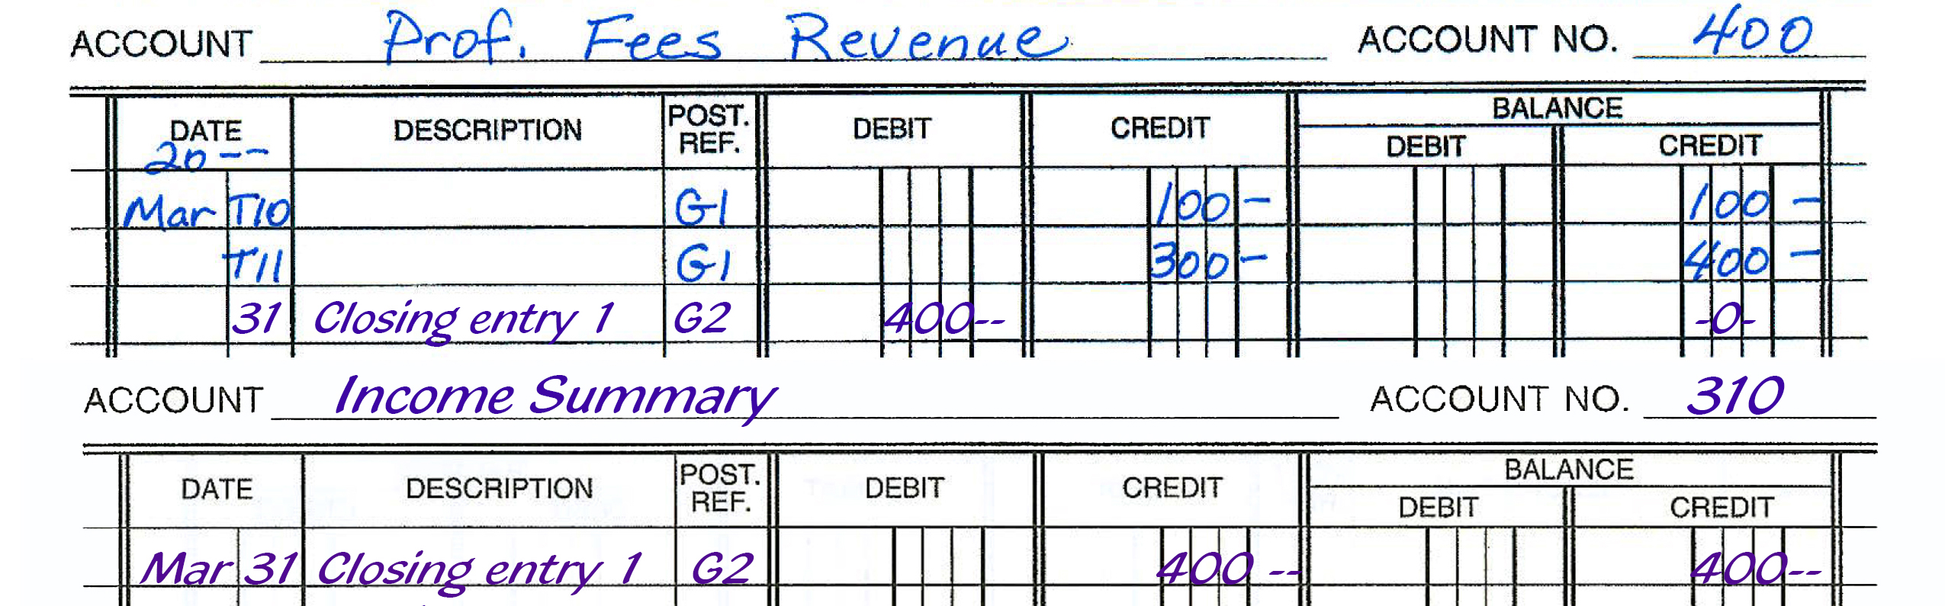
CE#1, Zero out CR balances
Journalize to General Journal;
Post to General Ledger

Slide 11
CE#2 – Close debit balances; transfer total to Income Summary (airport)
Note: the 3 CRs = the DR to IS
500 Cellphone Exp -E
505 Internet Exp -E
Income Summary - OE
B+ -
B+ -
35 35 (CE#2)
_______
0
25 25 (CE#2)
_______
0
No normal bal.
(CE#2) 100 400 (CE#1)
________
300 NI
525 Supplies Exp -E
B+ -
(AJE) 40 40 (CE#2)
_______
0

Slide 12
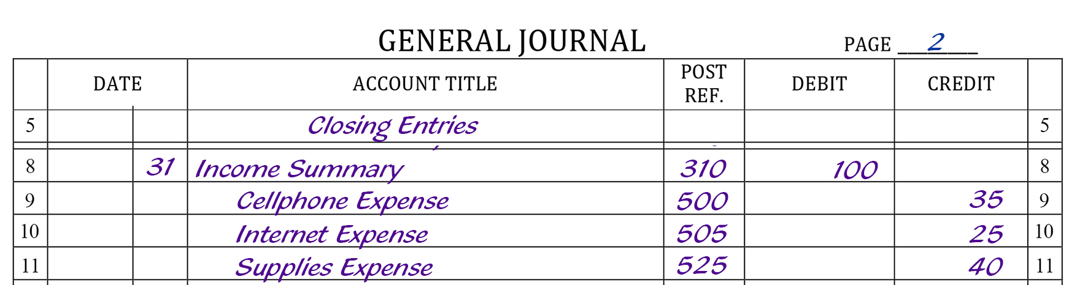

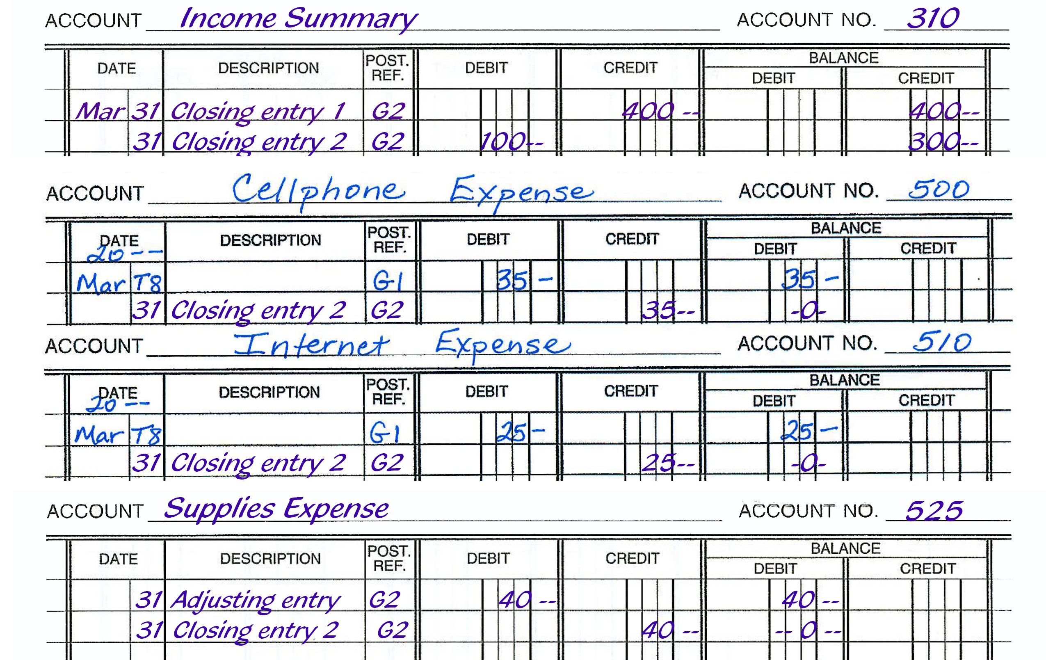
Note: the 3 CRs = the DR to
Income Summary
Closing Entry #2 –
Zero out debits: Journalize to General Journal;
Post to General Ledger

Slide 13
CE#3 – Close Income Summary; transfer Net Income to Capital account
(leave airport and fly home!)
300 K.M., Capital - OE
Income Summary - OE
— B+
No normal bal.
(CE#2) 100 400 (CE#1)
________
(CE#3) 300 300 NI
zero balance
3,000 (1)
1,800 (3)
4,800 COW
300 (CE#3)

Slide 14
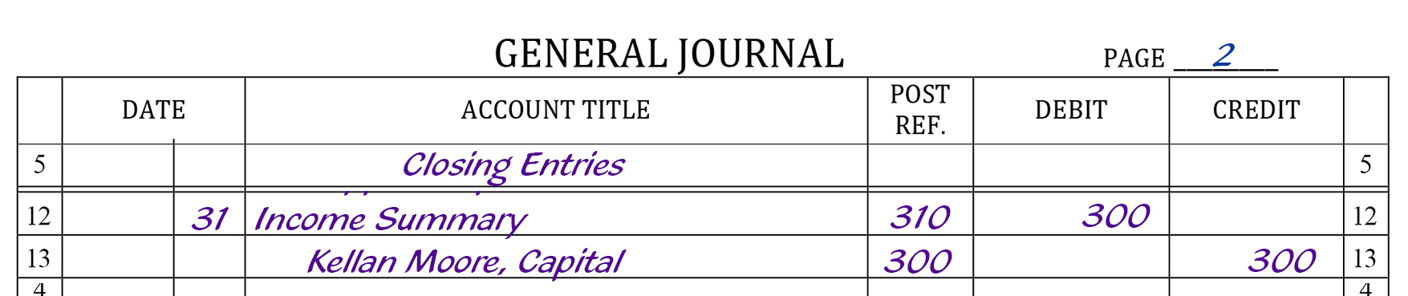
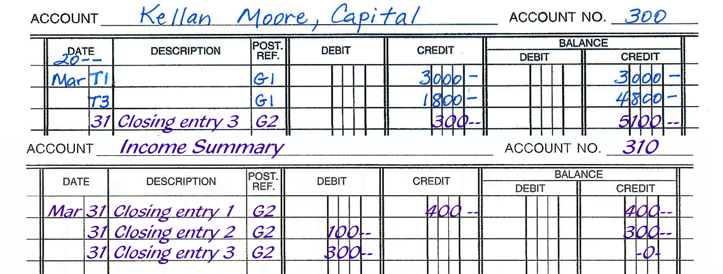
CE#3 – Close Income Summary;
Journalize and Post
(leave airport and fly home!)
Note that Income Summary started with 0 balance before closing entries and ended with 0 balance after closing entries.

Slide 15

Closing Entries …
DRAWING DOES NOT AFFECT
NET INCOME!
So the Drawing account does not fly home through the Income Summary airport!
(He drives straight home to Capital)

Slide 16
CE#4 – Close Drawing; transfer to Capital account
Drawing does not affect NI; don’t send to Income Summary
305 K.M. Drawing - D
300 K.M., Capital - OE
B+ -
— B+
50 50 (CE#4)
__________
0
3,000 (1)
1,800 (3)
4,800 COW
300 (CE#3)
(CE#4) 50

Slide 17
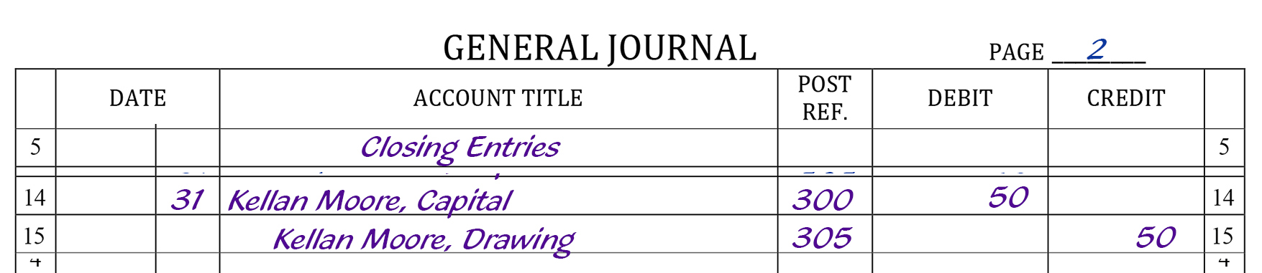
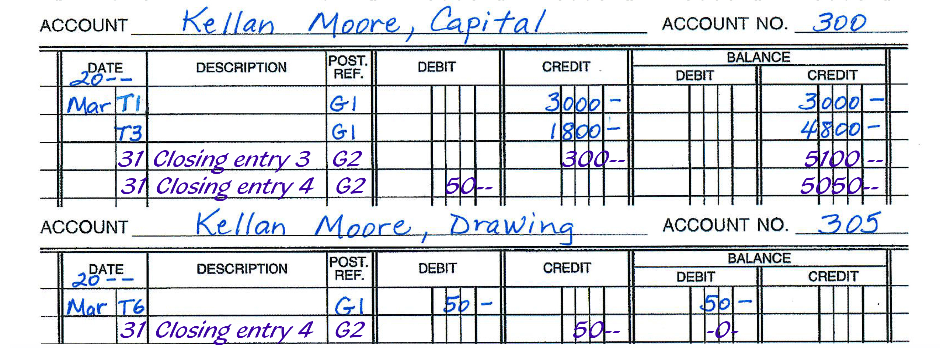
Closing Entry #4 – Close Drawing;
Journalize and Post
Drawing does not affect NI; ‘drive’ straight home to Capital

Slide 18
CAPITAL FORMULA after closing entries
300 K.M., Capital - OE
— B+
0 Beg.
Cap
3,000 + Inv.
1,800 + Inv.
4,800 = COW
300 + NI
5050 End.
Cap.
- DRAW 50
- NL

Slide 19
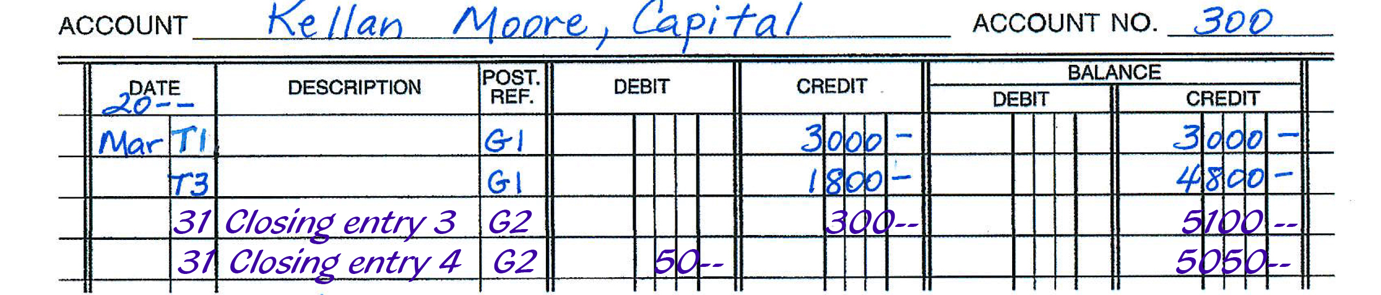
CAPITAL ACCOUNT in General Ledger after closing entries

Slide 20
Now, we’ll do a final check to see if DR = CR
(Perm. Account balances
ONLY)
#10 PCTB - Post Closing
Trial Balance
DR CR
Cash 2,755
A/R 0
Supplies 120
PPI 200
Ofc.Furn. 75
Comp.Eqp. 3,000
Total DRs 6,150
A/P 1,100
Capital 5,050
Total CRs 6,150

Slide 21
Accounting Cycle is Complete!
Temporary accounts have moved back ‘home’ to Capital until time to start another year off at ‘college.’
Permanent balances have been updated and are ready to start another cycle in the next fiscal period …

Slide 22

SUCCESS!
Well done! You’ve made
it through the entire accounting cycle.
Now practice other concepts or work more transactions to improve your accounting skills!

