Slide 1
UIL Accounting
State Concept #2
Promissory Notes & Interest
Kay Whitton
state contest director

Slide 2


Promissory Notes and
Interest
A promissory note (or ‘note’) is a written promise to pay a certain sum of money at a specific time.
Notes are formal documents that are evidence of credit granted or received.

Slide 3
Notes Payable vs.
Notes Receivable
N/P are issued to a creditor when a biz. buys or borrows on credit.
N/R are notes accepted from A/R customers who cannot pay on time.

Slide 4
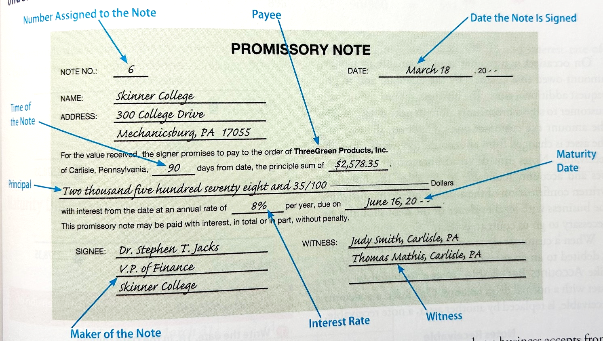
Sample Promissory Note (Cent.21 p.425)

Slide 5
Notes Terms
Principal (Face Value) – amt. borrowed
Term – amount of time to repay the note
Issue Date – date note is written
Payee – the one that payment goes to
Interest Rate – % fee charged for use of $
Maturity Date – due date of the note
Maturity Value – Prin + Int due @ Mat.date
Maker – the one promising to repay

Slide 6
Calculating Interest
P
01
x R
02
x T
03
Interest = Principal x Annual % Rate x Time

Slide 7
Calculating Interest
If $ is borrowed for one year, then the interest amount is just Principal X Rate (APR)
1000 x 10% (.10) = $100 interest

Slide 8
Calculating Interest for a partial year: simply express the T as a fraction
If $ is borrowed for six months, then the formula is Prin. X APR x 6/12 (or ½)
1000 x 10% x ½ = $50 int.
If $ is borrowed for 90 days, then the formula is
Prin. X APR x 90/360
1000 x 10% x 90/360 = $25

Slide 9
360 Days vs.
365 Days
365-day year – used by the federal government and on consumer loans
360-day year – used by most banks
Since 360 makes for easier calculations, it will be typically be used in UIL

Slide 10
RecordingInterest
Interest expense – the interest accrued on money borrowed; since it is a financial expense rather than operating expense, it is listed in Other Expenses
Interest income – interest earned on money loaned; it is investment income rather than operating income, so it is listed in Other Revenue

Slide 11
Note Classification
Since most notes payable and notes receivable are paid within one year, they are classified as current liabilities and current assets
But long-term notes (due in more than one year) would not be a current liability.

Slide 12

Issuing a Note Payable
Repaying a Note Payable
DR Cash
CR N/P
DR N/P
DR Interest Exp.
CR Cash

Slide 13
Interest Bearing Note Payable
Non-Interest
Bearing
Note Payable
Requires principal and interest to be paid on the maturity date.
Requires interest on a note to be paid in advance.

Slide 14
Non-Interest Bearing
Note Payable facts
14
Called ‘non-interest bearing’ since no add’l interest is due (paid up front)
Also called a discounted note
Interest deducted is called Bank Discount
Cash received = Proceeds of note
Proceeds = Note – Bank Discount
Bank Discount recorded as contra liability
Maturity Value = Face Value
Maturity Date – calculated the same

Slide 15
Issuing a Non-Interest Bearing N/P
Repaying a Non-Interest Bearing N/P
DR N/P 1000
DR Int. Exp. 100
CR Cash 1000
CR DON/P 100
DR Cash 900
DR DONP 100
CR N/P 1000

Slide 16

Discount on N/P (DON/P)
The bank discount taken from the note proceeds is future interest expense (or a prepaid expense).
It is recorded as a contra-liability account
Book Value of the Note/Pay is Note – DON/P
Bank Discount cannot be recognized as an expense until the note matures.

Slide 17
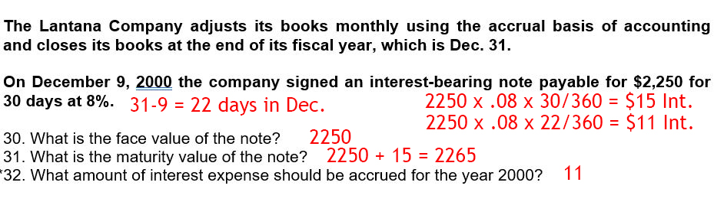
Sample test question:
(Interest-Bearing N/P – State 2001)

Slide 18
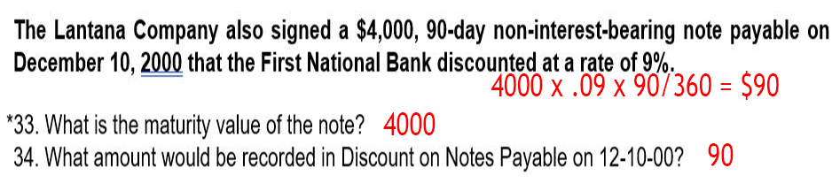
Sample test question:
(Non-Interest-Bearing N/P – State 2001)

Slide 19
When a Note/Rec is accepted from a customer who needs more time to pay
DR Note Receivable
CR Accts Rec.-Customer
Note #___
(post to both General Ledger and to customer page in A/R subsidiary ledger)

Slide 20
When Note/Rec is repaid…
DR Cash in Bank
CR Note Receivable
Receipt #___

Slide 21
If Note/Rec is NOT repaid… it is DISHONORED
DR Accounts Receivable – Cust.
CR Notes Receivable (face value)
CR Interest Income
Memo #___
(though not paid, the interest is earned and should be recognized as income)

Slide 22
It may later be written off as uncollectible…
DR Allow. for Uncollectible Accts.
CR A/R (for total P&I)
(The process shown may be important if the customer requests credit in the future or if collection is achieved later.)

Slide 23

SUCCESS!

