Slide 1
UIL Accounting
Regional Concept #3
Inventory Costing
Kay Whitton
State contest director

Slide 2
Inventory
General
Info…
Merchandise inventory (MI): largest asset of a merchandising biz. Reported on the BS & IS
Accuracy of inventory amount assures gross profit and net income are reported correctly
Computerized inventory; point-of-sale terminals read Universal Product Codes (UPCs)
Biz.’s count inventory when low; hire inv. agents that specialize in taking inventories
Determining the cost of an item is referred to as costing an item

Slide 3
More
Inventory
General
Info…
A form used during a periodic inventory to record information is an inventory record
A stock record is used to show kind of merchandise, qty rec’d, qty sold, & balance
A file of stock records for all merchandise on hand is a stock ledger
Costs are not recorded on inventory records; purchase invoices are used to find unit prices
The same inventory costing method must be used each fiscal period (Consistent Reporting)

Slide 4

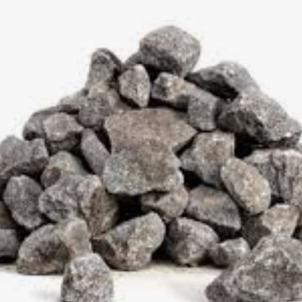


Four Inventory Costing Methods used on UIL Accounting tests
FIFO
(first-in,
first-out)
LIFO
(last-in,
first-out)
Weighted Average
(Total COGA / # units
X # EI)
Specific ID
(large-ticket
Items)

Slide 5
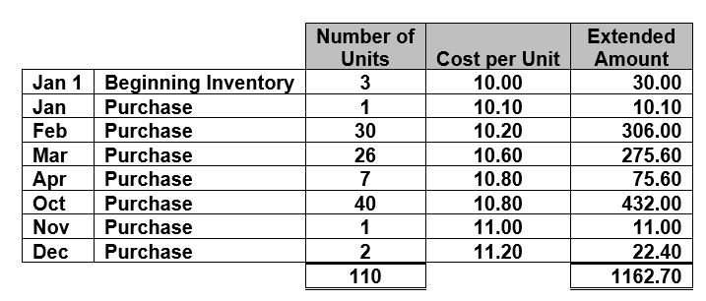
Inventory Stock Record
Note the Formula:
Beg. Inventory
+ Purchases
________________
= Cost of Goods Avail. For Sale (COGA)

Slide 6
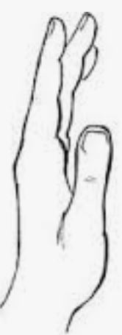
FIFO method
Ex. 17 units left in End. Inv.
With FIFO, cover the first rows with your hand; add from bottom:
2 @ 11.20
+ 1 @ 11.00
+14 @ 10.80
———-—————
= 17 184.52 E.I.
EI 17 units - 184.52
= COGS 93 units sold 978.18
======

Slide 7
LIFO method
Ex. 17 units left in End. Inv.
With LIFO, cover the lower rows with your hand; add from the top:
3 @ 10.00
+ 1 @ 10.10
+13 @ 10.20
———-—————
= 17 172.70 E.I.
EI 17 units - 172.70
= COGS 93 units sold 990.00
======

Slide 8
Weighted Average method
Ex. 17 units left in End. Inv.
With weighted average, divide the COGA $ amt by # COGA units
1162.70
÷ 110
= 10.57 /unit
X 17 units
= 179.69 E.I.
10.57 avg..
EI 17 units - 179.69
= COGS 93 units sold 983.01
======

Slide 9
Specific ID method
Ex. 17 units left in End. Inv.
Specific ID would have to provide the months of purchase of EI:
For ex.
2 in Jan. = 20
5 in Mar. = 53
10 in Oct.= 108
17 = 181
EI 17 units - 181.00
= COGS 93 units sold 981.70
======

Slide 10
So EI changes based on costing method
 | COGA | - EI | = COGS
FIFO | 1162.70 | 184.52 | 978.18
LIFO | 1162.70 | 172.70 | 990.00
Weighted Avg. | 1162.70 | 179.69 | 983.01
Specific ID | 1162.70 | 181.00 | 981.70

Slide 11
Here’s a basic inventory costing principle… and a silly mnemonic
FI-FO - FIGHER
LI-FO - LOWER
In periods of rising prices, FIFO method means higher
EI, GP, and NI
LIFO method means lower EI, GP, and NI

Slide 12
Whatever method is used to calculate EI, subtract COGS from Net Sales to get Gross Profit.
(Info would have to be provided about # units sold at some price.)
Ex. During the year
E-Fitness sold 93 units at $21.95 each. So,
NS = 2041.35
COGS
= Gross Profit
(Or the problem might not even say how many were sold, if it gave you the number of EI in the table…)

Slide 13
Multiply NS by whatever GP percentage is given in the problem (probably from a previous year) to calculate Gross Profit; then subtract GP from NS to get COGS.
Then using the formulas, solve backward for E.I.
Gross Profit Method of estimating Ending Inv.
Key is knowing
Net Sales = 100%

Slide 14
Lower of Cost or Market method: if market value of inventory is lower than its cost, record inventory at market value. (Info would have to be stated in the problem.)
Conservatism principle (don’t overstate assets)
Old technology in inventory might be worth less than cost.
Inv. on Bal. Sheet may be less than, but never greater than actual cost of inventory.
Decreases in value are recognized when they occur.

Slide 15
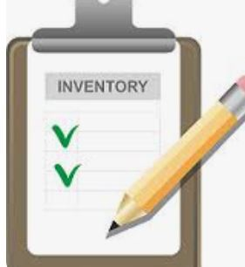

Periodic inventory method vs.
Perpetual inventory method
Periodic Inventory:
(a/k/a physical inventory)
Perpetual Inventory:
(a/k/a book inventory)

Slide 16
Periodic Inventory method
1
(a/k/a physical inventory)
counting, weighing, or measuring items of merchandise on hand
2
2
3
DR Purchases account in COGS category
4
Disadv.: COGS not known until a physical inventory is taken
5
Method taught in early chapters of the textbook

Slide 17
Perpetual
Inventory method
(a/k/a book inventory) continuous record of increases, decreases, and amt. on hand
01
The perpetual inventory is corrected per the actual periodic inventory
02
PURCHASES acct isn’t used; COGS account instead
(not category)
03

Slide 18
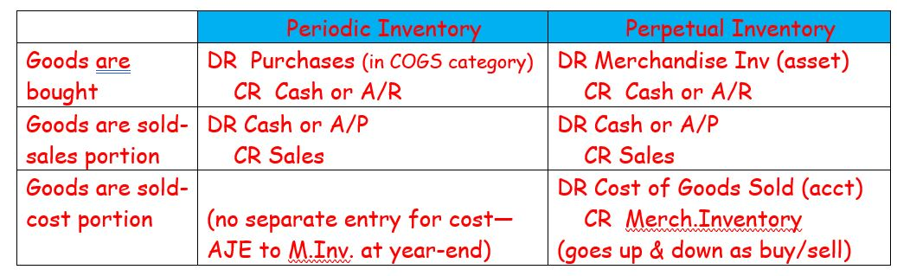
Comparison in Journal Entries

Slide 19

Success!
There may be needed edits or additions, but I’m trying to beat a deadline!

