Slide 1

UIL Accounting
Regional Concept #1
Depreciation & Plant Assets
Kay Whitton
state contest director

Slide 2
Current
Assets:
Cash
A/R
Merchandise Inventory
Supplies
Prepaid Insurance etc.
Exchanged for cash within one year
Or, are consumed within one year
Value doesn’t change, so no depreciation
Are generally more liquid than plant assets
Listed in order of liquidity (converted to cash)

Slide 3
Plant
Assets:
Equipment, Vehicles, Building, Airplane,
Computers, Furniture, etc.
Are used over multiple accounting periods
Are used to earn revenue, not to be resold
Cost is allocated over the years of useful life
Must be recorded at historical cost
Are called by several differing terms

Slide 4
Plant
Assets
Plant & Equipment
Property, Plant & Equipment
Long-lived Assets
Real Assets (vs. personal)
Long-Term Assets

Slide 5
Four factors in Calculating
Depreciation
1st 2 are known; 2nd 2 are estimated
Cost
Depreciation method to be used
Estimated useful life
Estimated salvage value

Slide 6
Plant Asset Cost
Cost of a plant asset includes all amounts spent to prepare it for use in the operations of the business. (Cost + Shipping + Sales Tax
+ Installation +Delivery)

Slide 7
Plant Asset Cost Example
A company called Hands Up located in Texas purchased a new machine on April 1, 2024 for $210,000. that will enable them to make latex gloves in various colors.
Hands Up was required by Texas to pay Texas sales tax of $14,220 because the Chicago company also had operations in Texas.
Hands Up was required to pay $7,200 to have the machine transported to Texas.
Upon arrival a specialized crew had to install the new machine at a cost of $4,440.
The machine was fully operational by April 12, 2004.(date to be used for put in service)
The machine’s technology is two years old, and the market value was $225,000. (distractor)
Hands Up estimates the useful life of the asset to be 10 years. The estimated value of the machine at its replacement time is determined by Hands Up to be $54,000 (salvage value).
210,000 + 14,220 + 7,200 + 4,440 = 235,860 COST - 54,000 Salvage Value = 186,860 Depr. Value

Slide 8
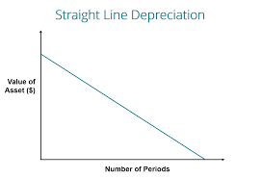
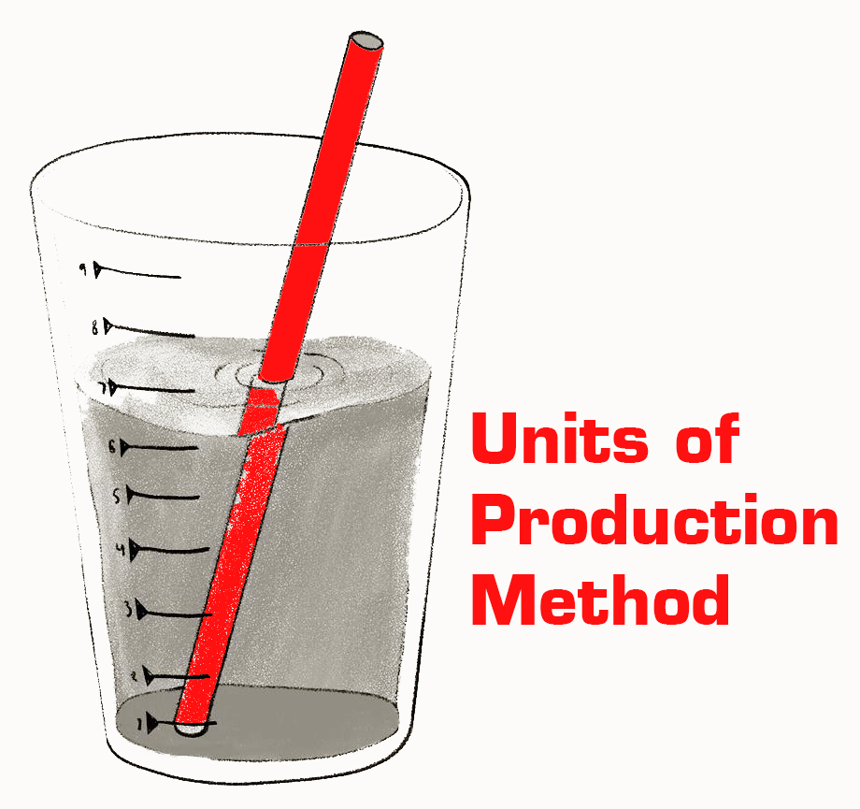
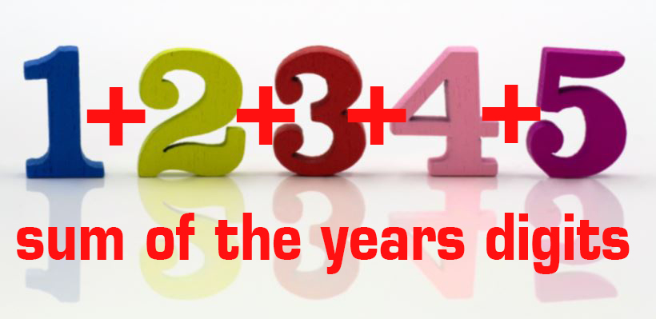
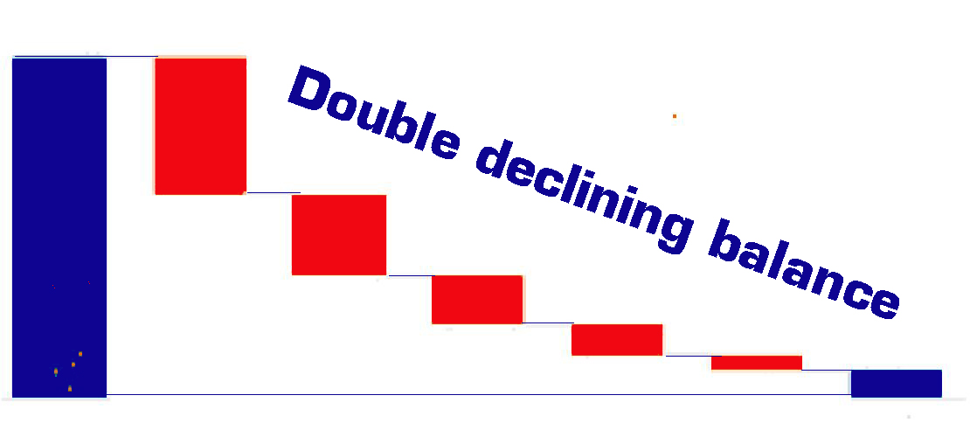
Four depreciation methods

Slide 9
The # of years of Useful Life is limited
Wears out from use
Becomes obsolete (digital camera)
Is based on experience or
Based on published IRS guidelines
Is an ESTIMATE!

Slide 10
Estimated
Salvage Value a/k/a disposal value scrap value trade-in value residual value
The portion of cost a biz expects to recover at the end of the asset’s life
Cannot be expensed (or depreciated)
Is based on previous experience or
Based on published IRS guidelines
Is an ESTIMATE!

Slide 11
Each year’s
DEPRECIATION AMOUNT reduces the asset’s value
But the asset value must stay at COST
So a contra-account is used to record the depreciation amounts from year to year
Contra-Asset is ‘Accumulated Depreciation’
And is shown on the Balance Sheet below its related asset account
Has a CREDIT balance
Asset – Accum Depr. = Book Value

Slide 12
Straight-Line Formula:
Cost
- SV (Salvage Value)
= DV (Depreciable Value)
÷ UL (# Yrs. Useful Life)
= AD (Annual Depreciation)
for Years 2 and following
÷ 12 = Mo. Depreciation
x # mos. owned in Year 1
= 1st Yr. Depr. Exp. amount
Method #1 Straight-Line
Equal amount method
Widely used
Easiest to calculate

Slide 13
Partial Year Calculation:
Assets bought mid-year are depreciated over their useful life PLUS ONE year: the fraction for Year 1 plus the fraction for the last year = a full year.
Round to the nearest whole month (If bought before the 15th or sold after the 15th, that month is counted as a month of ownership.
Depreciation for Partial Year

Slide 14
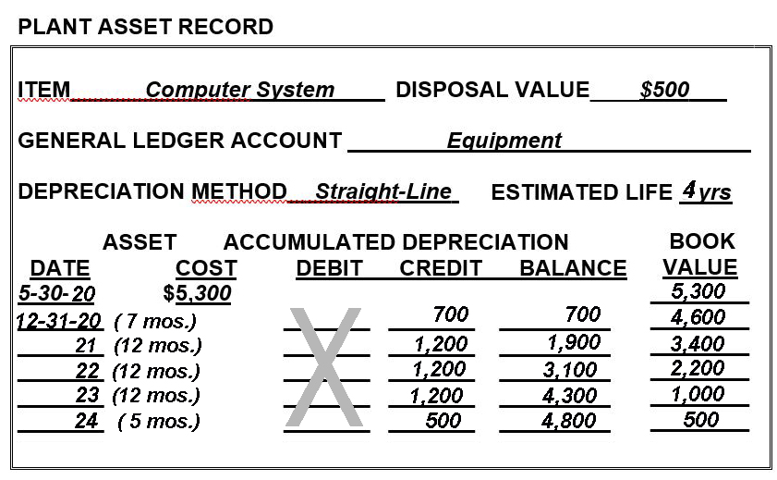
Straight-Line Formula
Cost $5,300
-SalVal - 500
= DepVal 4,800
÷ UL ÷ 4 yrs
= AnnDep = 1,200
12 = 100/mo.
x # 7 mos.
(Jun-Dec)
= Yr. 1 Depr. $ 700
Yr. 2 Depr. 1,200
Yr. 3 Depr. 1,200
Yr. 4 Depr. 1,200
Yr. 5 Depr. 500
In every year, COST - ACCUM. DEPRECIATION = BOOK VALUE
7 months in 2020 + 5 months in 2024 = 12 months, so 4 full years

Slide 15
Sample Questions for the Computer Equipment example just given:
What is the book value of the computer system at the end of 2022? $2,200
What is the amount of depreciation expense recorded for the computer equipment in 2020? $700
What is the book value of the computer equipment at the end of year 2024? $500
If the Total Fitness Center sells the computer system on 12-31-23 for $1,200, what is the amount of the gain or loss? $200 gain

Slide 16
Straight-Line Formula:
100%
÷ UL (# Yrs. Useful Life)
X 2
= AD % (Annual Depreciation %)
x Book Value each year
= Depr. Exp each year
Final year depr. exp. amt. is
Book Value – Salvage Value
1st Yr. Depr. Exp. can be partial, but most problems are dated Jan 1
Method #2
Double-
Declining-Balance
Accelerated method
More expense in earlier years

Slide 17
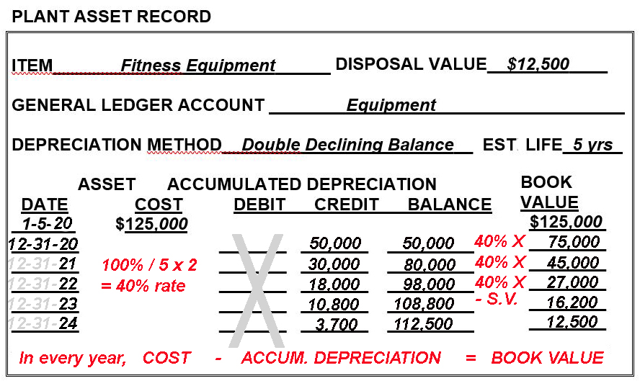
(Not 40%)

Slide 18
Sample Questions for the Fitness Equipment slide above:
What is the book value of the fitness equipment at the end of 2022? $27,000
What is the amount of depreciation expense recorded for the fitness equipment in 2020? $50,000
What is the book value of the fitness equipment at the end of year 2024? $12,500
If the Total Fitness Center sells the fitness equipment on 12-31-23 for $15,000, what is the amount of the gain or loss? $1,200 loss

Slide 19
As with double-declining-balance, the sum-of-the-years' digits method allocates more depreciation in the early years and less in later years.
However, unlike the double-declining balance method, the sum-of-the-years-digits method is calculated by applying a declining rate to a constant base: the asset's depreciable value.
(Depreciable Value = Cost – Salvage Value)
So, for 5-yr U.L. add 1+2+3+4+5 = 15
Depr. Exp. Yr. 1 5/15 x DV
Depr. Exp. Yr. 2 4/15 x DV
Depr. Exp. Yr. 3 3/15 x DV
Depr. Exp. Yr. 4 2/15 x DV
Depr. Exp. Yr. 5 1/15 x DV
Method 3
Sum of the Years Digits
(Accelerated method)

Slide 20
Method 4 Units of Production
(Accelerated method)
The units of production method allocates depreciation according to how much the equipment is used, based on its potential.
For example, a machine that cost $250,000 has a useful life expectancy of 1 million units. During the first year of operations, it manufactured 75,00 units. What would be the amount of depreciation for Year 1?
75,000 X (Depr Exp –Yr 1)
——————- = ———————-
1,000,000 $250,000
X = $18,750 = Depr. Expense, Year 1

Slide 21
SO NOW WHAT!
After determining the annual depreciation, an Adjustment on the Worksheet will be done
Then adjustments will be journalized as adjusting journal entries
DR Depreciation Expense
CR Accumulated Depreciation

Slide 22
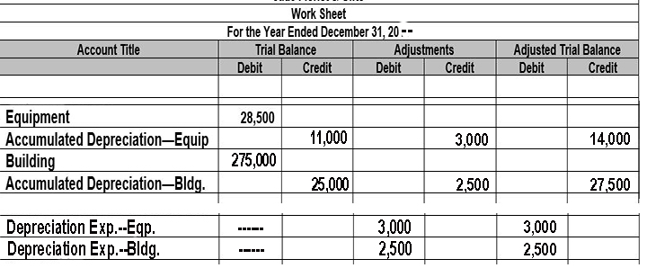
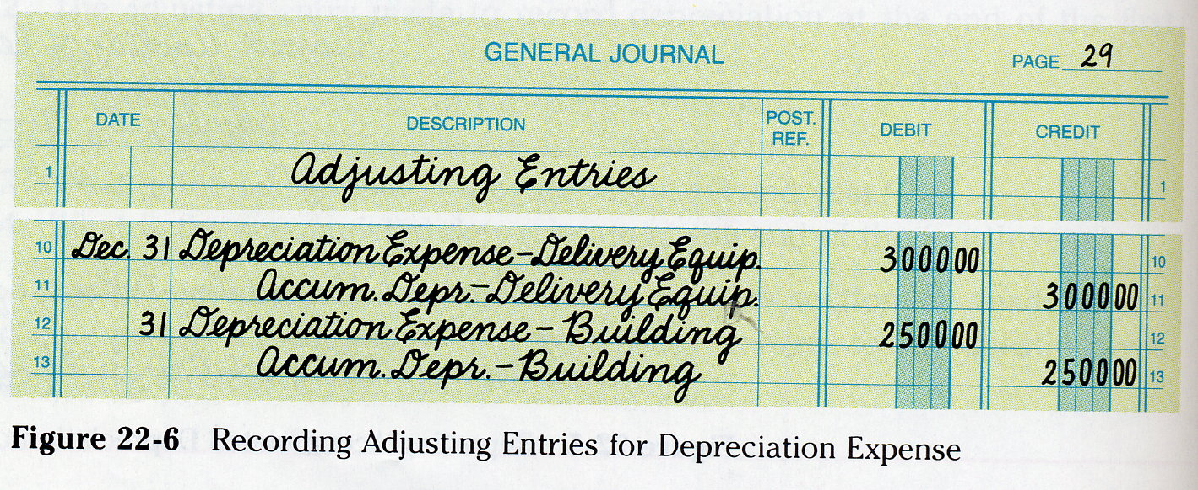
Worksheet Adjustments
Adjusting Journal Entries

Slide 23
Selling /Disposing of an Asset
Two Journal Entries to record disposal of an asset:
DR Depr Exp for current year depreciation;
CR A/D-Asset
(2) DR Cash for amt of $ received (money from sale)
DR Accum Depr-Asset (cancels the contra-asset balance)
DR Loss on Sale of Asset (if sold for less than book value)
OR CR Gain on Sale of Asset (if sold for more than book value)
CR Asset acct for full amt (cancels the asset)
Gain/Loss on Sale of Asset: no normal balance, Other Income/ Exp section

Slide 24
Plant Asset notes
Assets must be recorded at their historical cost (Historical Cost Concept)
Recording each year’s depreciation is an application of the Matching Principle; if no adjustment is made, Assets & Net Income would be OVERSTATED.
Accounting for depreciation amounts requires use of a contra-asset account called ‘Accumulated Depreciation’
Each plant asset (equipment, furniture, vehicles, etc.) has its own associated contra account for depreciation

Slide 25
More
Plant Asset notes
LAND IS NOT DEPRECIATED,
since it does not decrease in value
Real property is land and anything attached to the land.
All other property is considered personal property
Real and personal property values are taxed by county tax assessors
A loss in the usefulness of a plan asset as a result of wear or obsolescence is called depreciation.

Slide 26

SUCCESS!

