Slide 1
UIL Accounting
State Concept #1
Corporations and Stock
Kay Whitton
state contest director

Slide 2
Corporation
Facts
Separate legal identity
Charter is like its birth certificate
Employer ID No. (EIN) is like its SSN
Can sell shares of ownership to others
Given permission to operate by the State

Slide 3
MORE
Corporation
Facts
Stockholders are the owners
Run by a board of directors (like a school board)
Shareholders, same as stockholders
Max. # shares a corp. may sell is called authorized capital stock
No drawing account; earnings are distributed as dividends

Slide 4
Corporation
Cycle
Organizers do legal work to incorporate
Stock is sold to Stockholders
Common S/H elect board of directors
Board of Directors hires officers (President, CEO, general mgr., etc.)
Officers hire employees and run the biz

Slide 5
Getting a Corporation Started…
Incorporation fees paid to the state, attorneys’ fees for legal services, payments to promoters to sell stock, the cost of printing stock certificates, and other costs to bring a corporation into existence are called organization costs
(classified as Other Assets).

Slide 6


Two types of Corporations
Closely held
(like a family-owned business)
Publicly traded
(like Nike)

Slide 7
Corporation oversight…
Public corporations are regulated by the Securities & Exchange Commission (SEC)

Slide 8
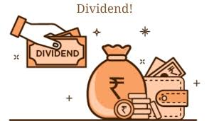
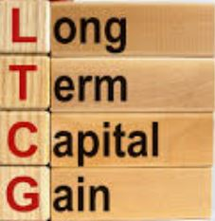
Two Reasons for Investing in a corporation
(by buying stock)
Short-Term Gain by earning dividends
Long-Term Gain by growth in the stock’s value

Slide 9
Corporations must hold annual meetings for shareholders
Shareholders vote for directors or submit a proxy (a vote in their place)
Annual Report is provided to S/H with
Financial statements for the fiscal period
Plus management analysis in
Notes to the Financial Statements
Follow Conservatism principle; no overstatement of assets or income

Slide 10




Corporation
Advantages:
Easy to raise money & expand (by issuing stock
Continuous existence
(many since1800s)
Easy to transfer ownership by selling shares
of stock
Losses limited to amount of investment only

Slide 11


Corporation
Disadvantages:
More upfront organizational costs
More complex to organize
More gov’t
regulations
Double taxation
1. corp. income
2. S/H’s dividends

Slide 12
Three differences between corporations and sole proprietorships/partnerships:
02
03
01
different accounts to record owner’s equity
(Capital Stock and Retained Earnings instead of Capital)
different procedures to distribute income to owners
(DR Dividends, not Drawing)
Corps. calculate and pay federal income tax on a corp. tax return, not as part of owner’s Form 1040

Slide 13

Retained Earnings
(S/E section) represents income of a corporation that is set aside (retained) by the corporation for future growth/ use/expansion
Distributed Earnings or
Dividends
(S/E section)
represents income of a corporation that is passed along to the shareholders as a return on their investment

Slide 14
Stockholders’ Equity Section accounts
Retained Earnings
Preferred Stock
Common Stock
Paid-in Capital in Excess of Par (PICEPAR)
Dividends

Slide 15
  Preferred Stock
  *receives dividends before common stockholders
  * given preference to the assets at dissolution
  *usually more expensive
  *no voting rights
  *guaranteed dividend amount is stated as e.g. $8 or 8% (percentage is calculated on stock price, which is usually, but not always $100)
  *the 8% (for ex.) dividend may be paid $8 annually, $4 semiannually or $2 quarterly
Common Stock
*no guaranteed dividends
* has voting rights
* rights to assets if the business closes
(after preferred stockholders)
* Dividends may be declared as a per share amount or a lump sum divided by all the common S/H

Slide 16
PICEPAR (pronounced pik-uh-par)
If a corp.’s common stock has a stated par value, any amount received over par value will go into a stockholders’ equity account:
Paid-In Capital in Excess of Par.
Common Stock will always represent the value of shares issued at par value only
(Trick to compute # shares: CS balance ÷ par value)

Slide 17
For example…
Corp. issued 100 shares of $10 common stock at $15/share
DR Cash 1,500
CR Common Stock 1,000
CR PICEPAR 500

Slide 18
Dividends
(like Drawing for a proprietorship or partnership)
may be declared annually, semi-annually, or quarterly (most common)
may be declared as an amt / share or as a total amount to be divided among S/H
Declared dividends cannot exceed the amount of retained earnings
Dividends are not required, but once declared, they cannot be canceled.
S/H on the date of record receive the entire dividend regardless of how long they’ve owned the stock.

Slide 19
Three
Dates that relate to Dividends
Date of Declaration (when board takes action to distribute $)
01
Date of Record
(S/H who own stock that day get dividend)
02
Date of Payment
(when dividends are actually issued to S/H)
03

Slide 20
Date of Declaration
When the dividends are declared, they become a liability of the corporation that day
DR Dividends (contra S/H acct)
CR Dividends Payable (liab.)

Slide 21
Date of Payment
When the dividends are paid, the liability is gone, but so is Cash!
DR Dividends Payable
CR Cash in Bank

Slide 22
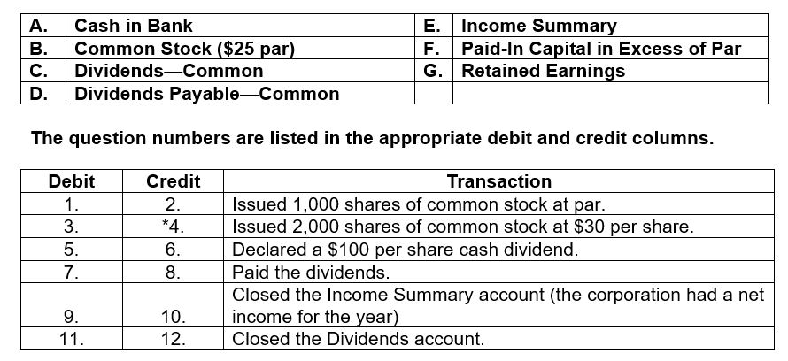
Sample problem from test…

Slide 23
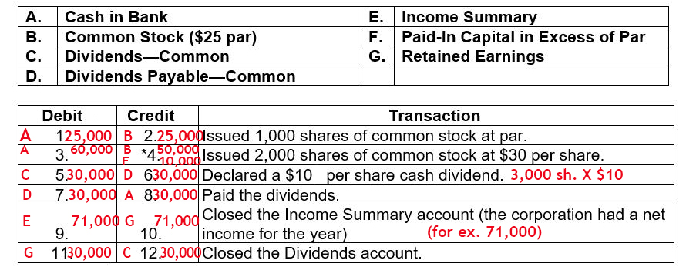
Solved problem from test…

Slide 24
Did you Notice?
Net Income INCREASES Retained Earnings
Dividends
DECREASE R/E
The Example of
Net Income of $71,000
Less the dividends
paid of $30,000
Resulted in an overall
Increase to Retained Earnings of $41,000
for future use

Slide 25
Statement of Stockholders’ Equity
(reports changes in S/E accounts during the period:
Beg Balance
+ Common Stock Issued
+ PICEPAR
+ Net Income
– Dividends
= Ending Balance

Slide 26
Corporations pay
Income Tax
4 x Year
(similar to self-employed persons)
April, June, September and December
Is an estimate of tax to be owed
DR Corp. Fed. Income Tax Expense
CR Cash in Bank when paid
AJE at year end to record add’l amt. owed

Slide 27
To calculate the C-FIT Exp. AJE
Total C-FIT Expense for the year
Total of the four estimated tax payments made
= AJE for remaining balance owed to IRS
DR C-FIT Expense
CR C-FIT Payable

Slide 28
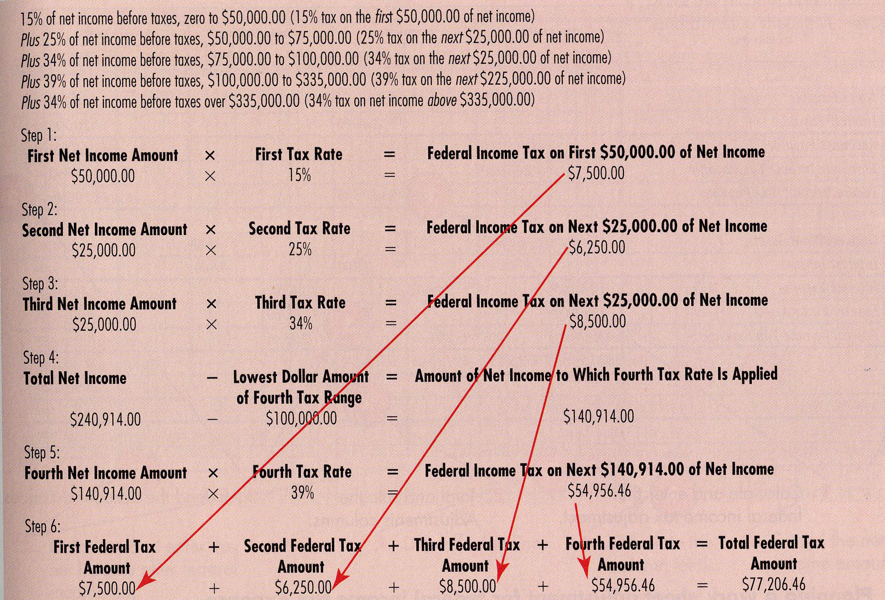

Slide 29

SUCCESS!

