Slide 1

UIL Accounting
Statement of Cash Flows
Kay Whitton
state contest director

Slide 2
Cash Flows IN… and OUT
As one textbook says, “cash flowing through a business is like blood flowing through your body,” keeping a business alive. Cash is needed for the daily operations of a business and unexpected expenses.

Slide 3
the
Statement of Cash Flows summarizes…
The amount of cash the business takes in
The sources of cash
The amount of cash the business paid out
The uses of cash
Cash reconciliation due to changes

Slide 4
Sample Statement of Cash Flows
(outflows or net decreases are shown in parentheses)
Statement of Cash Flows
For the Year Ending December 31, 20—
Cash flows from operating activities (net) $10,000
Cash flows from investing activities (net) (8,000)
Cash flows from financing activities (net) ( 250)
Increase (decrease) in cash 1,750
Cash balance January 1, 20— 3,150
Cash balance December 31, 20— $ 4,900
=======

Slide 5

3 types of Activities on the Cash Flow
Statement:
Operating Activities
Investing Activities
Financing activities

Slide 6
(chant)
Cash Flow
F
I
O
Even though the typical order of appearance is:
Operating
Investing
Financing,
(chanting OIF doesn’t have a ring to it!)

Slide 7
Operating
Activities
Transactions from normal business operations
Cash Basis items only, not Accruals
Revenues that have been received
Expenses that have been paid
So, amounts may not match financials

Slide 8
Examples of
Operating
Activities
Sales
Interest Income
Purchases of Merchandise
Operating Expenses
Interest Expense & Corp FIT Expense

Slide 9
Examples of Investing
Activities
Loans the business makes
Payments received for those loans
Purchase of plant assets (for cash)
Sale of plant assets
Investments

Slide 10
Examples of Financing
Activities
Long-term borrowing – notes payable (to finance business operations)
Issuance of stock or bonds (receiving $)
Proceeds from line of credit
Repaying loans (principal, not interest)
Paying cash dividends

Slide 11
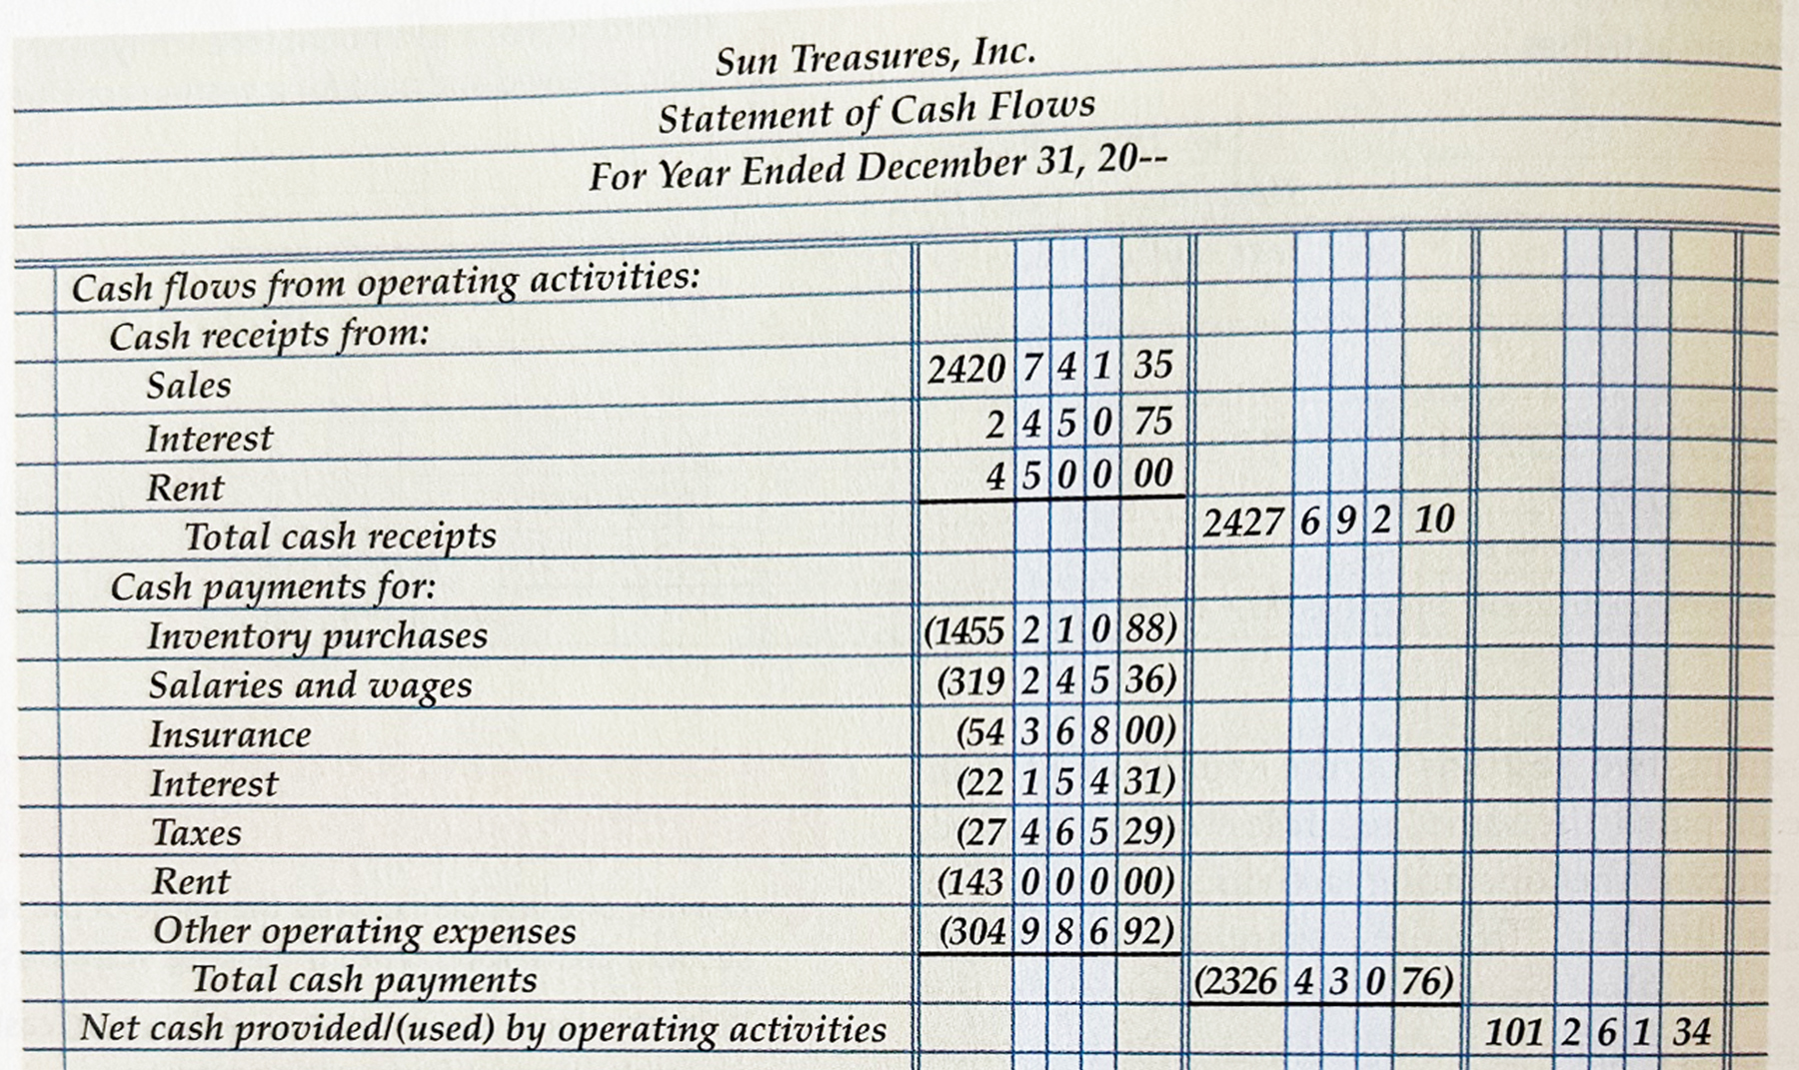
Copied from
Century 21
Textbook
Ch. 22
Page 696

Slide 12
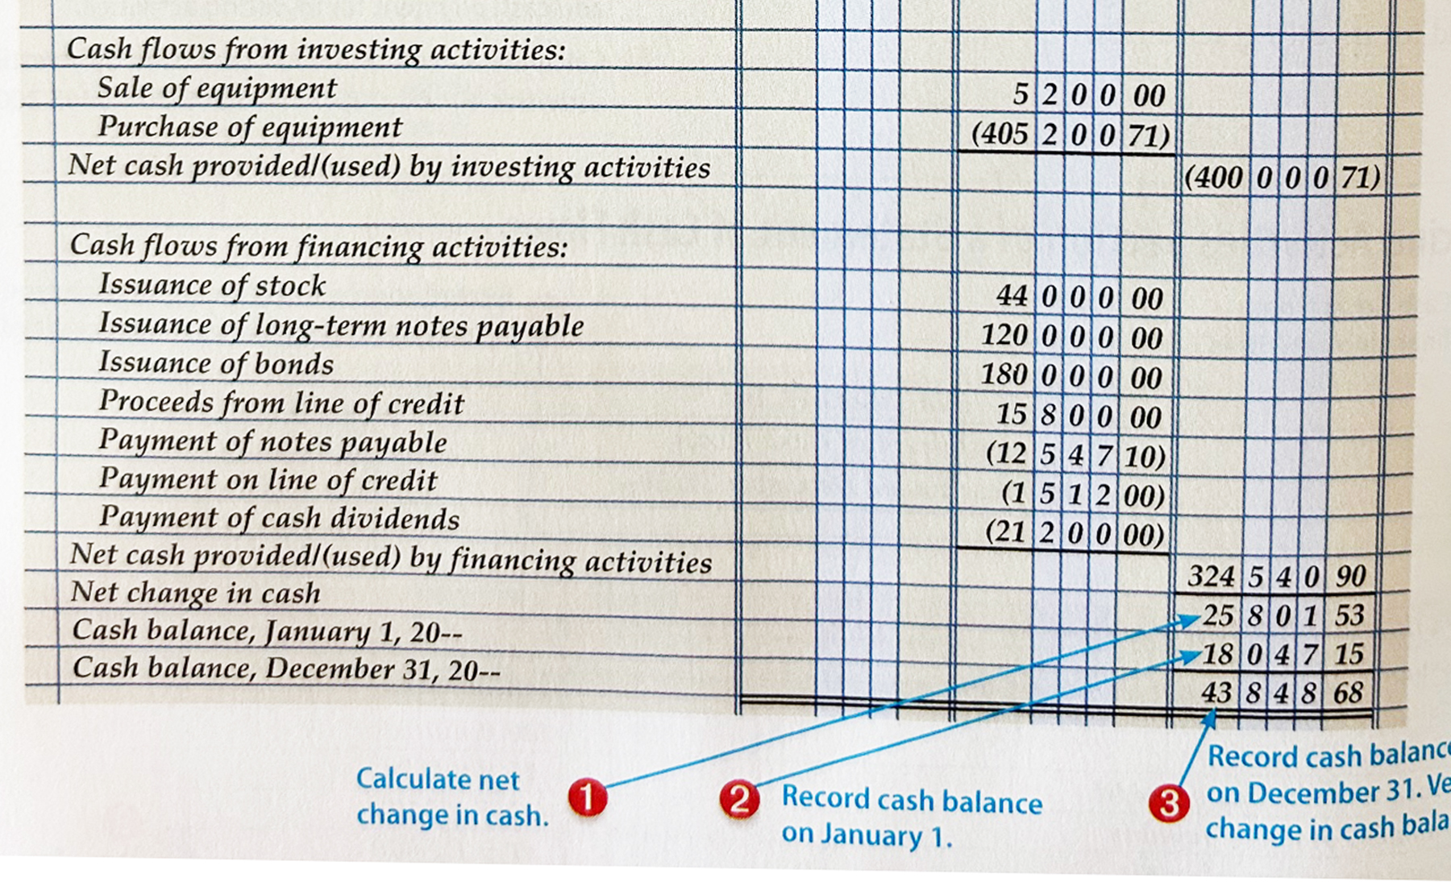
Copied from
Century 21
Textbook
Ch. 22
Page 696

Slide 13
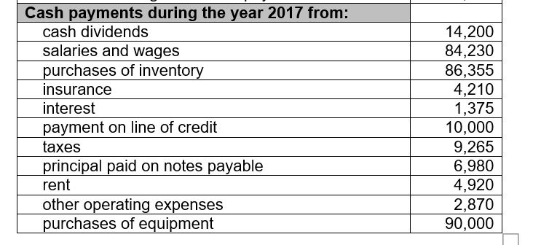
Sample UIL test: Cash Flow Statement

Slide 14
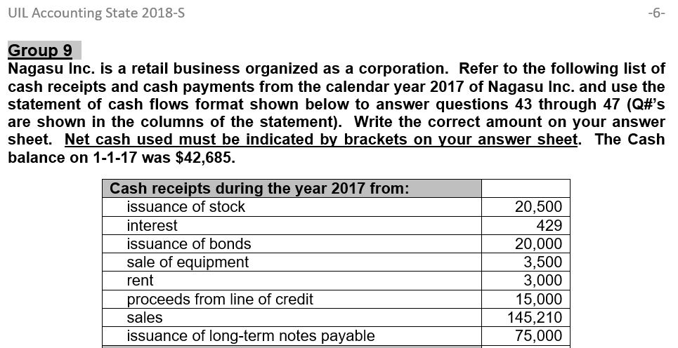
Sample UIL test: Cash Flow Statement

Slide 15
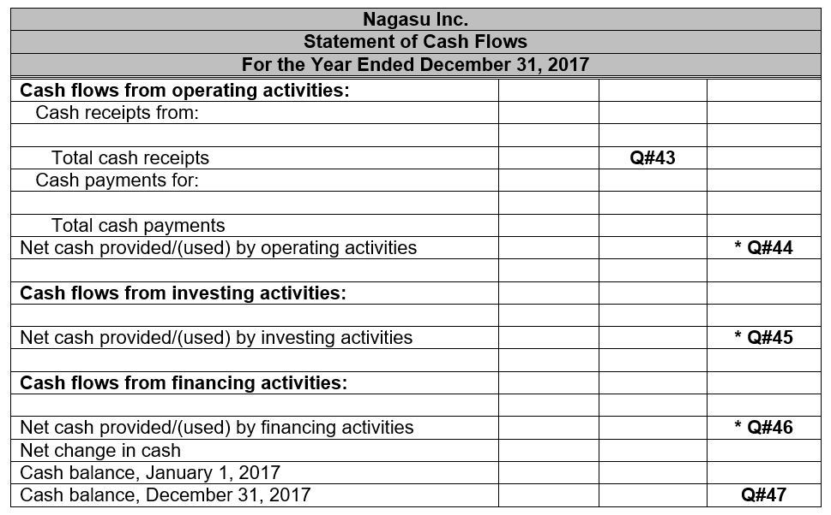
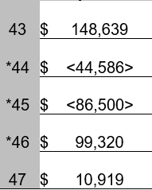
Sample UIL test:
Cash Flow Statement (part 3)

Slide 16

SUCCESS!

