Slide 1

UIL Accounting
Game Plan for
Accounting Rocks!
Kay Whitton
state contest director

Slide 2

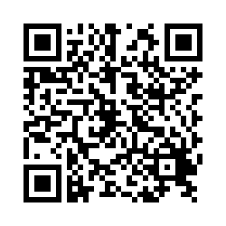

Register your attendance.
Complete this form for EACH session you attend today.
Session numbers are listed in schedule before titles.
2025
SCAN FOR ATTENDANCE CREDIT

Slide 3


Slide 4

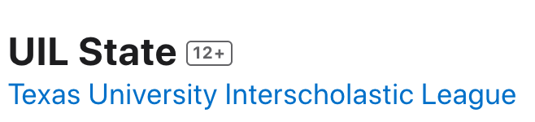

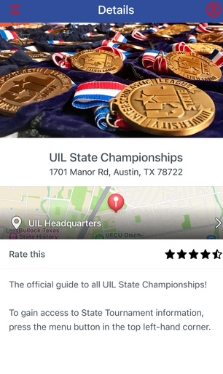
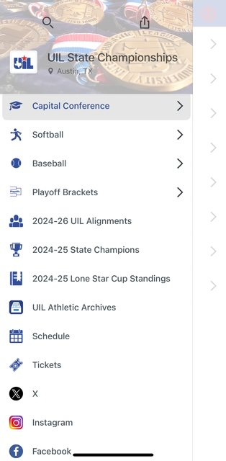
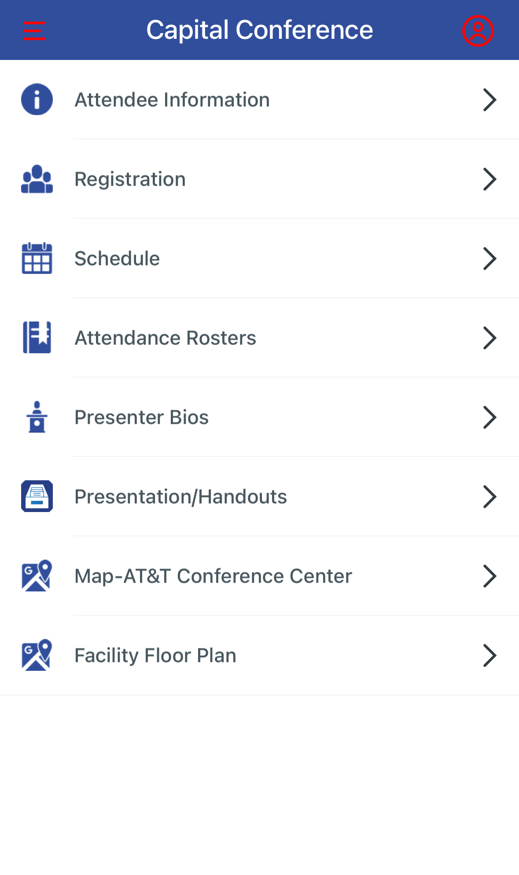
UIL STATE APP
For
Capital Conference

Slide 5
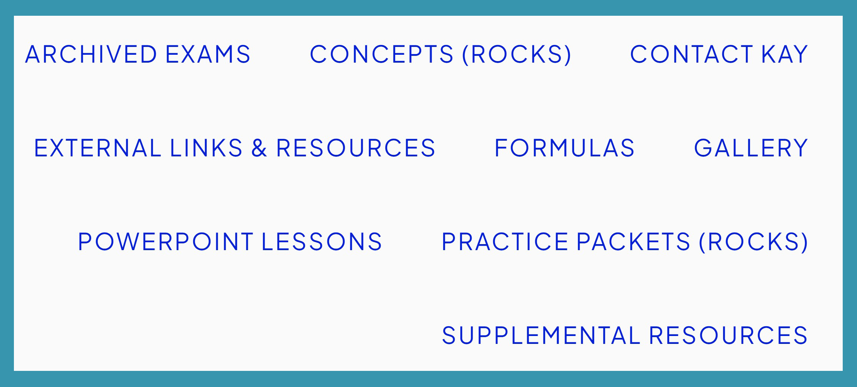
Accounting Rocks!

Slide 6
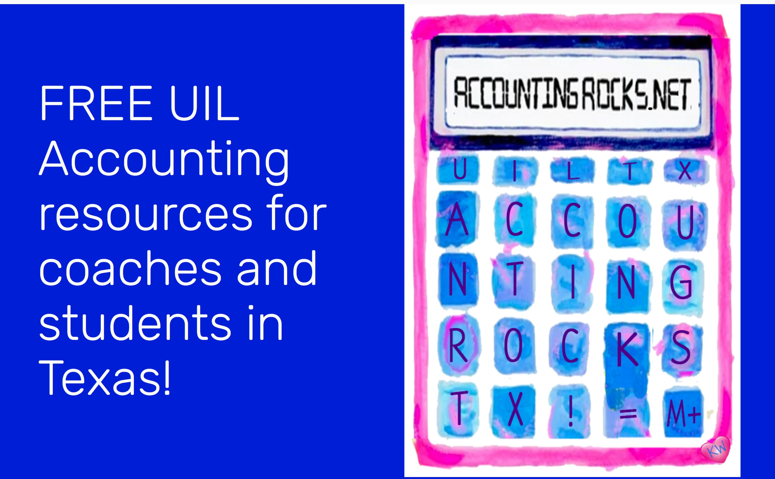
So many files…
Where do we begin?
AccountingRocks.net

Slide 7
Accounting Cycle
C-A-R-P-T-W-F-A-C-T-R
Pronounce it CarpetWFactor
C – Collect source documents
A – Analyze into Drs and Crs
R – Record in Journal
P – Post to General Ledger
T – Trial Balance
W – Worksheet
F – Financial Statements
A – Adjusting Entries
C – Closing Entries
T – Post-closing Trial Balance
R – Reversing entries (state)

Slide 8
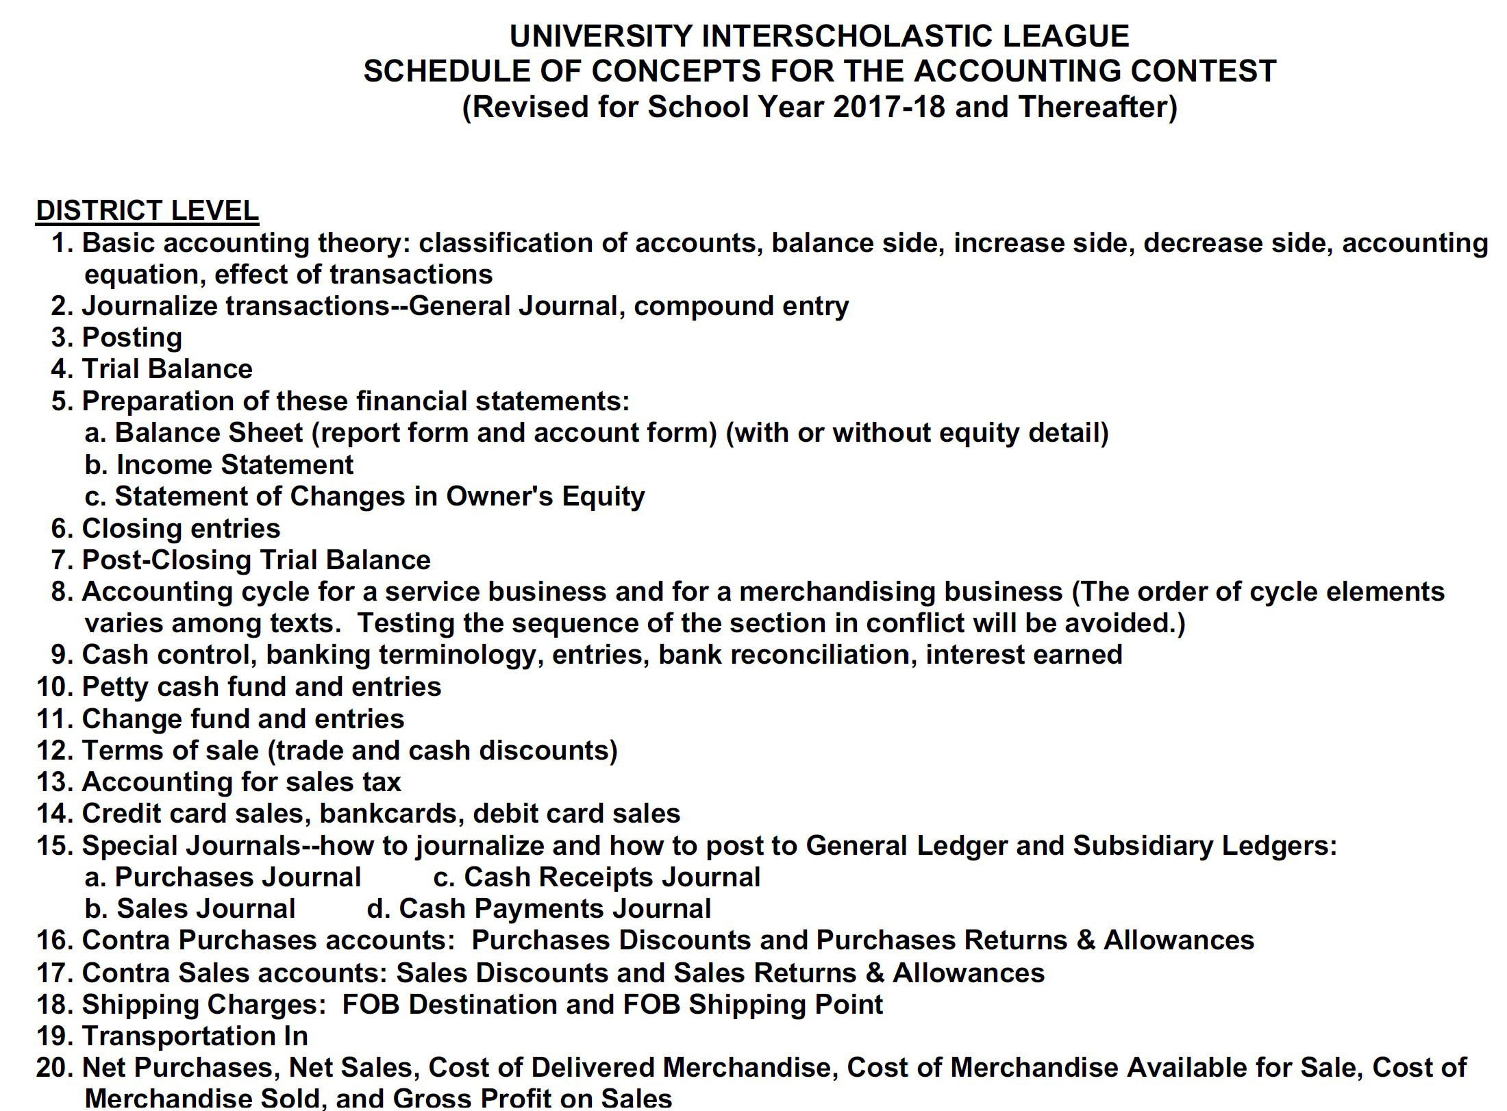
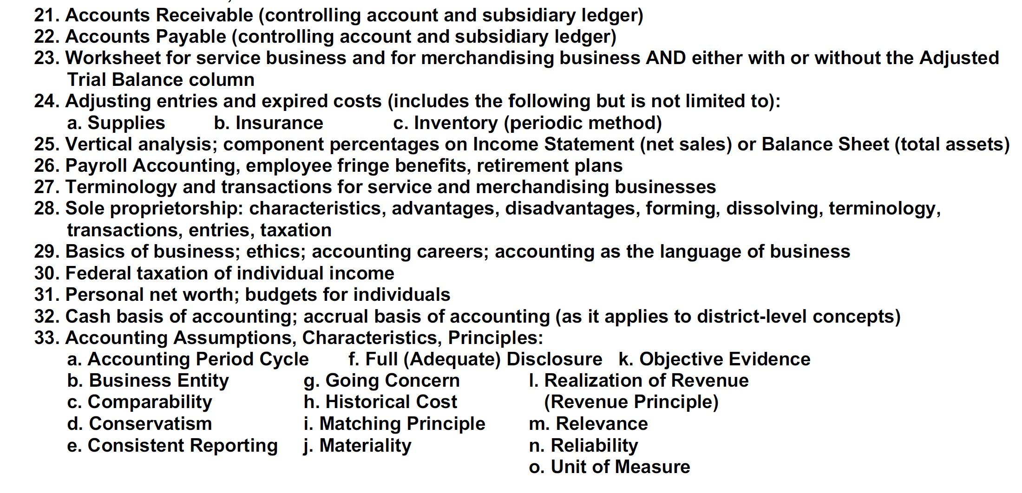
Invitational/District Accounting
Concepts
(former)

Slide 9
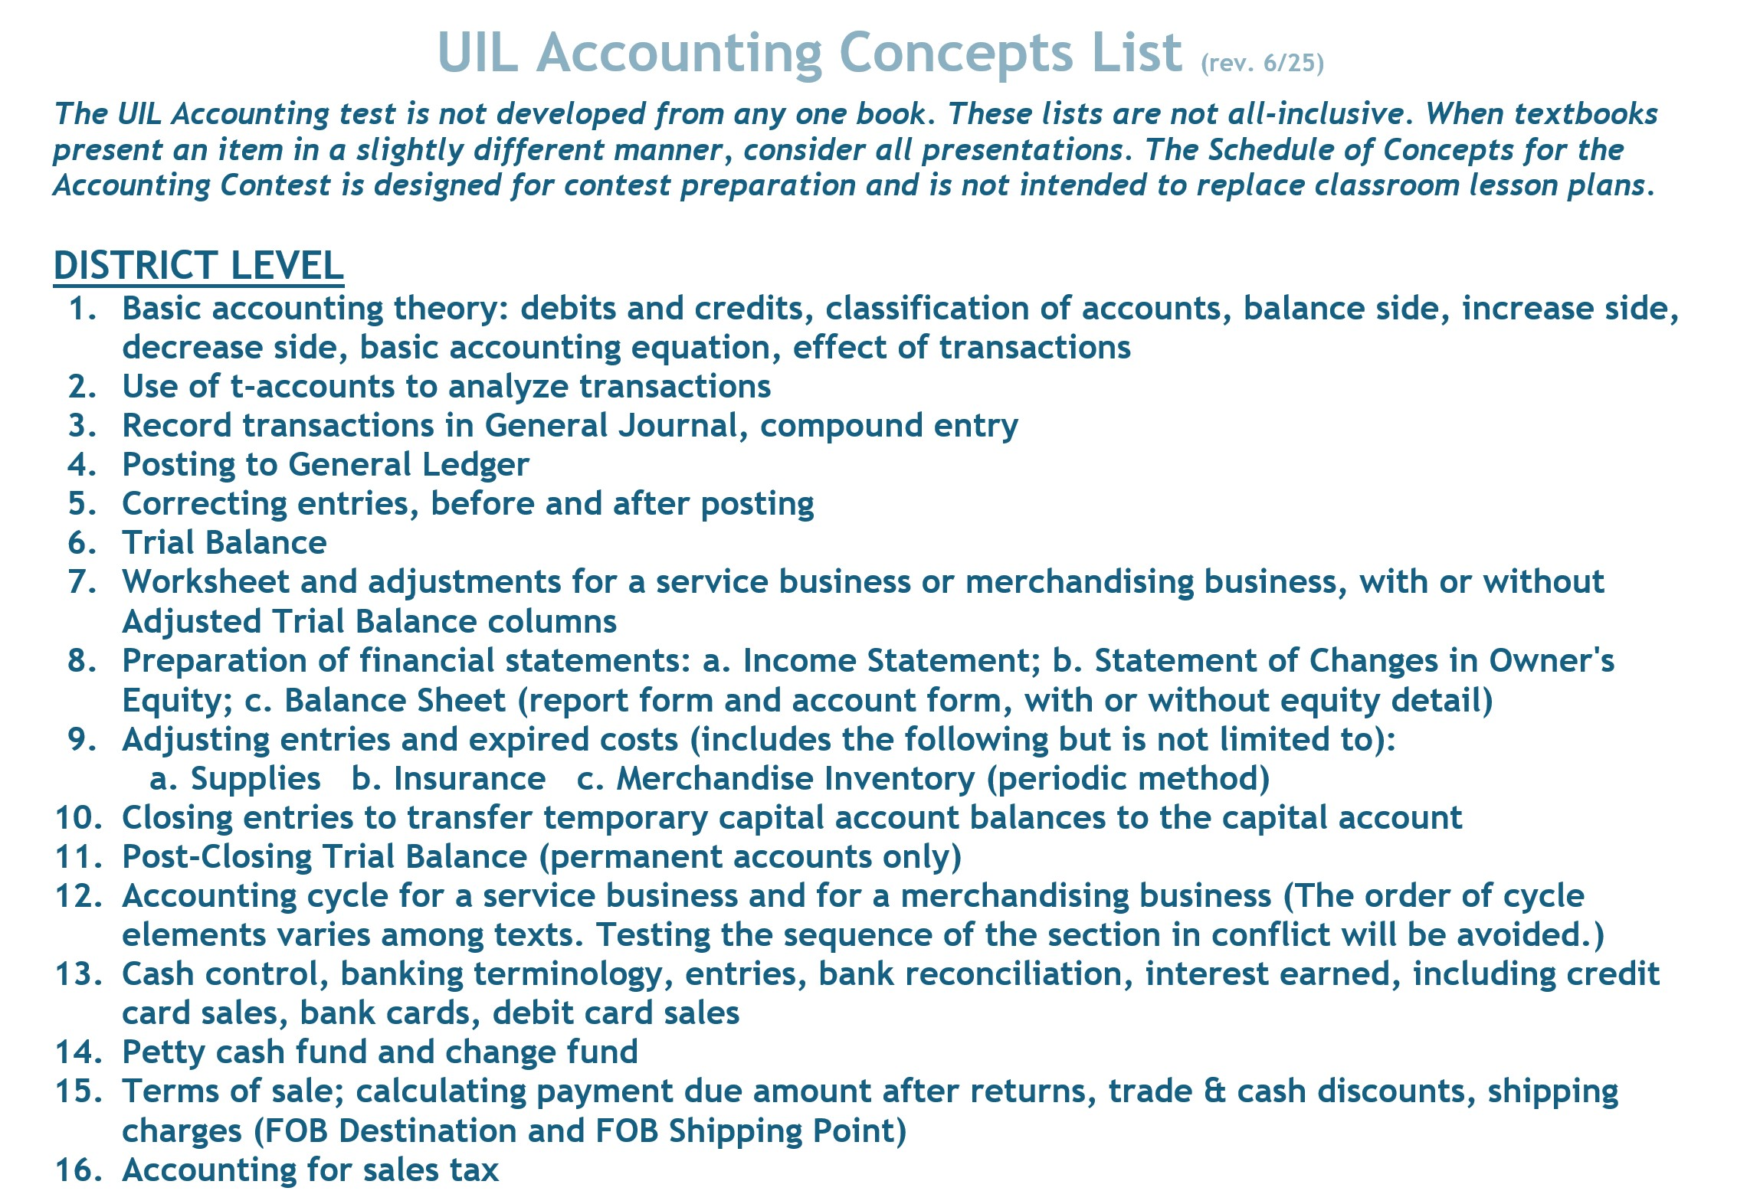
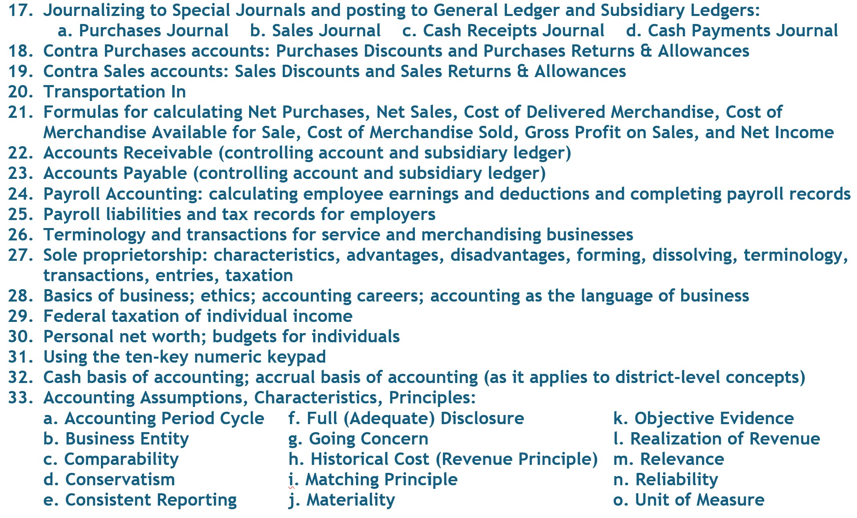
Invitational/District Accounting
Concepts
(revised 6/25)

Slide 10
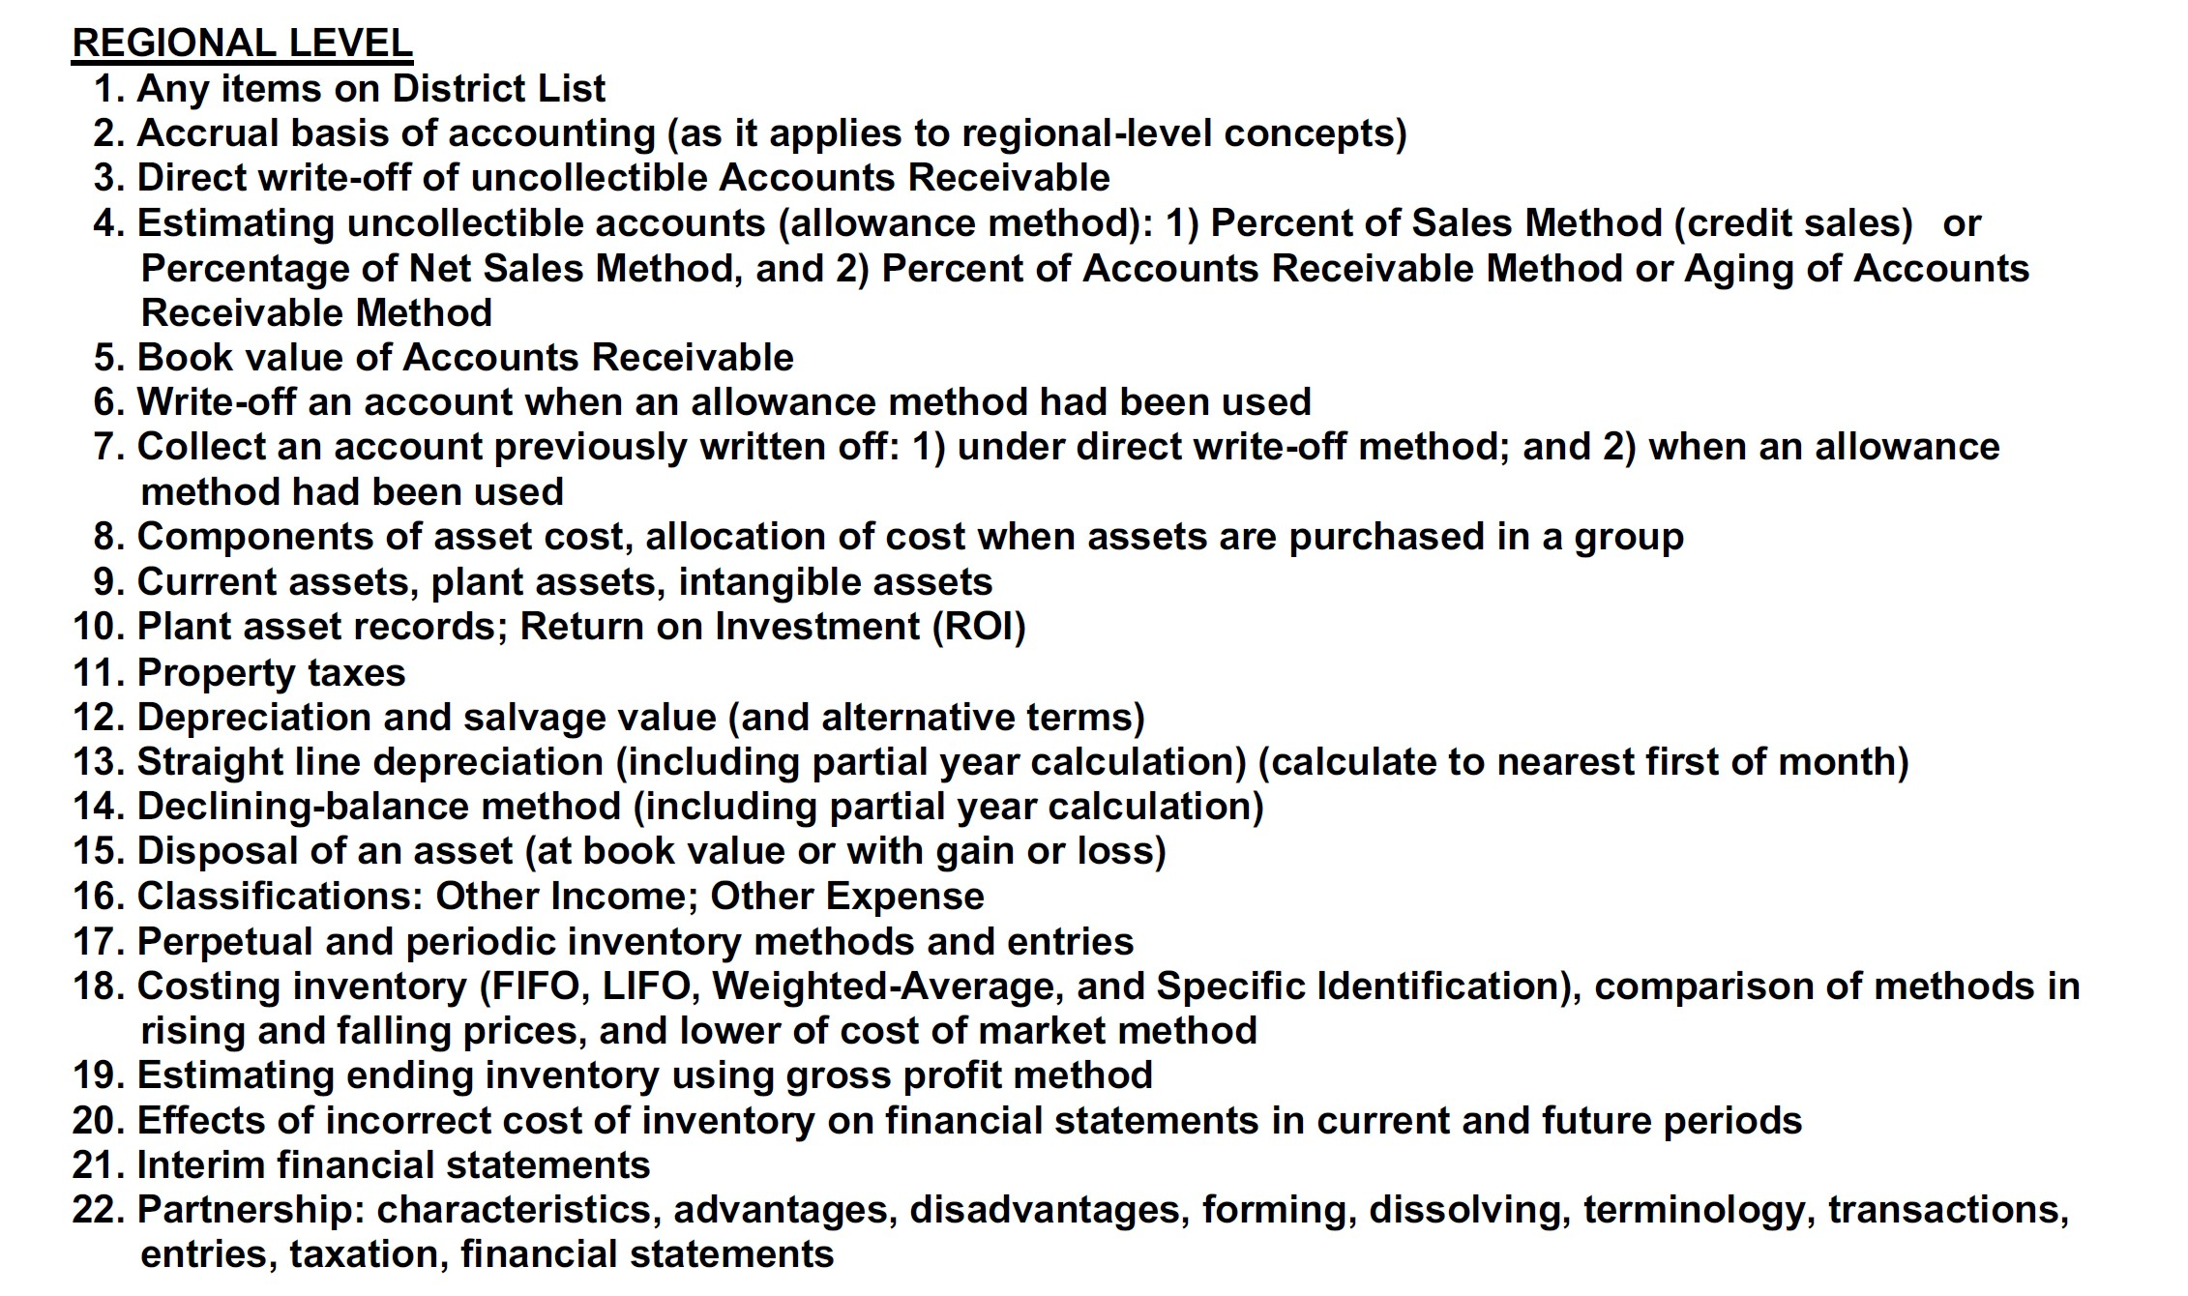
Regional
Accounting
Concepts
(former)

Slide 11
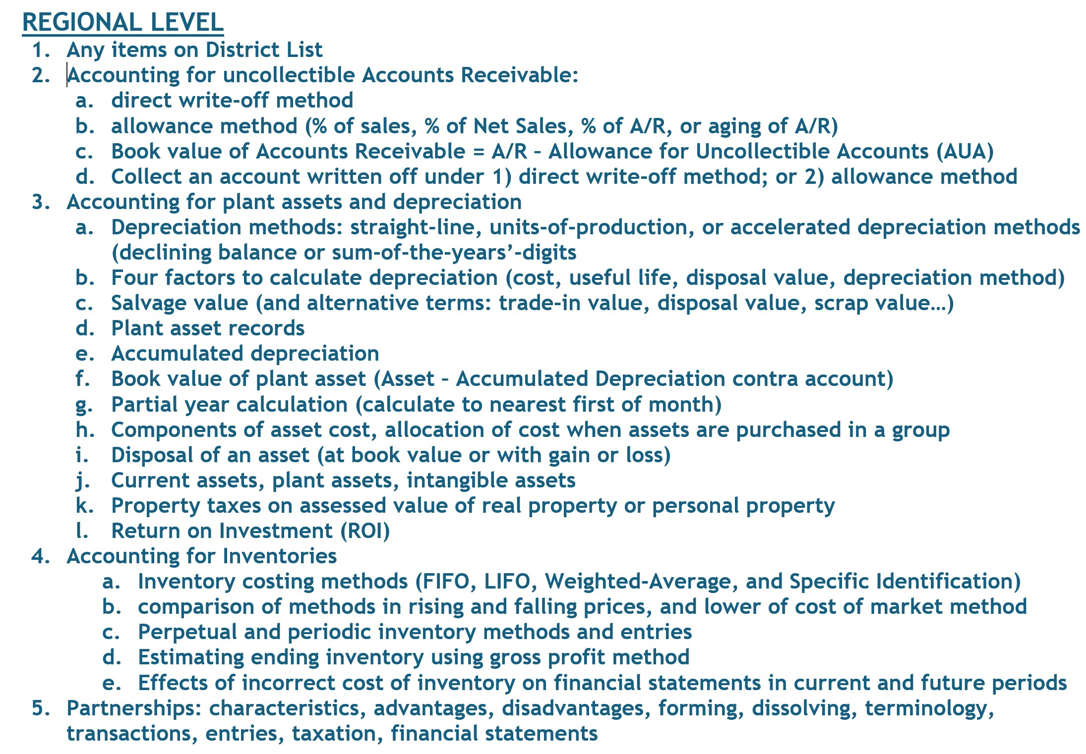
Regional Accounting
Concepts
(revised 6/25)

Slide 12
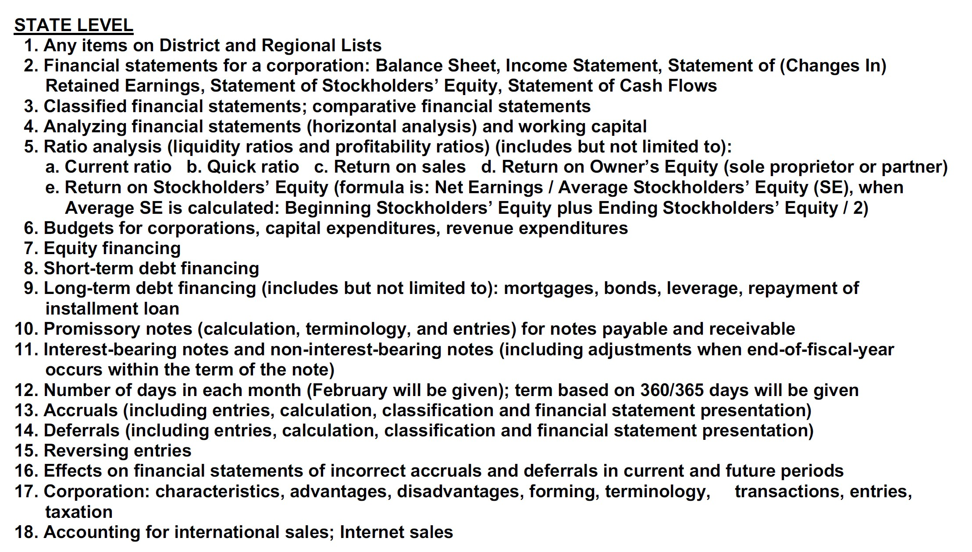
State Accounting
Concepts
(former)

Slide 13
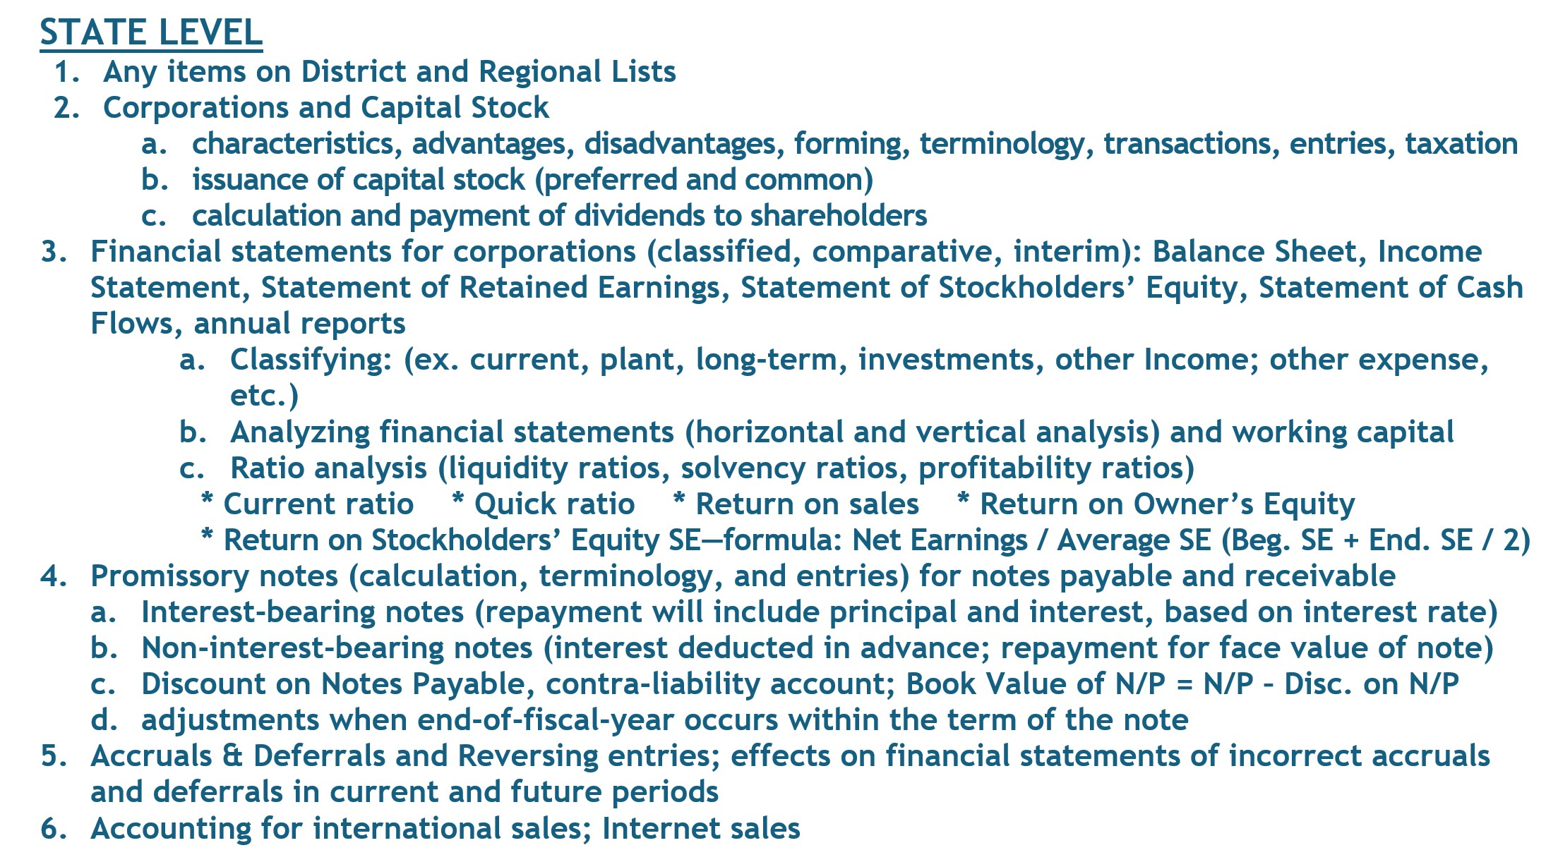
State Accounting
Concepts
(revised 6/25)

Slide 14
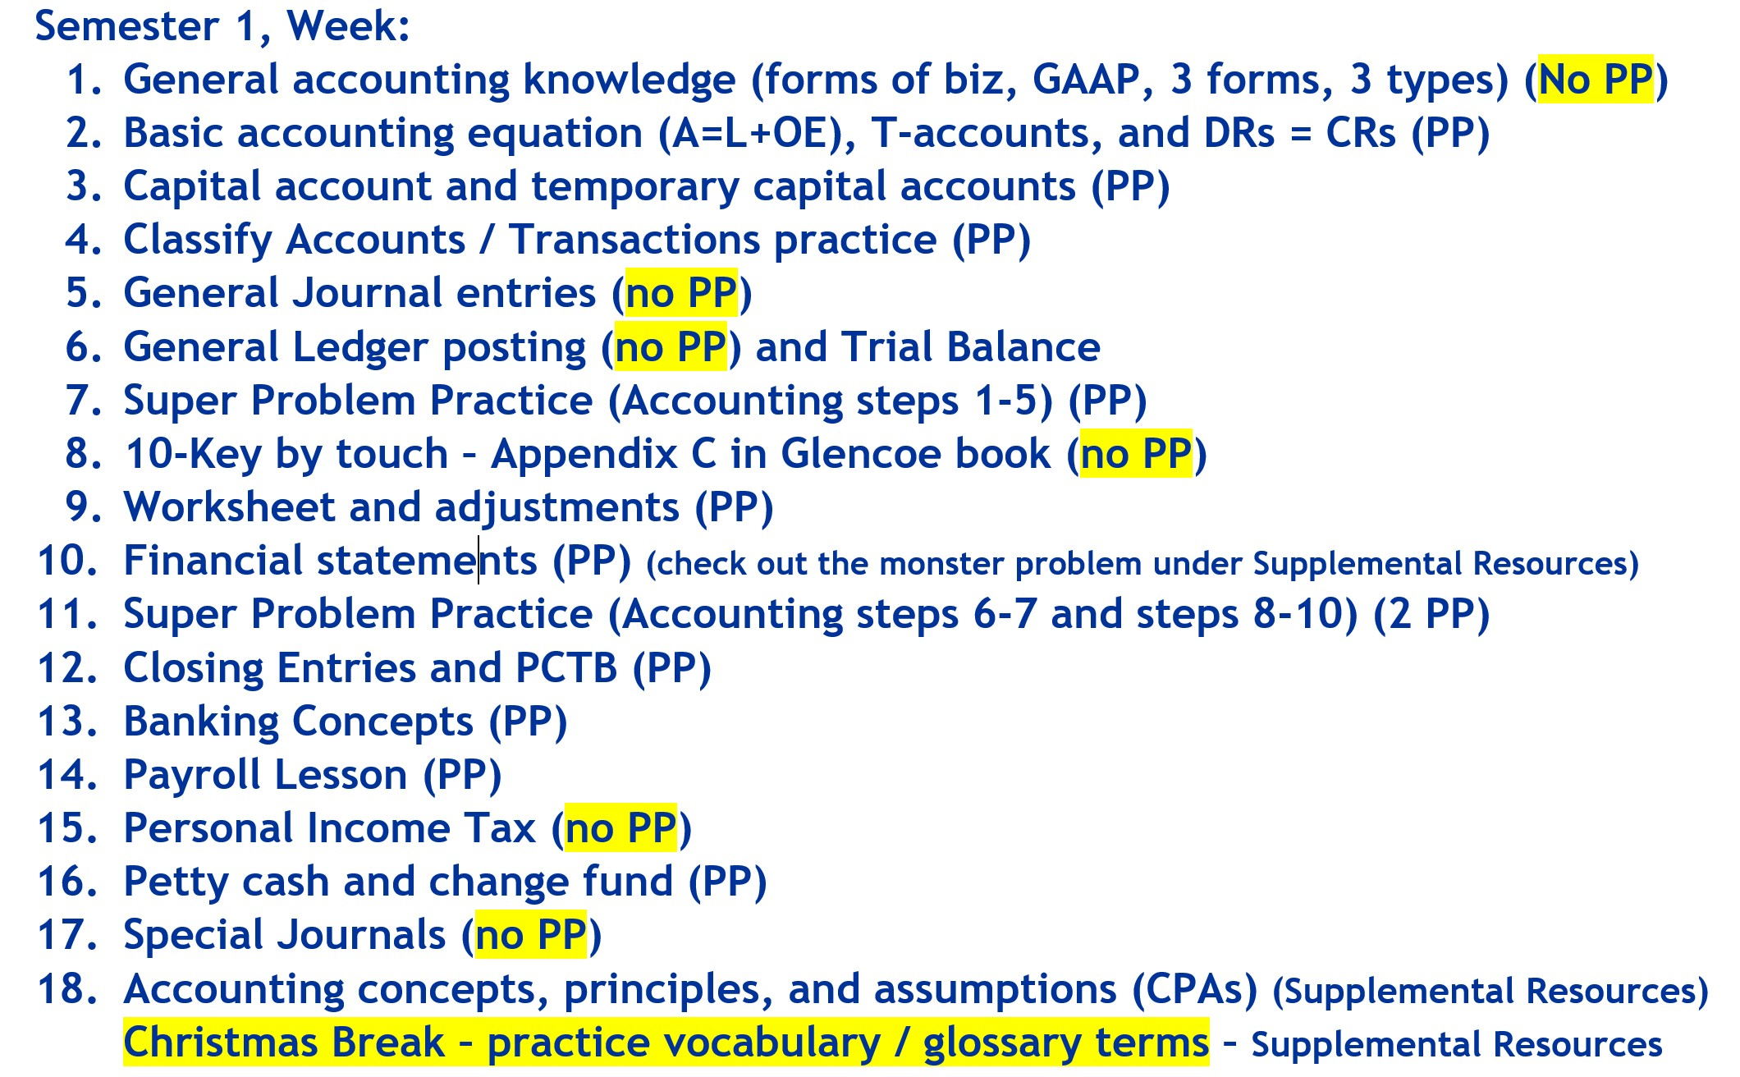
Accounting
Rocks!
Accounting Rocks!
Game Plan
(CapCon handout)
Based mainly on the concepts list…
Semester 1
https://
accountingrocks.net/videos/

Slide 15
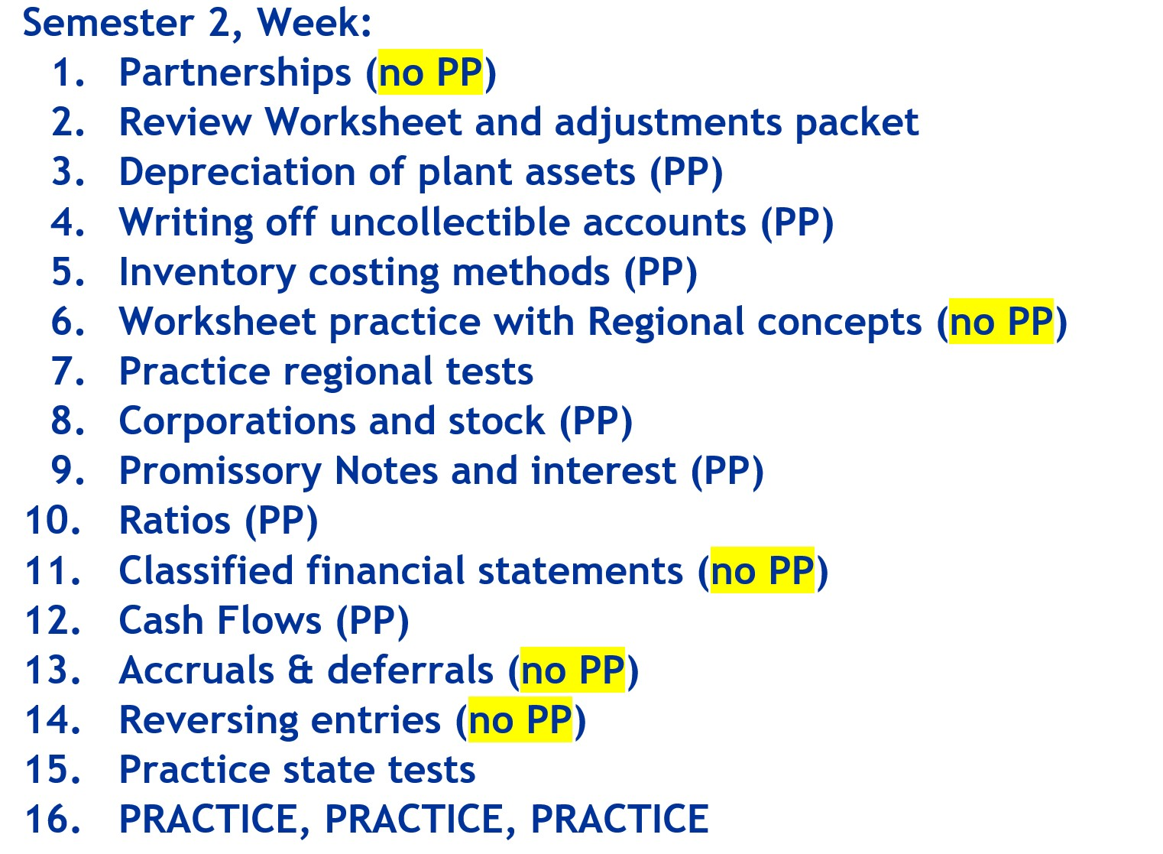
Accounting
Rocks!
Accounting Rocks!
Game Plan
(CapCon handout)
Regional and
State concepts …
Semester 2
https://
accountingrocks.net/videos/

Slide 16
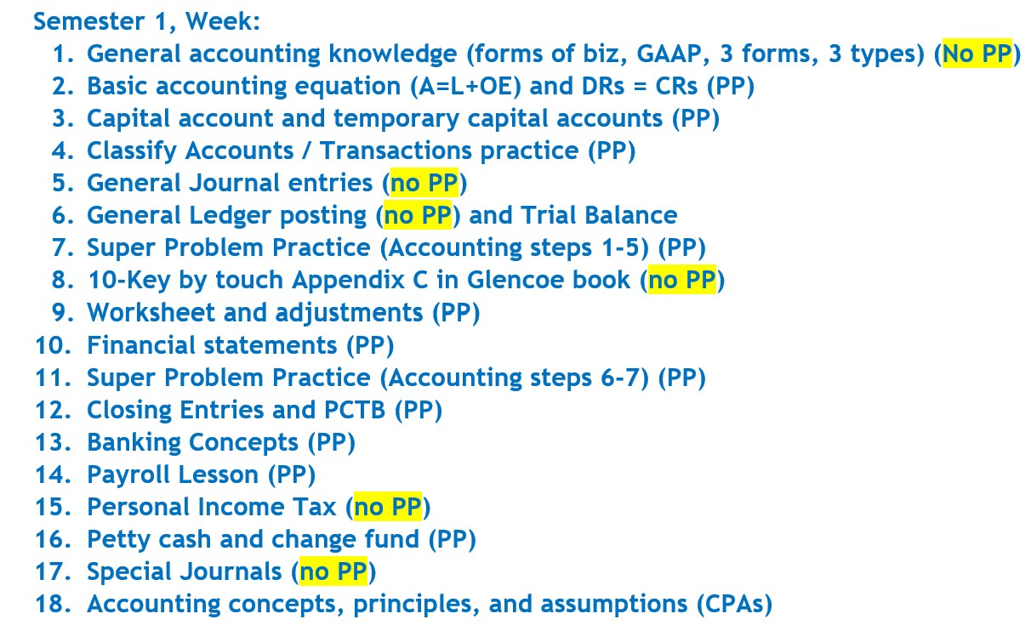
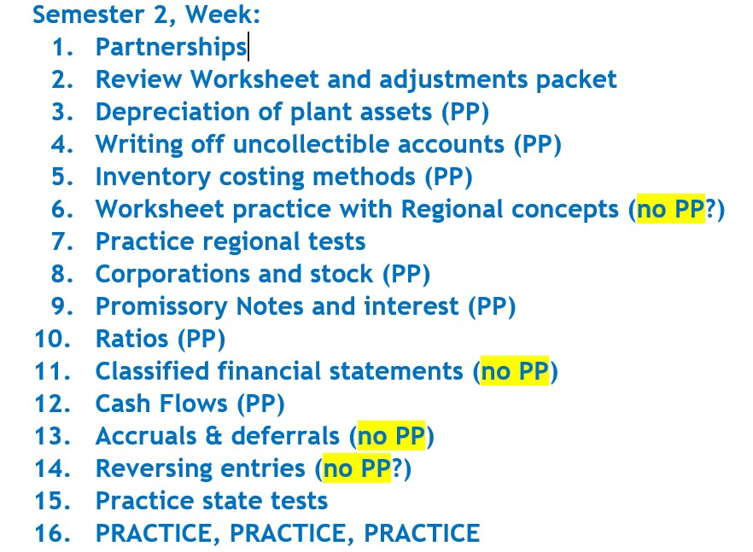
Accounting
Rocks!
Open your Game Plan handout while we look at the website…
https://accountingrocks.net/videos/

Slide 17
Bring your students to a SAC near you!
Sept 13 University of Texas RGV, Edinburg
Sept 27 West Texas A&M University, Canyon
Oct 25 University of Texas at Austin
Nov 1 Richland High School, Prosper

Slide 18

Contact Kay at
kaywhitton@gmail.com
Free resources at
accountingrocks.net

Slide 19


