Slide 1
Accounting UIL
Petty Cash & Change Fund Lesson
Kay Whitton
State accounting director

Slide 2


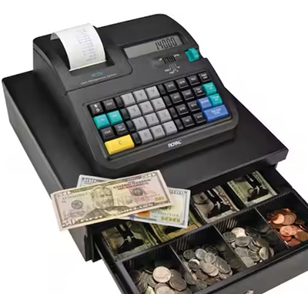

Most of a business’s cash is in its Cash in Bank account.
But there are two other accounts it keeps $ in...
A small amount of cash kept on hand for small or incidental expenses, with bills and small change kept in a lock box or safe.
A set amount of money kept on hand by stores
to make change for customers at cash registers.

Slide 3
For each fund, the procedure to create the fund is the same:
Write a check to get cash from the bank…
Put the $ in the box or register.
To journalize the transaction:
DR Petty Cash
CR Cash
To journalize the transaction:
DR Change Fund
CR Cash

Slide 4
Each fund has cash on hand used for different purposes…
Making change for customers or accepting payment from charge customers at the register.
Typical transactions would be paying a delivery driver or taking cash to buy stamps or supplies.

Slide 5
Let’s start with reconciling the Change Fund…
The cashier starts off with an exact amount of cash each day
At the end of each day, a cash proof is done to reconcile the cash
Amounts on the cash register tape are used on the cash proof
The same amount of cash is left in the cash drawer for the next day

Slide 6
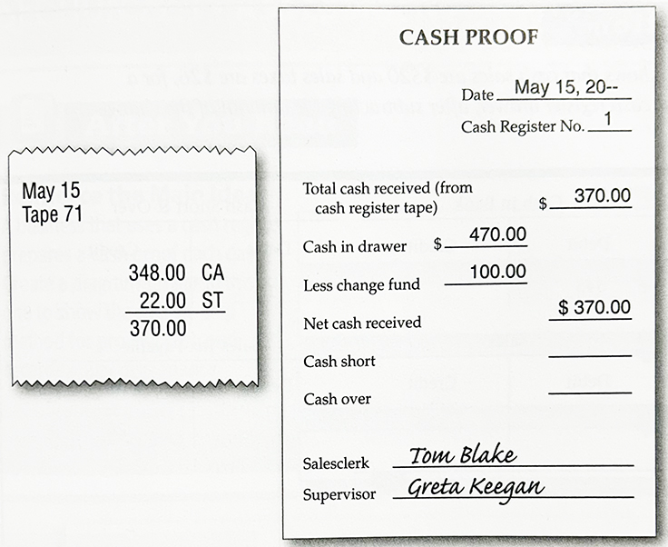
The tape shows $370 cash was received.
Cash counted in the drawer was $470
Less:
starting cash $100
= $370 which matches the tape

Slide 7
To journalize the day’s sales and sales tax…
DR Cash 370
CR Sales 348
CR Sales Tax Pay. 22

Slide 8

Cashier makes mistakes in making correct change
Customer says ‘keep the change’
All cash received as shown on the tape would always equal the amount in the drawer…
But mistakes happen:
Coins get dropped accidentally
Cash is taken (it happens)

Slide 9
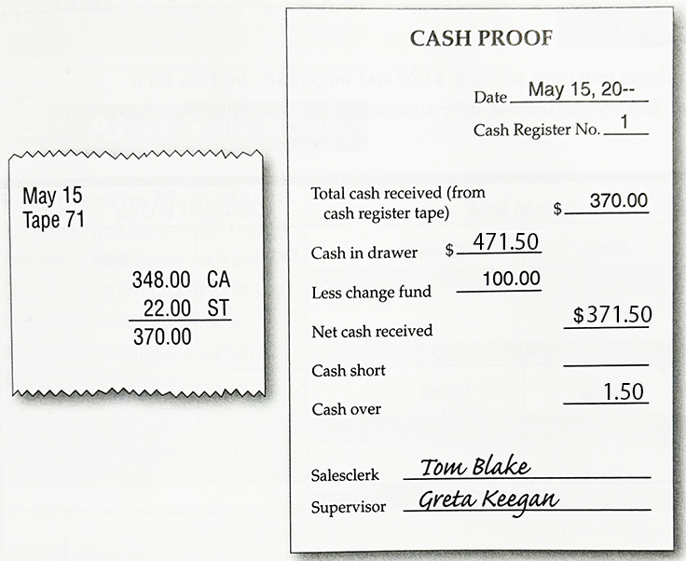
Situation #2
The tape shows $370 cash was received.
Cash counted in the drawer was $471.50
Less:
starting cash $100
= $371.50 which means
we have 1.50 cash OVER

Slide 10
When the amounts do not equal, we use an account called Cash Short and Over
DR Cash 371.50
CR Sales 348.00
CR Sales Tax Pay 22.00
CR Cash Over 1.50

Slide 11
Cash Short and Over doesn’t have a normal
DR or CR balance
If there is less cash than the tape indicates, it is CASH SHORT, so it is Debited
(like extra expense)
If there is more cash than the tape indicates, it is CASH OVER, so it
is Credited
(like extra revenue)

Slide 12
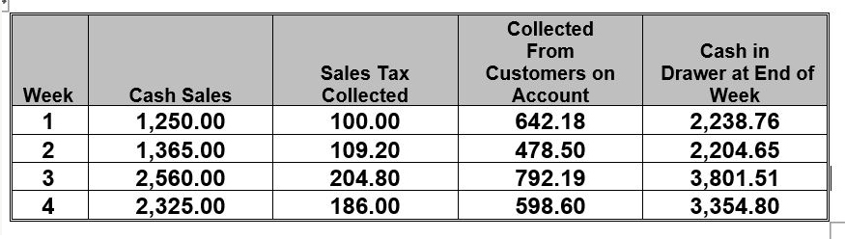
Sample Change Fund Problem

Slide 13
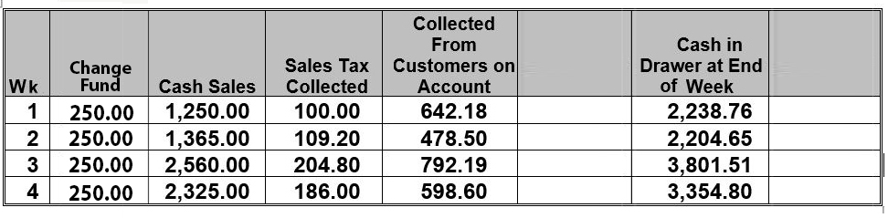
And How To Solve It!
(Amounts for 4 weeks added for monthly totals)
Sales (Rev.) Increased
Sales Tax (Liab.)
Increased
A/R (asset) Decreased
Cash (asset) Increased
+
+
+
=
-
Actual
=
Cash
<Short>
Over
Expected Cash
2242.18
2202.70
3806.99
3359.60
11,611.47
< 3.42 >
1.95
< 5.48 >
< 4.80>
<11.75 >
7500.00
600.00
2511.47
11,599.72
-(4x250=1000)
= 10,599.72
To be deposited

Slide 14
So to journalize the month’s cash drawer:
DR Cash 10,599.72
DR Cash Short 11.75
CR Sales 7,500.00
CR Sales Tax Pay 600.00
CR A/R 2,511.47
DR =10,611.47
CR = 10,611.47

Slide 15
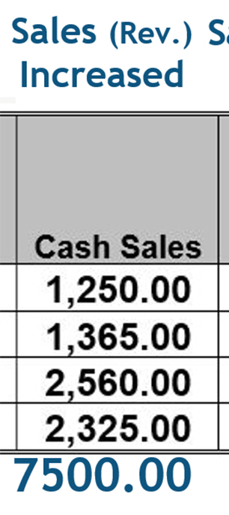
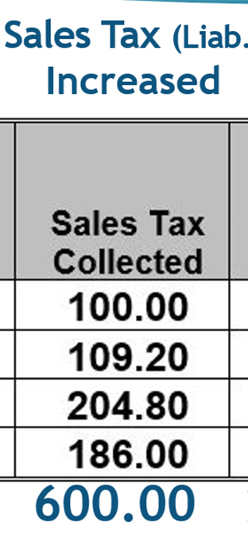
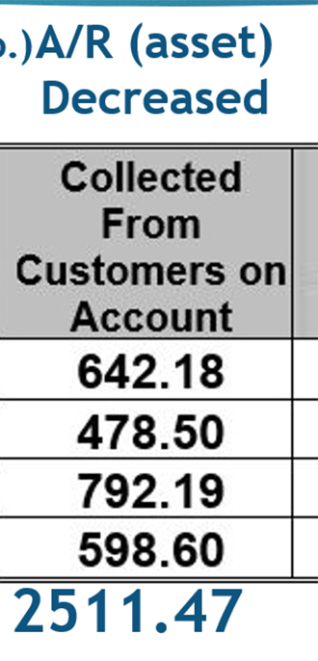
Sample Questions from a UIL test…
23. The total sales for the month of January are:
A. $6,500 B. $7,500 C. $8,100 D. $8,488.25 E. $8,500 F. $10,011.47
24. By what amount was a liability account increased for the month of January?
A. $0.00 B. $11.75 C. $600
D. $618.75 E. $2,511.47
25. By what amount was an asset account decreased for the month of January?
A. $0.00 B. $600 C. $1,000
D. $2,511.47 E. $7,500

Slide 16
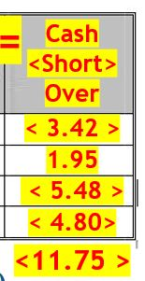
More Questions from a UIL test…
27. The sales tax rate is
A. 5% B. 7.75% C. 8%
D. 8.25% E. 8.75%
*28. For the month of January, the cash fund was over or short and by what amount?
Amount Over/Short
A. zero neither
B. $3.42 short
C. $11.75 short
D. $1.95 over
E. $11.75 over
F. $988.25 short
600 ÷ 7500 = .08 or 8%

Slide 17
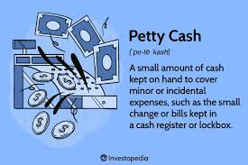
Now, let’s look at the Petty Cash fund:

Slide 18
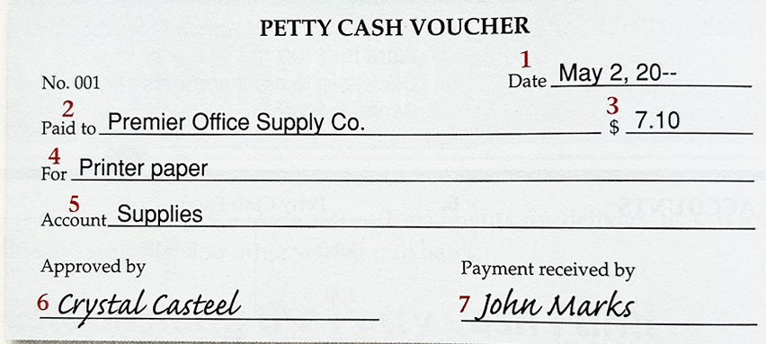
Petty Cash voucher:
(prepared for each payment)
#1 Date
#2 Person/biz. payment goes to
#3 Amount of the payment
#4 Reason for the payment
#5 Account to be debited
#6 signature of the petty cashier
#7 signature of person getting $

Slide 19
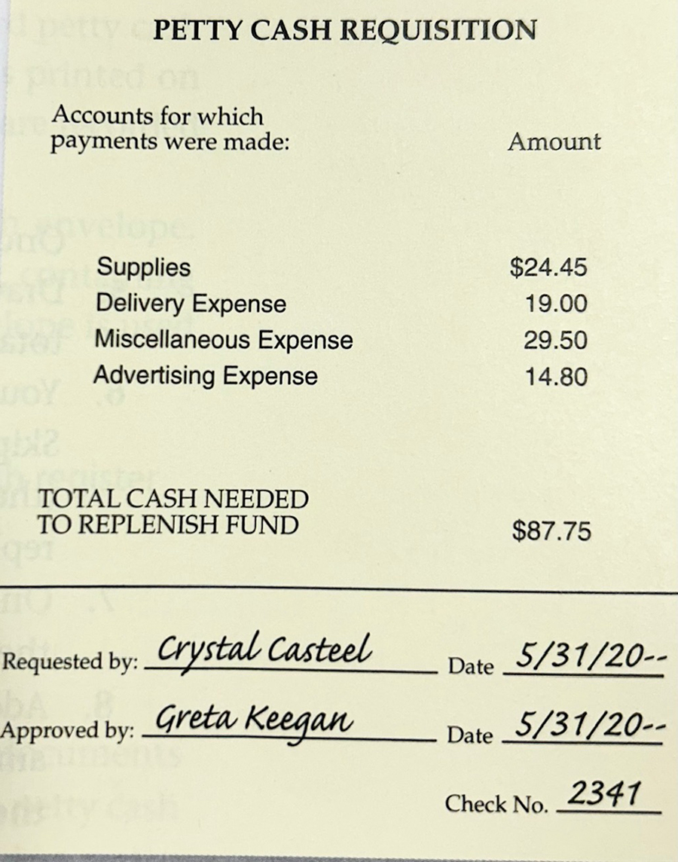
Time to Replenish…
The remaining Cash in the box is counted
The vouchers are totaled and summarized
The requisition form is completed
A check is obtained and cashed
$ is added back to the box

Slide 20
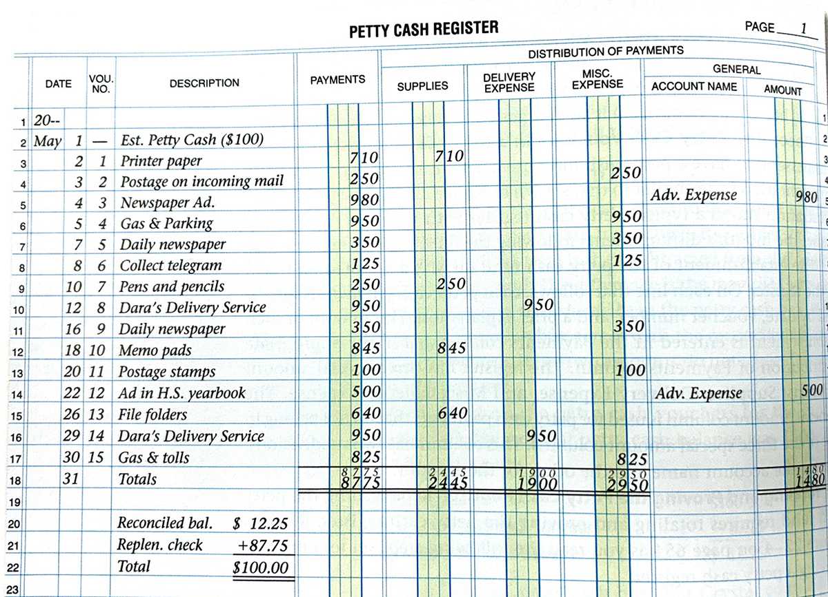
For some businesses,
the petty cashier completes a petty cash register with all the monthly disbursements

Slide 21
Either way, the fund is replenished at the end of the month and journalized:
DR Supplies 24.45
DR Del. Exp. 19.00
DR Misc. Exp. 29.50
DR Adv. Exp. 14.80
CR Cash 87.75

Slide 22
Cashier makes mistakes in making correct change
Customer says ‘keep the change’
The total of the petty cash vouchers would always balance with the amount shown on the register…
But mistakes happen:
Coins get dropped accidentally
Cash is taken (it happens)

Slide 23
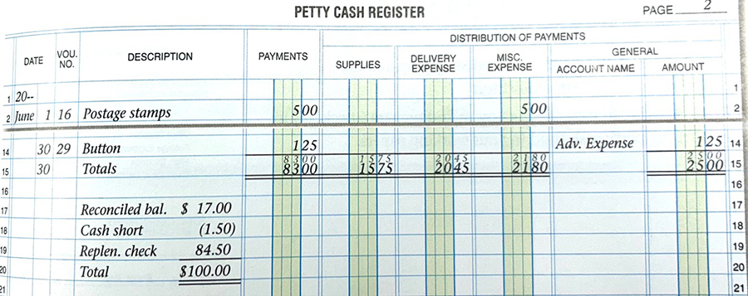
Situation #2
The actual amount in the drawer is subtracted from the fund amount to know how much cash to replenish.
In this case there’s only 15.50 when there should be $17.00, so
CASH IS SHORT

Slide 24
The fund is replenished at the end of the month and journalized:
DR Supplies 15.75
DR Del. Exp. 20.45
DR Misc. Exp. 21.80
DR Adv. Exp. 25.00
DR Cash Short 1.50
CR Cash 84.50

Slide 25
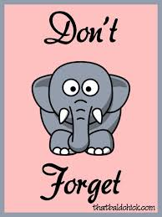
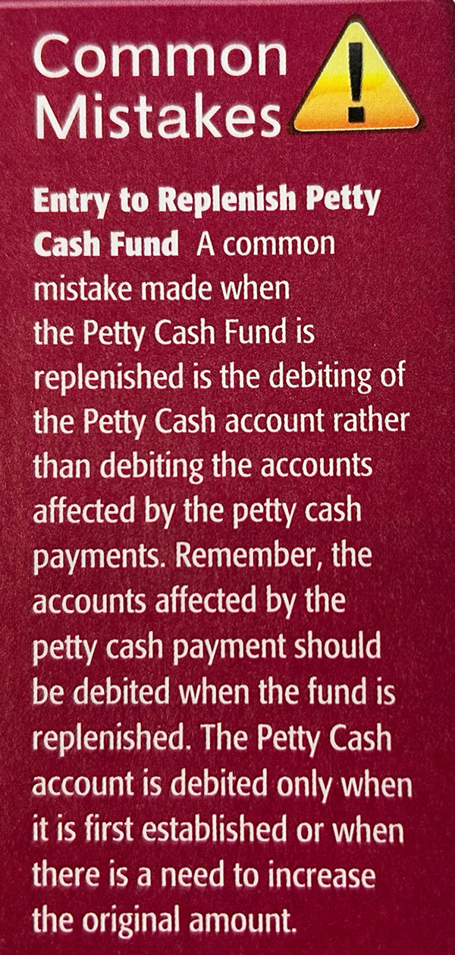
NOT WHEN IT IS REPLENISHED!
Petty Cash is only DR’d when it is established
OR
when it’s increased!

Slide 26
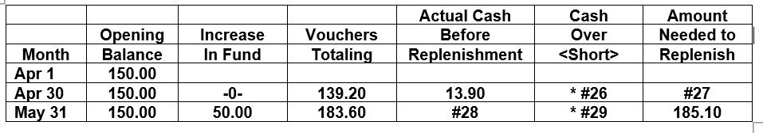
Sample petty cash UIL test questions…
The following chart summarizes the activity in the petty cash fund of a
business for two months. Calculate the amounts needed to complete
the blanks in each line. Cash short must be indicated by < > or ( ).

Slide 27
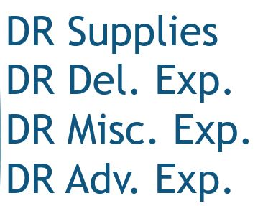
KW’s shortcut way to do petty cash:
(April 30 line from chart)
Summarize all payment categories as ‘Voucher’ Expense
  DR ‘Voucher’ Expense 139.20
  2. Write Cash Short/Over to balance (do you need more DR or CR?)
  CR Cash S/O 3.10 (139.20 – 136.10)
  3. Credit Cash for the amount needed to replenish ($150 – $13.90)
  CR Cash 136.10

Slide 28
KW’s shortcut way to do petty cash:
(May 31 line from chart)
NOTE: PETTY CASH WAS INCREASED BY $50 to $200!
Summarize all voucher categories as ‘Voucher’ Expense
  DR ‘Voucher’ Expense 183.60
  2. Write Cash Short/Over to balance (do you need more DR or CR?)
  DR Cash S/O 1.50 (185.10 – 183.60)
  3. Credit Cash for the amount needed to replenish (given)
  CR Cash 185.10

Slide 29
Cash Short and Over doesn’t have a normal
DR or CR balance
If you need more CREDITS to balance,
CASH OVER
is Credited
(like extra revenue)
If you need more DEBITS to balance,
CASH SHORT
is Debited
(like extra expense)

Slide 30
To solve other unknowns:
Fund Balance
- Actual Cash
= Amt. to Replenish
Fund Balance
- Amt. to Replenish
= Actual Cash

Slide 31

SUCCESS!

