Slide 1

UIL Accounting
PP 6 Closing Entries &
Post-Closing Trial Balance
Kay Whitton
state contest director

Slide 2
Final two steps of the accounting cycle…
Closing Entries
& Post-Closing
Trial Balance
(PCTB)
WS is source for Closing Entries
Move balances to Inc. Summary
Moves NI/NL to capital acct
Post-Closing Trial Balance lists permanent accounts
Temporary accounts start over at 0 for next financial period

Slide 3
CAPITAL FORMULA
(the college kids come Home to Capital)
300 K.M., Capital - OE
— B+
0 Beg.
Cap
3,000 + Inv.
1,800 + Inv.
4,800 = COW
300 + NI
5050 End.
Cap.
- DRAW 50
- NL

Slide 4
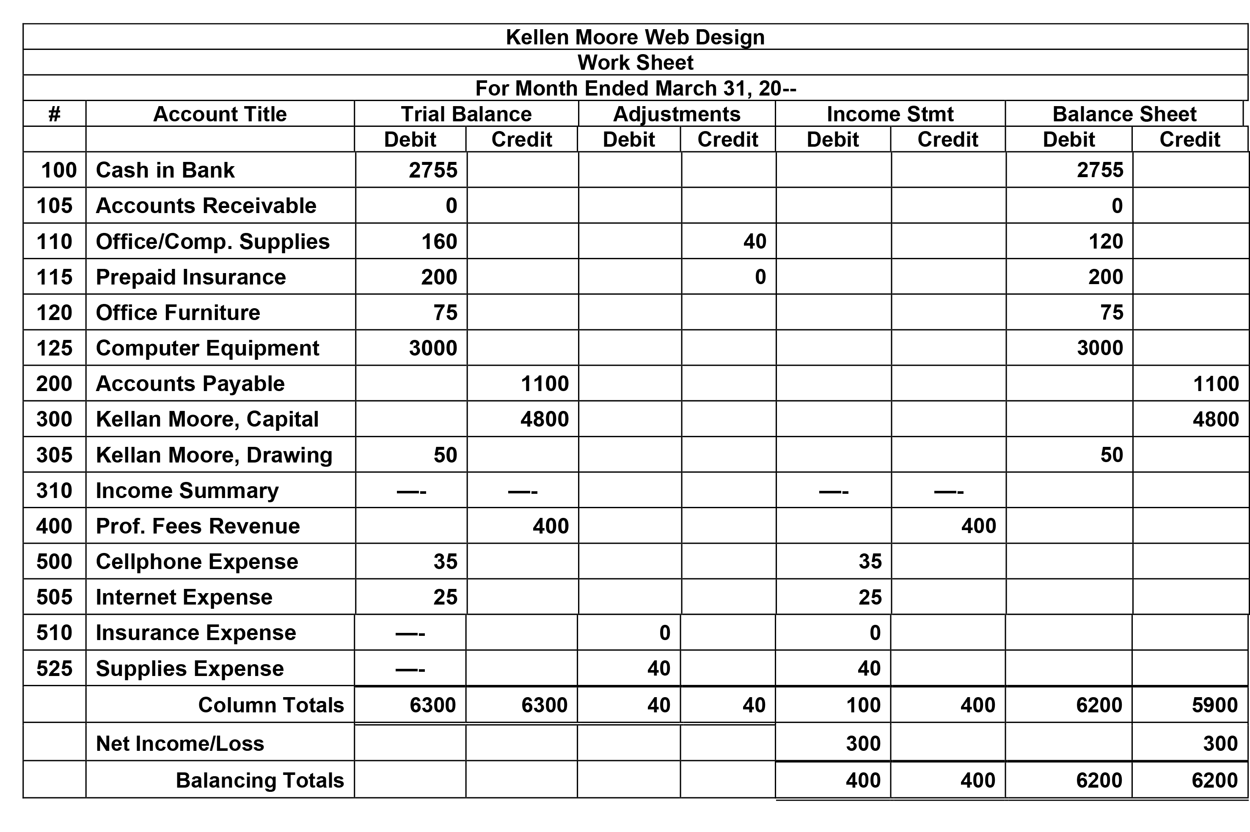
B
The temp. capital accounts listed below Capital will be closed to zero.
I

Slide 5
Order of Closing Entries to zero out the temporary capital accounts…
C-D-I-D
Close IS CRs to Income Summary
Close IS DRs to Income Summary
Close NI/NL to capital acct
Close Drawing to capital acct

Slide 6
Closing Entry #1
Close Revenue accounts to Income Summary
DR = CR
400 Prof. Fees - R
310 Inc. Summary -OE
— B+
— B+
100 (10)
300 (11)
400
CR 400 - R
DR 400
ZERO

Slide 7
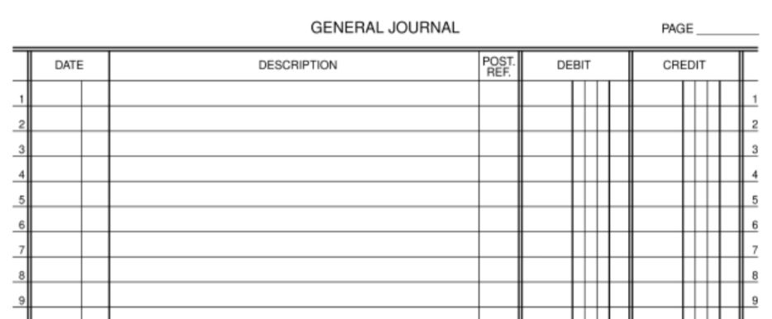
Closing Entry #1 Journalized
5
20—
Closing Entries
Dec 31 Professional Fees 400—
Income Summary 400—

Slide 8
Closing Entry #2
Close Expense accounts to Income Summary
500 Cellphone Exp -E
310 Inc. Summary -OE
B+ -
— B+
35 CR
Exp 100
(8) 35
505 Internet Exp -E
CR 400 - R
ZERO
25 CR
B+ -
(9) 25
525 Supplies Exp -E
ZERO
B+ -
(AE) 40
40 CR
ZERO

Slide 9
Closing Entry #2 Journalized
5
20—
Closing Entries
Dec 31 Professional Fees 400—
Income Summary 400—
31 Income Summary 100—
Cellphone Expense 35—
Internet Expense 25—
Supplies Expense 40—

Slide 10
Closing Entry #3
Close Income Summary (NI) to Capital
300 Capital - OE
310 Inc. Summary -OE
— B+
0 Beg.
Cap
3,000 + Inv.
1,800 + Inv.
4,800 = COW
300 + NI
5050 End.
Cap.
— B+
Exp 100
- DRAW 50
- NL
CR 400 - R
N.I. 300

Slide 11
Closing Entry #3 Journalized
5
20—
Closing Entries
Dec 31 Professional Fees 400—
Income Summary 400—
31 Income Summary 100—
Cellphone Expense 35—
Internet Expense 25—
Supplies Expense 40—
31 Income Summary 300—
Kellen Moore, Capital 300—

Slide 12
Closing Entry #4
Close Drawing to Capital
300 Capital - OE
305 K.M. Drawing - D
— B+
0 BC
3,000 + Inv.
1,800 + Inv.
4,800 = COW
300 + NI
5050 End.
Cap.
B+ -
(6) 50
50
- DRAW 50
- NL

Slide 13
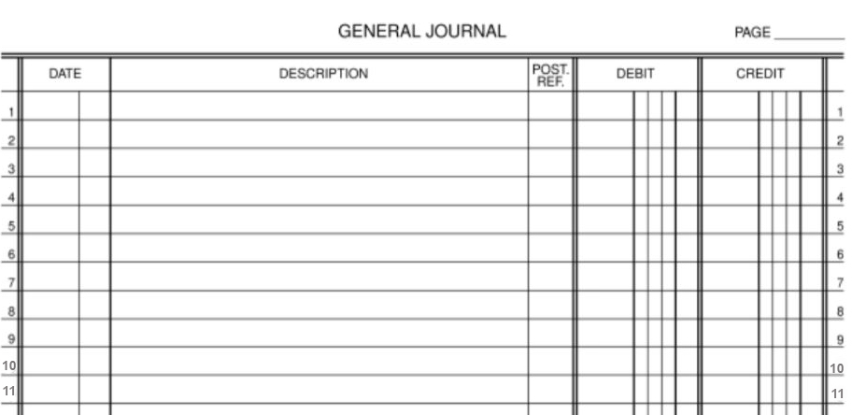
Closing Entry #4 Journalized
5
20—
Closing Entries
Dec 31 Professional Fees 400—
Income Summary 400—
31 Income Summary 100—
Cellphone Expense 35—
Internet Expense 25—
Supplies Expense 40—
31 Income Summary 300—
Kellen Moore, Capital 300—
31 Kellen Moore, Capital 50—
Kellen Moore, Drawing 50—

Slide 14
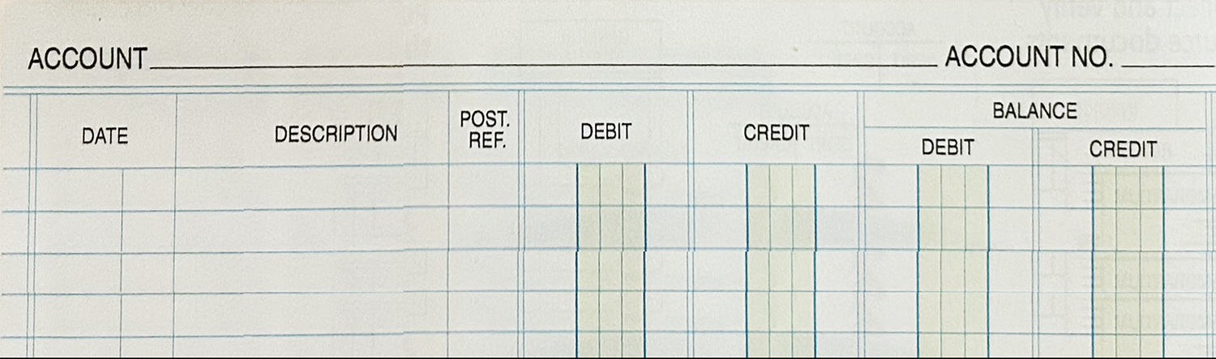
Sample Temporary Accounts after closing
Prof Fees
400
20—
Jan 1 Beg. Bal 0—
J-D 31 G4 400— 400—
Dec 31 Closing Entry G5 400— ——
Supplies Expense
525
20—
Dec 31 Adj. Entry G5 40— 40—
Dec 31Closing Entry G5 40— ——

Slide 15
Capital Account after closing
Kellen Moore, Capital
300
300 Capital - OE
20—
— B+
0 BC
3,000 + Inv.
1,800 + Inv.
4,800 = COW
300 + NI
5050 EndCap
Jan 1 Beg. Bal —0—
J-D 31 Investments G4 4,800— 4800—
Dec 31 Closing Entry G5 300— 5100
31 Closing Entry G5 50— 5050
- DRAW 50
The General Ledger is
a more formal version of the
T-account we’ve been using.

Slide 16
The PCTB is a final check to see if
DR = CR
(Perm. Account balances
ONLY)
PCTB - Post Closing
Trial Balance
DR CR
Cash 2,755
A/R 0
Supplies 120
PPI 200
Ofc.Furn. 75
Comp.Eqp. 3,000
Total DRs 6,150
A/P 1,100
Capital 5,050
(Ending)
Total CRs 6,150

Slide 17
Accounting Cycle
C-A-R-P-T-W-F-A-C-T-R
Pronounce it CarpetWFactor
C – Collect source documents
A – Analyze into Drs and Crs
R – Record in Journal
P – Post to General Ledger
T – Trial Balance
W – Worksheet
F – Financial Statements
A – Adjusting Entries
C – Closing Entries
T – Post-closing Trial Balance
R – Reversing entries (state)

Slide 18

SUCCESS!

