Slide 1

UIL Accounting
PP 5 Financial Statements
Kay Whitton
state contest director

Slide 2
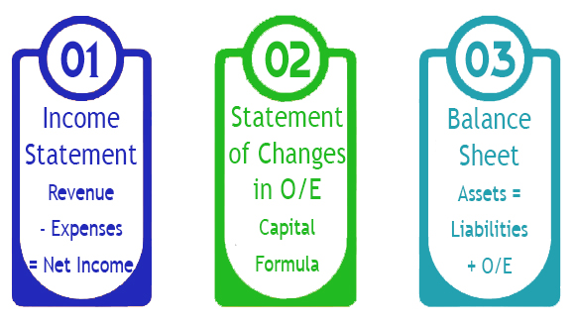
Three types of Financial Statements
(Two primary; one supporting statement)

Slide 3
New concept…
Financial Statements
Source of info is Worksheet
Summarize changes resulting from business transactions during year
Income Statement reports
Net Income or Net Loss
Balance Sheet is a statement of financial position a/o a date
2 Supporting Statements:
SOCIOE and Stmt of Cash Flows

Slide 4
Income Statement
(for service business)
Revenue (earned by a biz- Capital)
- Expenses (costs to earn the revenue)
= Net Income (value added to the O/E acct)
or Net Loss (if expenses > revenue)

Slide 5
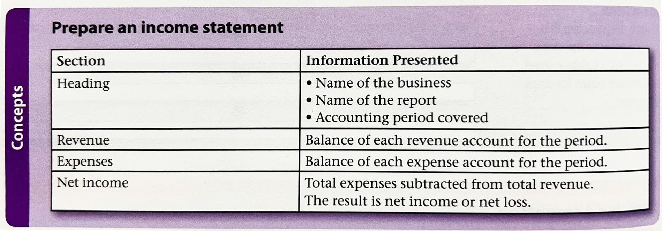
Preparing an Income Statement

Slide 6
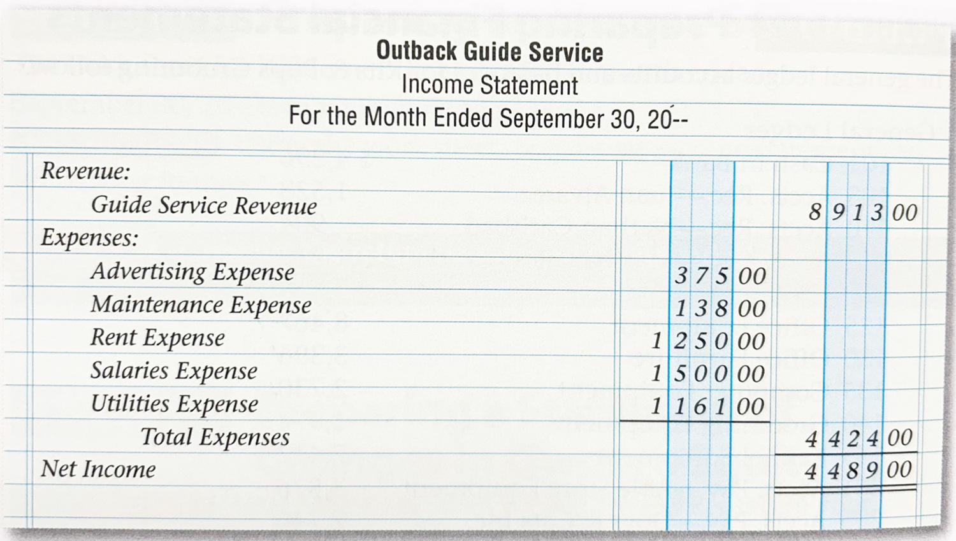
Income Statement Example
(Service Biz)
R
-E
=NI

Slide 7
Income Statement
Formulas
Calculate COGS
(for merchandising biz)
Purchases
+ Trans. In
= Cost of Del. Goods
- Purch Discounts
- Purch Ret & Allow
= NET PURCHASES
+ Beg. Inventory
= Cost of Goods Avail.
- End. Inventory
= Cost of Goods Sold
P
+ TI
= CODG
- PD
- PRA
= NP
+ BI
= COGA
- EI
= COGS

Slide 8
Income Statement Formulas Calculate Net Income
(for merchandising biz)
Sales
- Sales Discounts
- Sales Ret & Allow
= NET SALES
- Cost of Goods Sold
= Gross Profit
- Expenses
= Net Income
S
- SD
- SRA
= NS
- COGS
= GP
- Exp
= NI

Slide 9
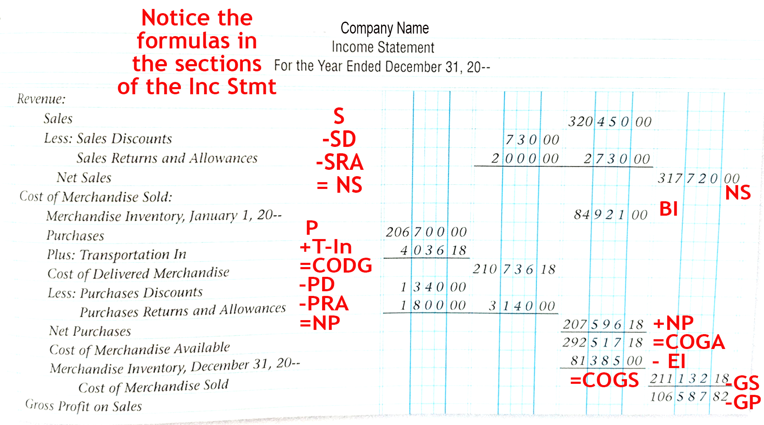
Income Statement - top portion merchandising business

Slide 10
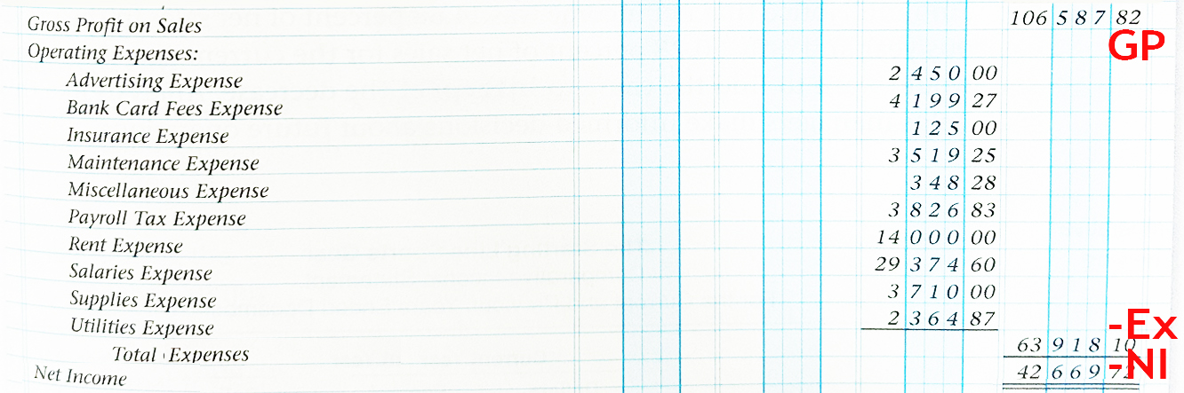
Income Statement - bottom portion merchandising business

Slide 11
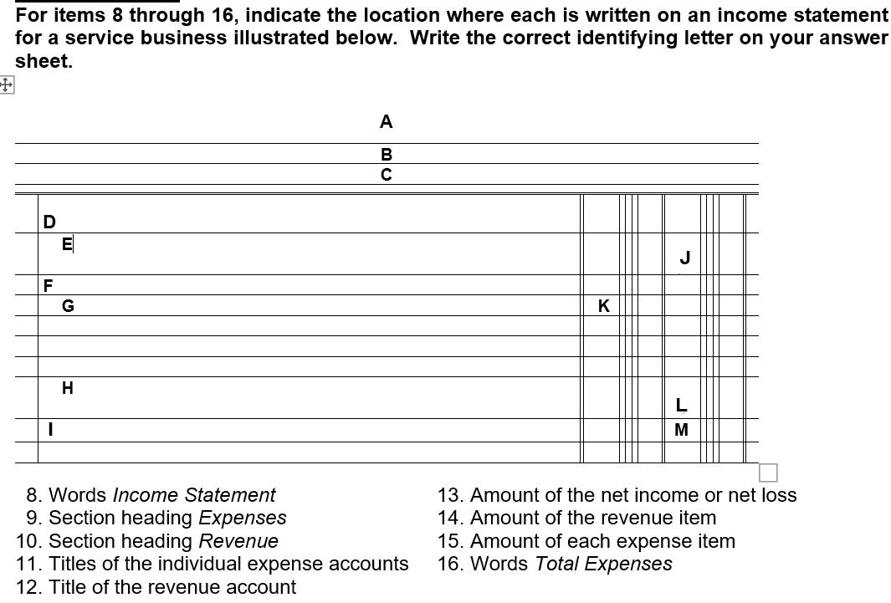
How It
Might be Tested

Slide 12
Who Company Name
What Income Statement
When Date
Revenue:
Service Fees
Rev. Amt:
Expenses:
Advertising Expense, etc.
Exp. Amt:
Total Expenses
Total Exp. Amt:
Net Income
Net Inc. Amt:
B
M
F
J
D
K
G
H
E

Slide 13

Net Income from the Income Statement …
flows to the Statement of Changes in Owner’s Equity

Slide 14
An Important Reminder about Capital on the Worksheet
(COW)
The amount of Capital on the Worksheet is NOT ending capital.
The Income Statement (temporary) accounts will affect the Capital balance, and so will Drawing.

Slide 15
The CAPITAL FORMULA is the Statement of Changes in Owner’s Equity aka SOCIOE
300 K.M., Capital - OE
— B+
0 Beg.
Cap
3,000 + Inv.
1,800 + Inv.
4,800 = COW
300 + NI
5050 End.
Cap.
- DRAW 50
- NL

Slide 16
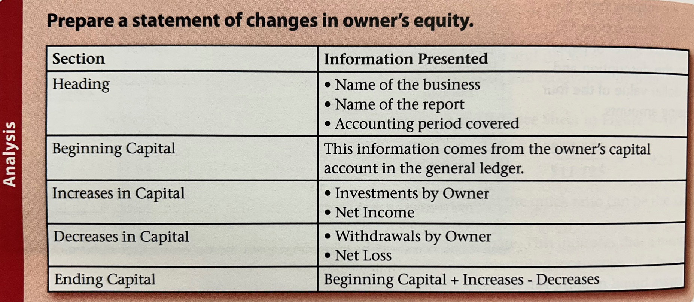
Preparing a SOCIOE

Slide 17
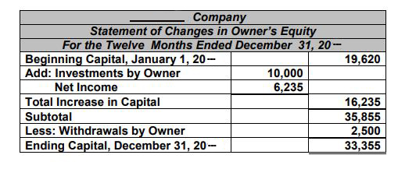
SOCIOE example from test

Slide 18
ENDING CAPITAL on the SOCIOE flows to the Balance Sheet
300 K.M., Capital - OE
The SOCIOE summarizes the impact of the business transactions on the owner’s capital account.
— B+
0 Beg.
Cap
3,000 + Inv.
1,800 + Inv.
4,800 = COW
300 + NI
5050 End.
Cap.
- DRAW 50
- NL

Slide 19
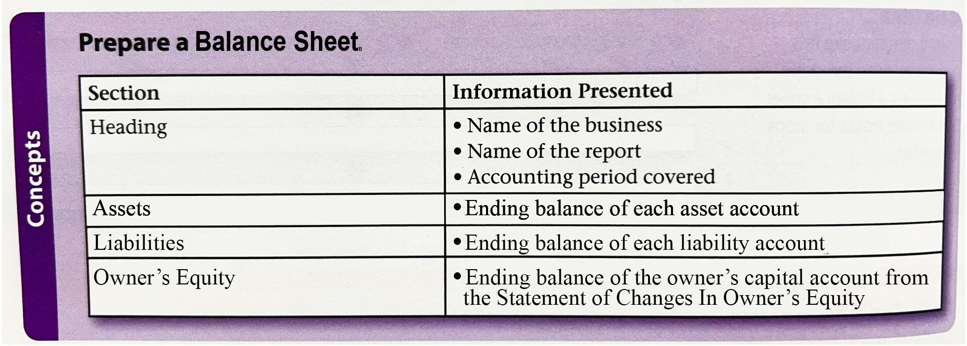
Preparing a Balance Sheet

Slide 20
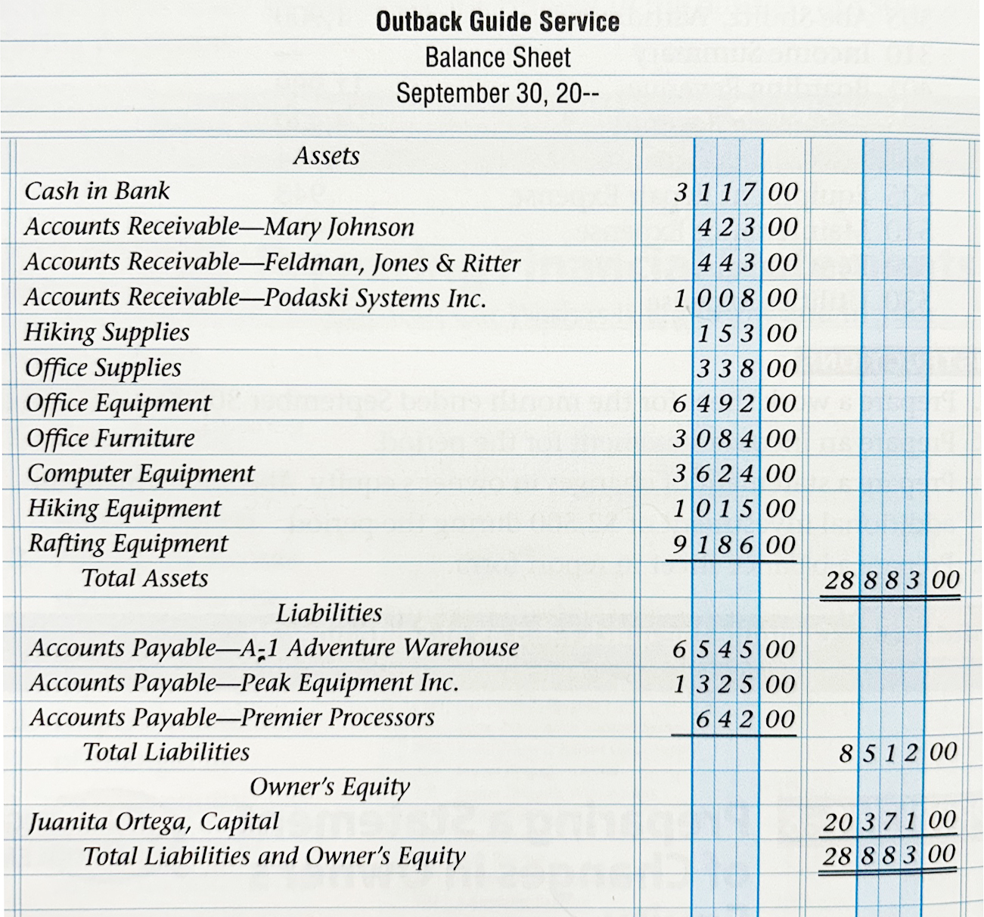
Balance Sheet reports ALOE accounts
(Report form shown lists
A, L, & OE vertically)
A
L
OE

Slide 21
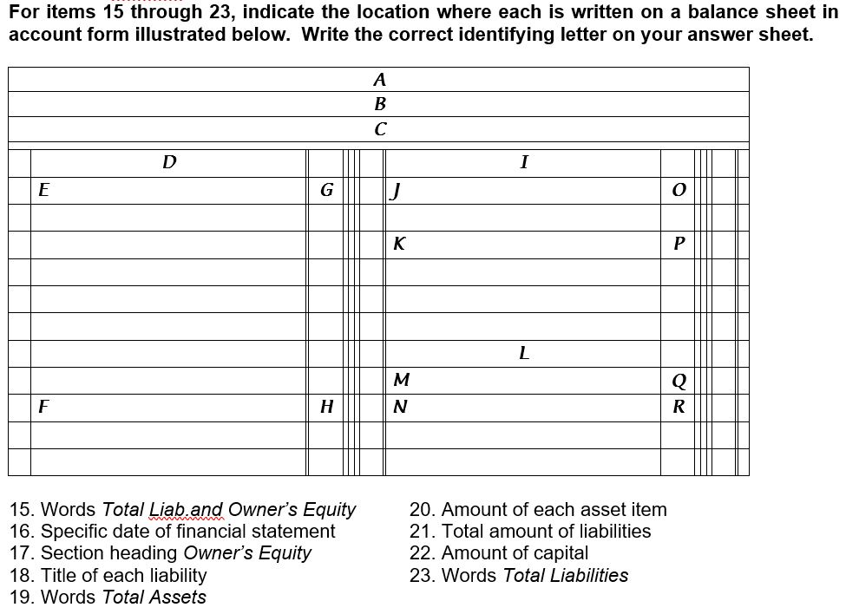
How It
Might be Tested

Slide 22
How It
Might be Tested
(Account form shown shows
A on left;
L & OE on right)
Who Company Name
What Balance Sheet
A
When Date
Assets Heading
L
Liab. Heading
Asset Accts
Liab. Accts
Liab. Amt.
Asset Amt
Total Liab.
Total Liab. Amt.
OE
Owner’s Equity
Total
Asset
Amt.
Cap. Acct.
Capital Amt
Total Assets
Total L & OE
L&OE Amt
N
G
C
P
L
Q
J
K
F

Slide 23
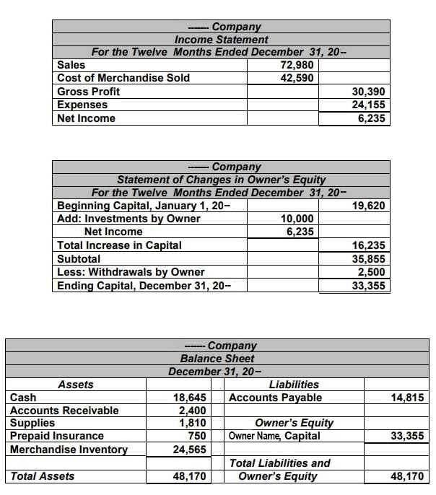
Another method of presenting Financial Statements

Slide 24
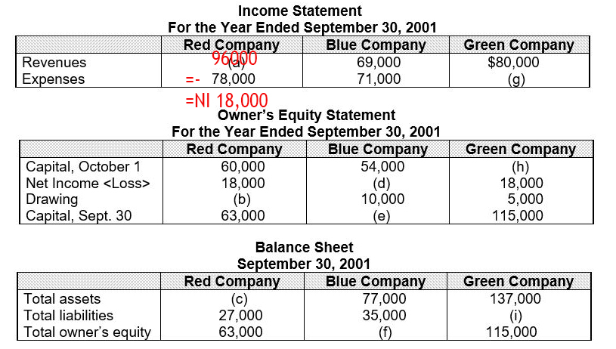
Or solving for the missing amounts…

Slide 25
Statement of Cash Flows is a supporting statement for the financials.
But it is not addressed
in this lesson…
See separate PowerPoint Presentation for Cash Flows Statement

Slide 26
Accounting Cycle
C-A-R-P-T-W-F-A-C-T-R
Pronounce it CarpetWFactor
C – Collect source documents
A – Analyze into Drs and Crs
R – Record in Journal
P – Post to General Ledger
T – Trial Balance
W – Worksheet
F – Financial Statements
A – Adjusting Entries
C – Closing Entries
T – Post-closing Trial Balance
R – Reversing entries (state)

Slide 27

SUCCESS!

