Slide 1

UIL Accounting
PP 4 Worksheet & Adjusting Entries
Kay Whitton
state contest director

Slide 2
Next step of the accounting cycle:
Worksheet
Working paper
Make adjustments
Correct errors
Calculate Net Income (IS cols)
Statement of Position (BS Cols)

Slide 3
Completing the
Worksheet
List accounts & #s in TB
Make sure that DRs = CRs
Record Adjustments
Extend adjusted balances
Calculate column totals
Calculate Net Income

Slide 4
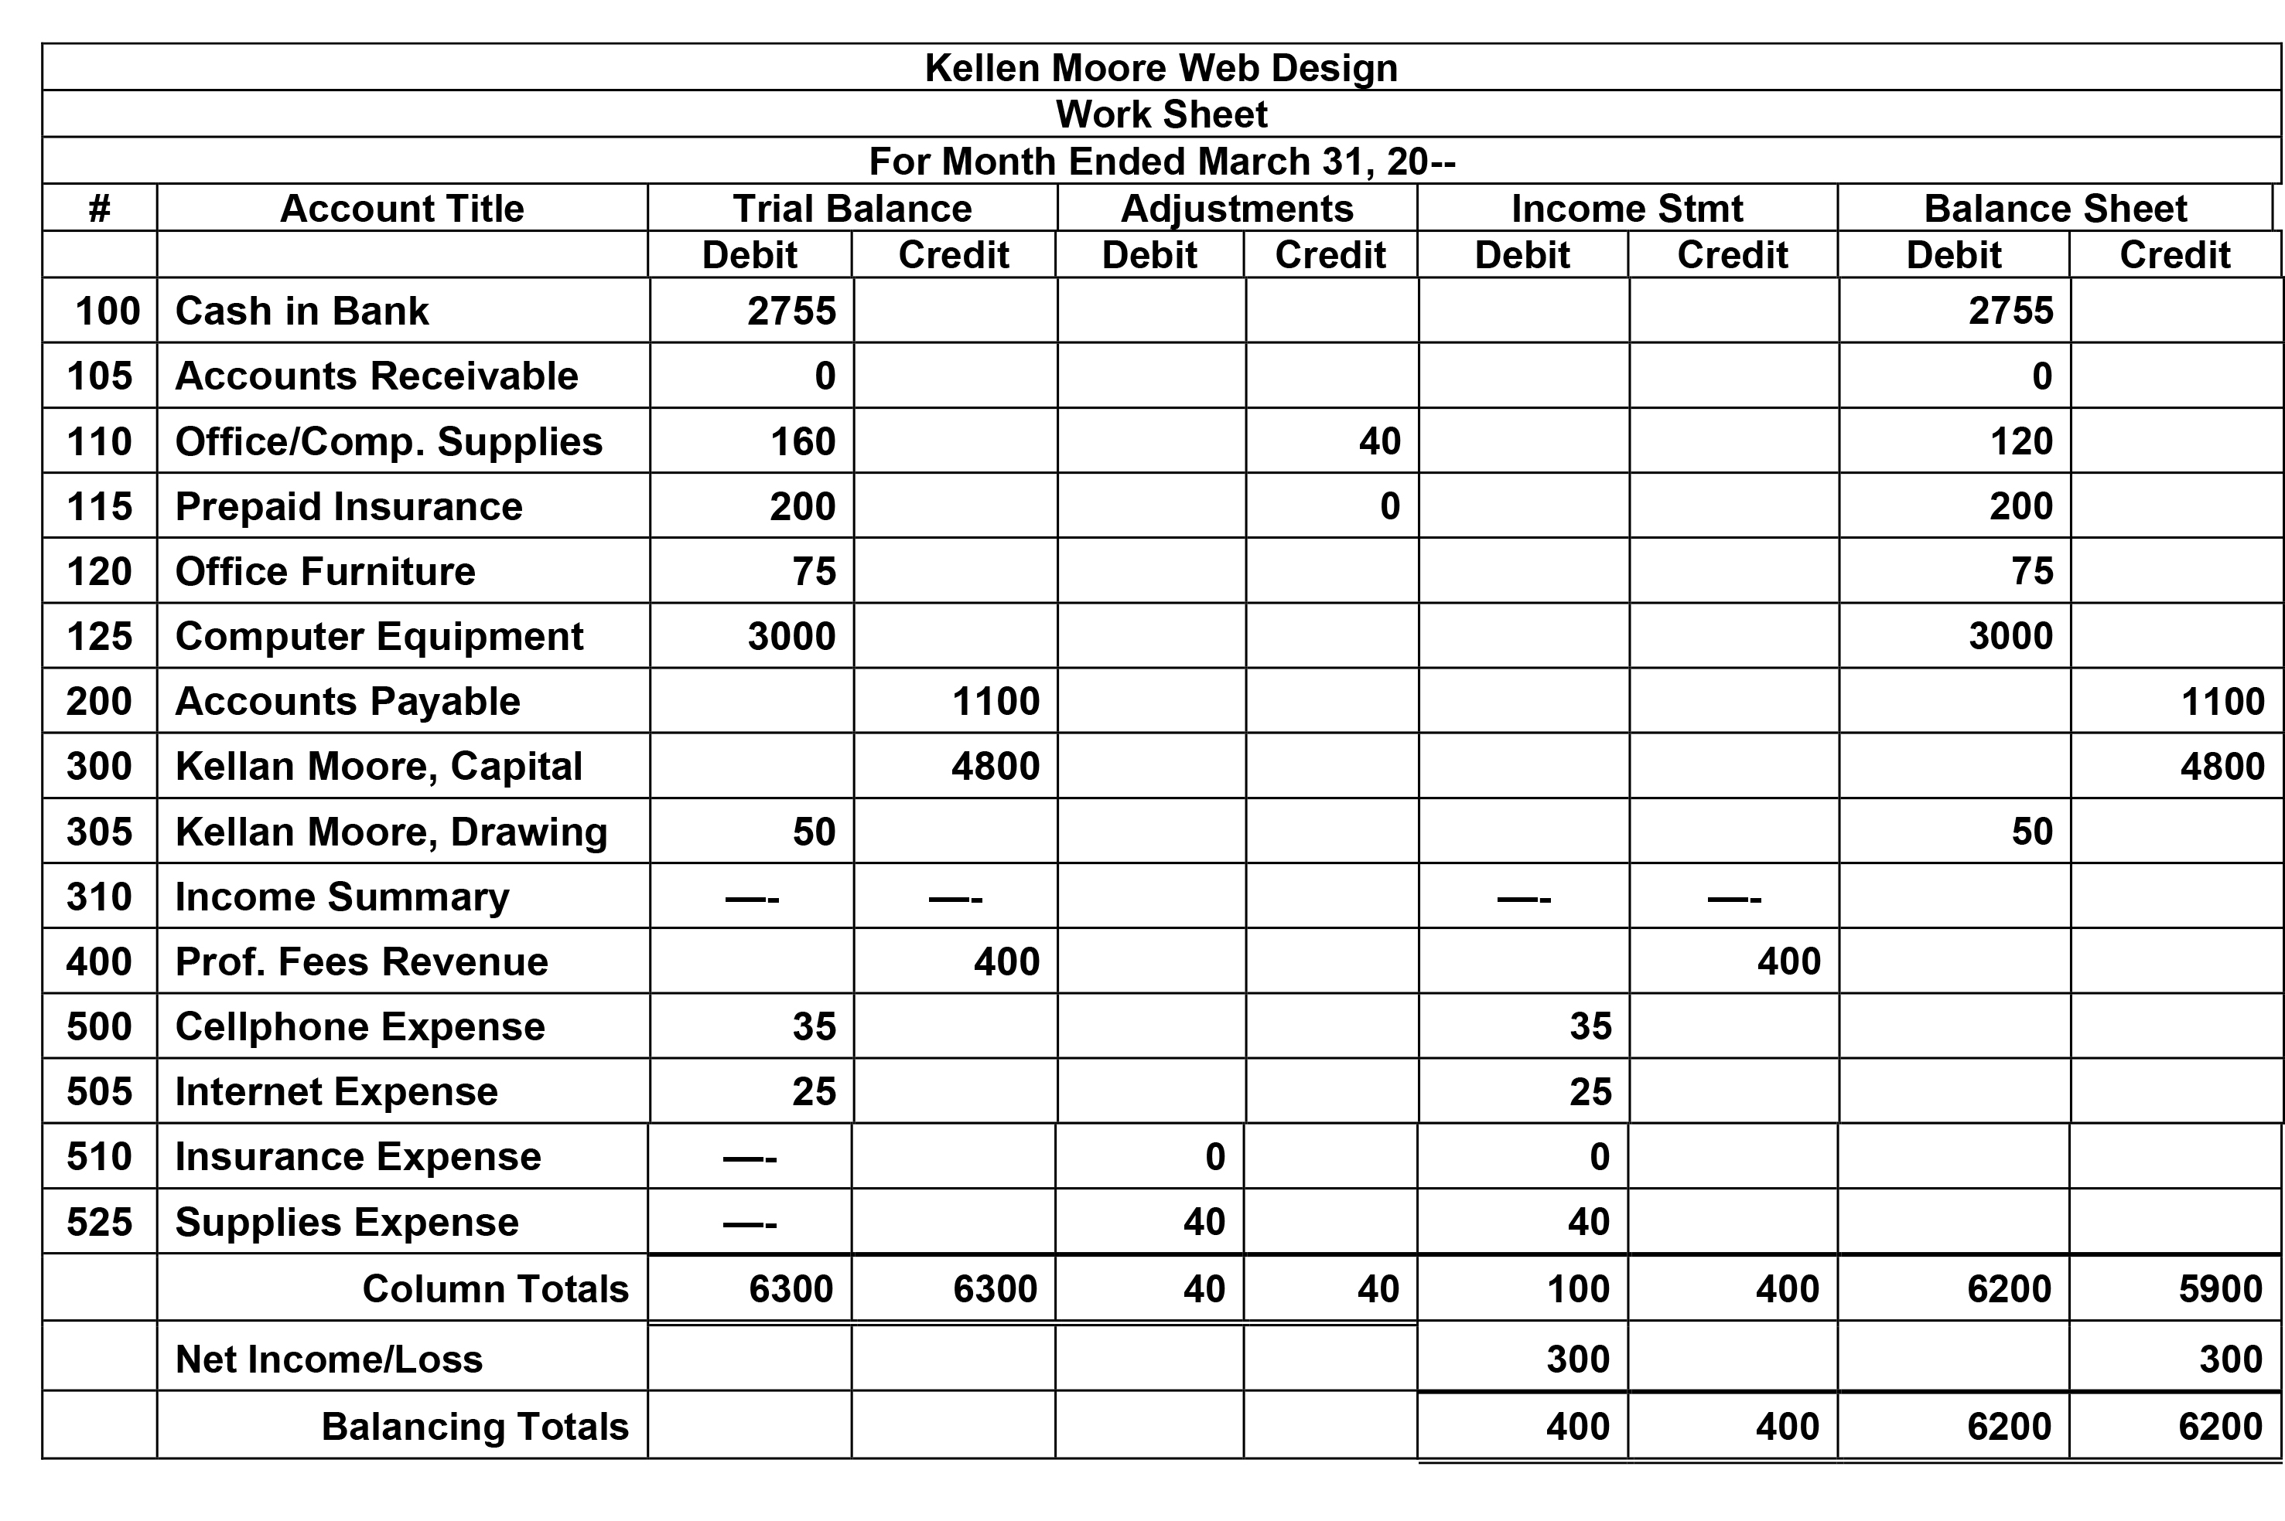
B
6 Sections of the Worksheet
1) The Heading (Who, What, When)
2) The Account # and Title Section
3) The Trial Balance Section (DR=CR)
4) The Adjustments Section (DR=CR)
I
5) The Income Statement Section
(Revenue - Expenses)
6) The Balance Sheet Section
(Assets & Draw, Liab & OE)

Slide 5
The Trial Balance prepared after journalizing the transactions will be the start of the Worksheet…
Trial Balance
DR CR
Cash 2,755
A/R 0
Supplies 160
PPI 200
Ofc.Furn. 75
Comp.Eqp. 3,000
Drawing 50
Cell Exp 35
Internet Exp 25
Total DRs 6,300
A/P 1,100
Capital 4,800
Fees Rev 400
Total CRs 6,300

Slide 6
B
3) The Trial Balance Section
(DR=CR)
I

Slide 7
B
3) The Adjustments Section
(DR=CR)
I

Slide 8
B
3) The Income StatementSection
(DR CR)
CR-DR = NI
I

Slide 9
B
3) The Balance Sheet Section
(DR CR)
DR-CR = NI
I

Slide 10
An Important Note about Capital on the Worksheet
(COW)
The amount of Capital on the Worksheet is NOT ending capital.
The Income Statement (temporary) accounts will affect the Capital balance, and so will Drawing.

Slide 11
Adjustments bring account balances up to date from internal operations
Three typical adjustments on Inv. and Dist. UIL tests:
Adjust Supplies (down)
Adjust Prepaid Ins. (down)
Adjust Merch. Inventory
(up or down)

Slide 12
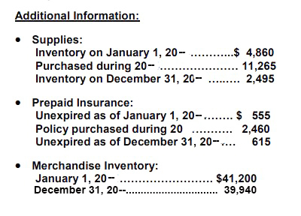
Sample Test Portion

Slide 13
Use the supplies formula to calculate the missing amount
Supplies - A
B+ —
Memorize:
Beg
+ Bot
= SOT
– Used
= End
Beg. Supplies 4,860
+ Bought -11,265
= Supp. On TB 16,125
(SOT)
= End Supplies 2,495
====
Solve for missing amt.
- Supplies Used
(Supplies Exp.)
16,125
- 2,495
13,760 = Sup. Exp.

Slide 14
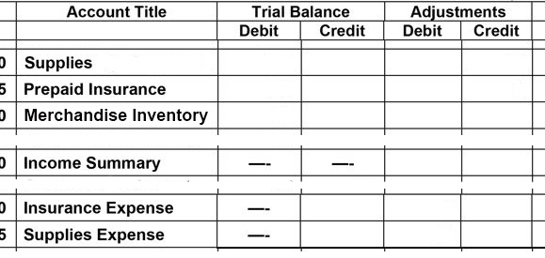
Supplies Adjustment
DR Supplies Expense 13,760
CR Supplies (Asset) 13,760
SOT= 16,125
13,760
NOTE: Zero
Balances
B4 Adj.
13,760

Slide 15
Use the insurance formula to calculate the missing amount
Prepaid Insurance - A
B+ —
Memorize:
B-PPI
+ Bot
= POT
– Used
= E-PPI
Beg. PPI 555
+ Bought 2,460
= PPI On TB 3,015
(POT)
= End PPI 615
====
Solve for missing amt.
- Insurance Used
(Ins. Exp.)
3,015
- 615
2,400 = Ins. Exp.

Slide 16
Insurance Adjustment
DR Insurance Expense 2,400
CR Prepaid Ins (Asset) 2,400
16,125
13,760
POT= 3,015
2,400
NOTE: Zero
Balances
B4 Adj.
2,400
13,760

Slide 17
Why adjust accounts?
Not all the supplies get used by year end.
Not all the insurance expires by year end.
Not all the merchandise bought gets sold.

Slide 18


When supplies & insurance are bought, they’re recorded in
ASSET ACCOUNTS (because they’re not an expense until used) and adjusted to temporary
EXPENSE ACCOUNTS
However, when merchandise is bought during the year, it is recorded in the temporary account PURCHASES
and adjusted to the ASSET ACCOUNT
called
MERCH. INVENTORY

Slide 19
Even more confusing…
The temporary account called
PURCHASES is not adjusted…
Instead, the difference in beginning and ending merchandise inventory is adjusted to another temporary account called
INCOME SUMMARY

Slide 20
Adjusting Merchandise Inventory
(two possibilities)
If Ending MI is HIGHER than Beg. MI
DR Mer. Inventory (to increase it)
CR Income Summary
Just
Remember!
If Ending MI is LOWER than Beg. MI
DR Income Summary
CR Mer. Inventory (to decrease it)

Slide 21
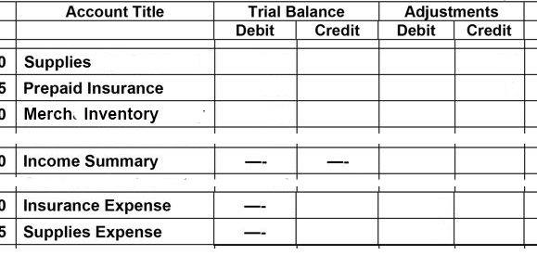
Merch. Inventory Adj.
Beg. Inv. = 41,200
End. Inv. = 39,940 (dec. by 1,260)
SOT= 16,125
13,760
POT= 3,015
2,400
BI = 41,200
1,260
NOTE: Zero
Balances
B4 Adj.
1,260
2,400
13,760

Slide 22
Important:
Each adjustment affects a permanent account and a temporary account.
So THREE partnerships:
Prepaid INSURANCE partners with
INSURANCE Expense
SUPPLIES
partners with
SUPPLIES Expense
Merch. INventory
partners with
INcome Summary

Slide 23
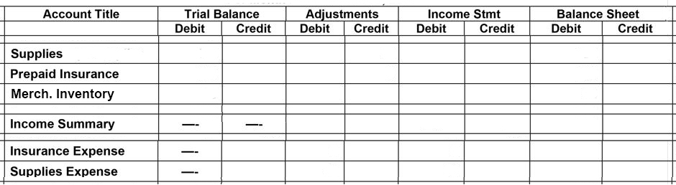
Adjusted Worksheet
(accounts affected by adjustments)
3 Temp. Accts.
3 Perm. Accts.
16,125
13,760
2,495
3,015
2,400
615
41,200
1,260
39,940
1,260
1,260
2,400
2,400
13,760
13,760

Slide 24
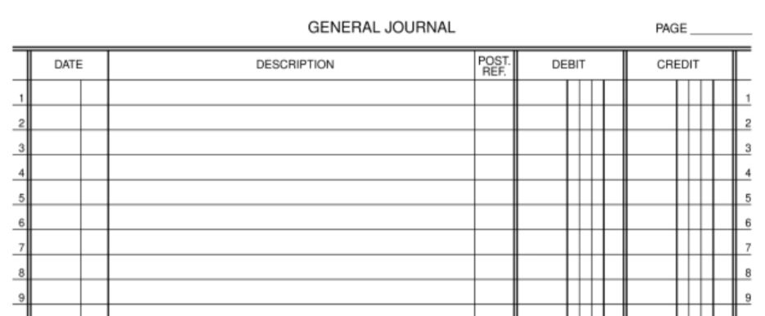
WS Adjustments must be journalized…
5
20—
Adjusting Entries
Dec 31 Supplies Expense 13760—
Supplies 13760—
31 Insurance Expense 2400—
Prepaid Insurance 2400—
31 Income Summary 1260—
Merchandise Inventory 1260—

Slide 25
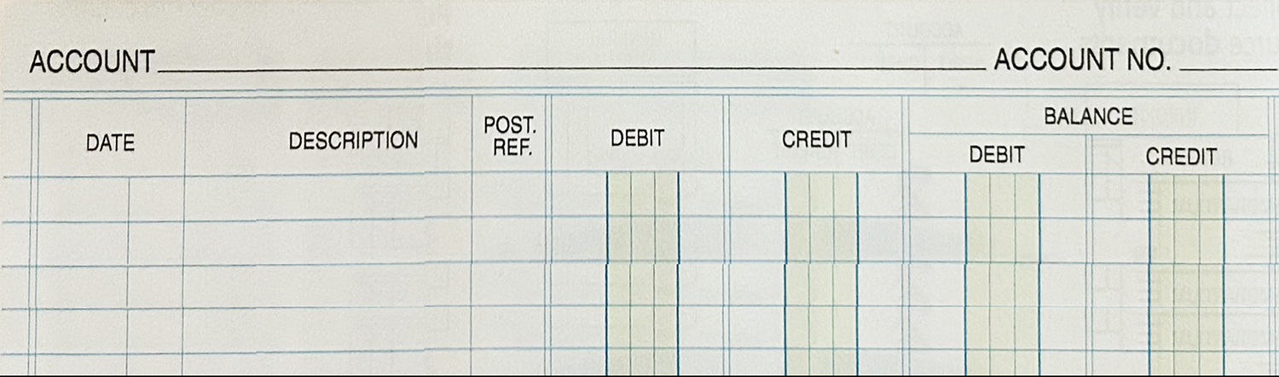
and posted to the General Ledger
(or balances will not be updated to the WS amounts)
Supplies
110
20—
Jan 1 Beg. Bal 4860—
J-D 31 Bought in yr G4 11265— 16125—
Dec 31 Adj. Entry G5 13760— 2495—
Supplies Expense
525
20—
Dec 31 Adj. Entry G5 13760— 13760—

Slide 26
Posting to the General Ledger, cont’d
Prepaid Insurance
115
20—
Jan 1 Beg. Bal 555—
J-D 31 Bought in yr G4 2460— 3015—
Dec 31 Adj. Entry G5 2400— 615—
Insurance Expense
510
20—
Dec 31 Adj. Entry G5 2400— 2400—

Slide 27
Posting to the General Ledger, cont’d
Merchandise Inventory
120
20—
Jan 1 Beg. Bal 41200—
Dec 31 Adj. Entry G5 1260— 39940—
Income Summary
310
20—
Dec 31 Adj. Entry G5 1260— 1260—

Slide 28
Accounting Cycle
C-A-R-P-T-W-F-A-C-T-R
Pronounce it CarpetWFactor
C – Collect source documents
A – Analyze into Drs and Crs
R – Record in Journal
P – Post to General Ledger
T – Trial Balance
W – Worksheet
F – Financial Statements
A – Adjusting Entries
C – Closing Entries
T – Post-closing Trial Balance
R – Reversing entries (state)

Slide 29

SUCCESS!

