Slide 1

UIL Accounting
PP 2 Permanent & Temporary Accounts
Kay Whitton
state contest director

Slide 2

In PP Lesson 1, we introduced the Basic Accounting Equation and Debits = Credits
In this lesson, we’ll continue by explaining Permanent accounts vs. Temporary accounts.

Slide 3



BAE Basic Accounting Equation
(your first formula!)
Things that are owned by a business
Assets = Liabilities
+ Owner’s
Equity

Slide 4
The transactions in PP 1 affected only Assets,
Liabilities & Owner’s Equity accounts
Permanent a/k/a
Balance Sheet
Real
ALOE accounts (KW term)
Their balances carry over from one year to the next:
(ex. Cash on 12/31/24 = 1/1/25)

Slide 5
There are other income-related transactions that affect only the Owner’s Equity Capital account
Temporary a/k/a
Income Statement
Nominal
REN accounts (KW term)
Their balances zero out at the end of each year to start new income records.

Slide 6
Basic Income Equation
(REN: your second formula!)
Revenue (earned by a biz- Capital)
- Expenses (costs to earn the revenue)
= Net Income (value added to the O/E acct)
or Net Loss (if expenses > revenue)

Slide 7
4 Transactions affect Capital
RI - DE
Capital - Owner’s Equity
— B+
Two transactions — owner-related
Drawing – takes out Investments - puts IN
Two transactions — income-related
Expenses – outgo Revenue – INcome
I
D
E
R

Slide 8
1. Owner draws out (withdraws) $500 from the biz for personal use
Cash in Bank - A
Capital - OE
B+ -
— B+
25,000
5,000
25,000
D
500
less capital
1,000
3,000
500
less $

Slide 9
Advertising (EXPENSE) on local webpages is paid for with a check for $300
Cash in Bank - A
Capital - OE
B+ -
— B+
25,000
5,000
25,000
500
300
less capital
1,000
3,000
E
500
300
less $

Slide 10
Provided services (REVENUE) by designing a new customer’s website and getting $400
Cash in Bank - A
Capital - OE
B+ -
— B+
25,000
400
more $
5,000
25,000
500
300
3,000
1,000
400
more capital
500
R
300

Slide 11
Provided services on account by designing a new website for $800
(SOAR) Sell on Accounts Receivable
A/R (future $) - A
Capital - OE
B+ -
— B+
800
more future $
25,000 I
1,000 I
400 R
800 d
more capital
D 500
E 300
R

Slide 12
After just a few transactions, the capital account is confusing
Capital - OE
— B+
25,000 I
1,000 I
400 R
800 R
D 500
E 300

Slide 13
Of the 4 transactions that affect capital, three groups (RED) will have many transactions during the year
Capital - Owner’s Equity
owner-related
Drawing – hopes to take out lots of $
income-related
Expenses – many expenses to earn $
— B+
owner-related
Investments - puts in (hopefully very few)
income-related
Revenue – lots of income to record

Slide 14
So we will give 3 of the 4 groups their own ‘identity’ during the year
(like kids going off to college-they’ll come home to capital at the end of the year!)
Capital - Owner’s Equity
— B+
Two transactions — owner-related
Drawing – takes out Investments - puts in
Two transactions — income-related
Expenses – outgo Revenue – income

Slide 15
Revenue as CR balance
Expense & Drawing as DRs
Capital - Owner’s Equity
— B+
Expenses – EOE
Drawing – DOE
Investments will stay in Capital
B+ -
B+ -
Revenue – ROE
— B+
Expenses & Drawing will each have DR balances since Debits make capital go
CRevenue will have CR balance since it makes capital go

Slide 16
New acronyms to help learn DRs and CRs!
D
E
A
D
C
O
R
L

Slide 17
Memorize these acronyms!
Debits
Expenses
Assets
Drawing
Credits
Owner’s Eq.
Revenue
Liabilities

Slide 18
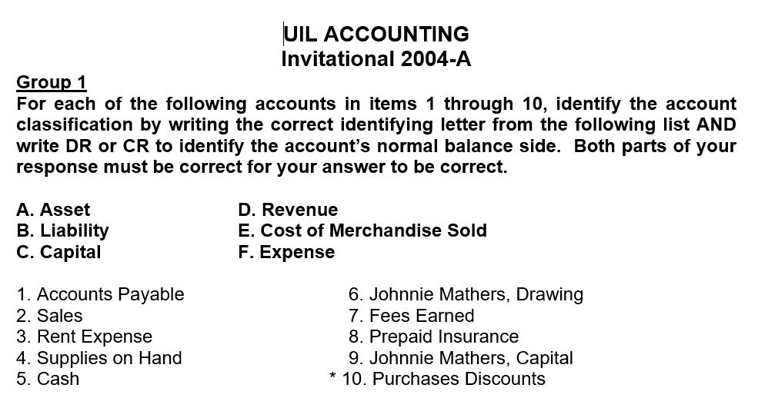
Sample UIL test questions on DRs and CRs…

Slide 19
Previous (archived) tests are currently online at this link…
http://www.funderburkcpa.com/uil/exams
Hopefully they’ll be moved soon to
accountingrocks.net

