Slide 1

UIL Accounting
PP 1 Start Here First!
(for new learners!)
Kay Whitton
state contest director

Slide 2
Let’s Start at the very beginning, a very good place to start…
People go into business to make money…
And businesses need a way to organize their records to keep track of that money!
Thus, accounting!

Slide 3
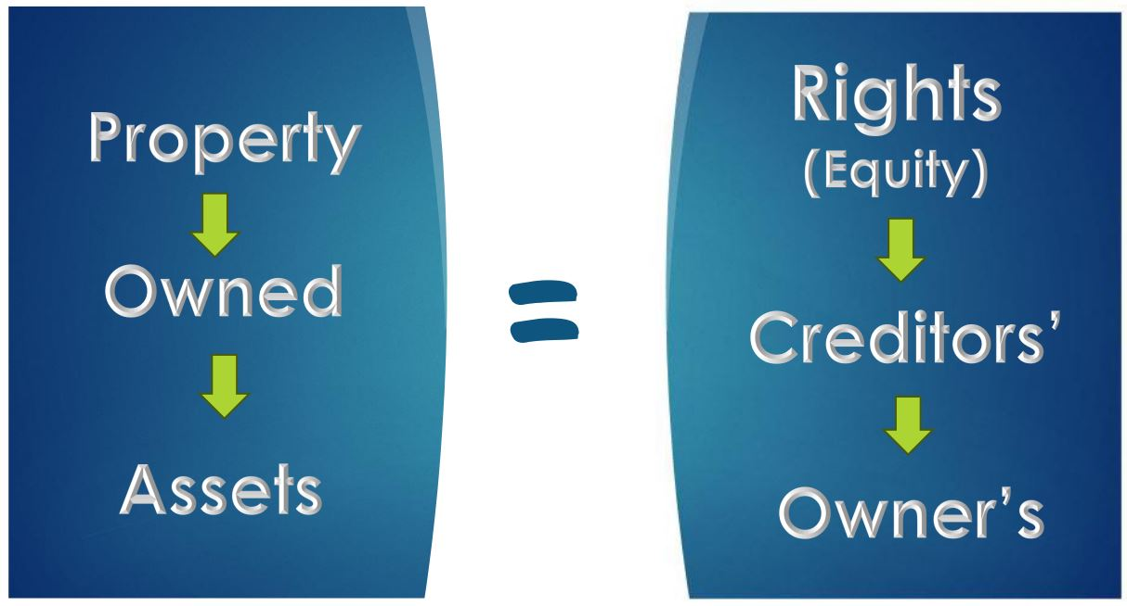

Slide 4
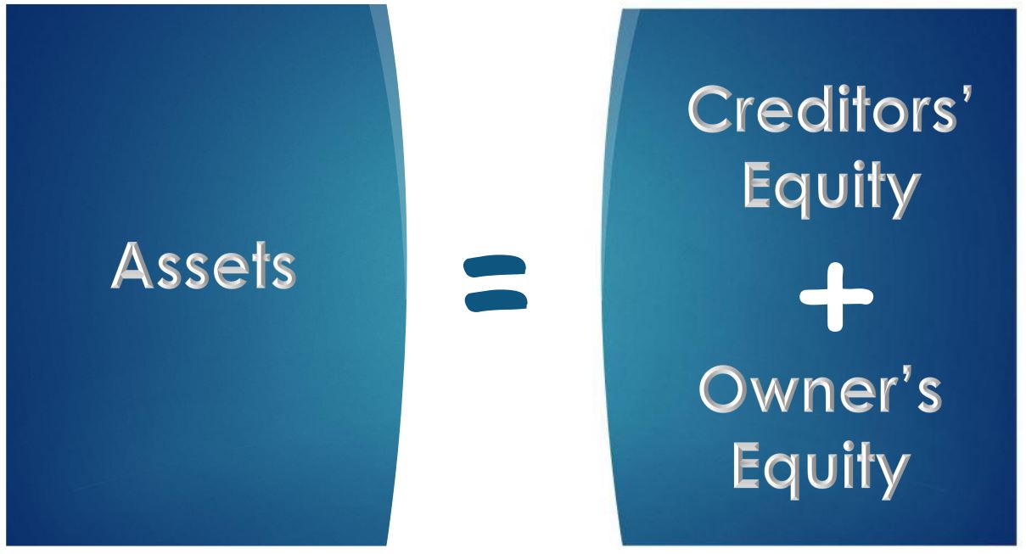

Slide 5


=
Owner’s Equity
Assets
(meaning
NO DEBT!)

Slide 6
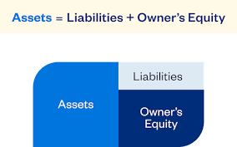
In the real world, businesses rely on credit to grow…

Slide 7



BAE Basic Accounting Equation
(your first formula!)
Things that are owned by a business
Assets = Liabilities
+ Owner’s
Equity

Slide 8
Let’s go on to a new concept…
‘DC’
Dallas Cowboys
Washington DC
Debits = Credits
Debits on the left
Credits on the right

Slide 9
T Accounts are a tool used to organize account balances…
D
C
DEBIT balances on the left
(DR)
CREDIT balances on the RIGHT
(CR)

Slide 10

Accounting ‘Rock’:
DR = CR

Slide 11

Debits = Credits
Neither is better than the other.

Slide 12
Balances are based on what side of the = sign accounts are in the BAE
Assets = Liab. + Owner’s Eq.
D
C
Liab. & O/E are on the RIGHT side of the BAE,
so they have a CREDIT balance
(CR)
Assets are on the LEFT of the BAE,
so assets have a DEBIT balance
(DR)

Slide 13
Account balances go and
Accounts are increased on their balance side; decreased on the opposite side.
D
C
-
Assets are decreased on the right
B+
Assets are increased on the left

Slide 14
Account balances go and
Accounts are increased on their balance side; decreased on the opposite side.
D
C
-
Liab. & O/E
are decreased
on the left
B+
Liab. & O/E
are increased
on the right

Slide 15
Balances are based on what side of the = sign accounts are in the BAE
Assets = Liab. + Owner’s Eq.
D
C
Liab. & O/E are on the RIGHT side of the BAE,
so they have a CREDIT balance
(CR)
Assets are on the LEFT of the BAE,
so assets have a DEBIT balance
(DR)

Slide 16
Sample accounts
Assets = Liab. + Owner’s Eq.
Cash in Bank
Accts Receivable
Supplies
Equipment
Delivery Van
Building
Liabilities are amounts owed (payable) to someone else
Accts Payable (A/P)
O/E Account: Capital
Things that are owned by a business
Owner’s value after liabilities.

Slide 17
A common first transaction:
Owner invests $25,000 of personal $ into a new business
the Biz has more
Cash in Bank, A
D C
Balance Side =
Increase side, B+
$25,000
Decrease side —

Slide 18
Owner invests $25,000 personal $ into a new business
the owner has all the rights so
Capital, O/E is increased
D C
Decrease side —
Balance Side =
Increase side, B+
$25,000

Slide 19
Owner invests personal desk & furniture
DR = CR
Computer Furn. - A
Capital. - OE
, B+ —
, — B+
1,000
25,000
1,000

Slide 20
Biz buys new computer equipment by writing a check for $5,000
DR = CR
Cash in Bank - A
Computer Eqp. - A
, B+ -
, B+ -
25,000
5,000
Less $
5,000
But more equip.

Slide 21
Biz buys delivery equipment for $38,000, with $3,000 down payment and financing the balance due
Cash in Bank - A
Delivery Eqp. - A
Accts./Pay. - L
, B+ —
, B+ —
, — B+
25,000
5,000
38,000
more equip.
35,000
More debt
3,000
Less $
DR = CR

Slide 22
The transactions so far have affected only Assets,
Liabilities & Owner’s Equity accounts
ALOE accounts a/k/a
Balance Sheet
Real
Permanent
Their balances carry over from one year to the next

Slide 23
There are other income-related transactions that affect only the Owner’s Equity Capital account
REN accounts a/k/a
Income Statement
Nominal
Temporary
Their balances zero out at the end of each year

Slide 24
Basic Income Equation
(REN: your second formula!)
Revenue (earned by a biz- Capital)
- Expenses (costs to earn the revenue)
= Net Income (value added to the O/E acct)
or Net Loss (if expenses > revenue)

Slide 25
4 Transactions Affect Capital
Capital - Owner’s Equity
— B+
Two transactions — owner-related
Drawing – takes out Investments - puts IN
Two transactions — income-related
Expenses – outgo Revenue – INcome

Slide 26
Owner draws out (withdraws) $500 from the biz for personal use
Cash in Bank - A
Capital - OE
B+ -
— B+
25,000
5,000
25,000
500
less capital
1,000
3,000
500
less $

Slide 27
Advertising on local webpages is paid for with a check for $300
Cash in Bank - A
Capital - OE
B+ -
— B+
25,000
5,000
25,000
500
300
less capital
1,000
3,000
500
300
less $

Slide 28
Provided services by designing a new customer’s website and getting $400
Cash in Bank - A
Capital - OE
B+ -
— B+
25,000
400
more $
5,000
25,000
500
300
3,000
1,000
400
more capital
500
300

Slide 29
Provided services on account by designing a new website for $800 (SOAR)
A/R (future $) - A
Capital - OE
B+ -
— B+
800
more future $
25,000
500
300
1,000
400
800
more capital

Slide 30
After just a few transactions, the capital account is confusing
Capital - OE
— B+
25,000 I
1,000 I
400 R
800 R
D 500
E 300

Slide 31
Of the 4 transactions that affect capital, three groups (RED) will have many transactions during the year
Capital - Owner’s Equity
owner-related
Drawing – hopes to take out lots of $
income-related
Expenses – many expenses to earn $
— B+
owner-related
Investments - puts in (hopefully very few)
income-related
Revenue – lots of income to record

Slide 32
So we will give 3 of the 4 groups their own identity during the year
(like kids going off to college)
Capital - Owner’s Equity
— B+
Two transactions — owner-related
Drawing – takes out Investments - puts in
Two transactions — income-related
Expenses – outgo Revenue – income

Slide 33
Revenue as CR balance
Expense & Drawing as DRs
Capital - Owner’s Equity
— B+
Expenses – EOE
Drawing – DOE
Investments will stay in Capital
B+ -
B+ -
Revenue – ROE
— B+
Expenses & Drawing will each have DR balances since Debits make capital go
CRevenue will have CR balance since it makes capital go

Slide 34
New acronyms to memorize!
D
E
A
D
C
O
R
L

Slide 35
New acronyms to memorize
Debits
Expenses
Assets
Drawing
Credits
Owner’s Eq.
Revenue
Liabilities

Slide 36

Any questions so far?

Slide 37
Now, let’s talk about the UIL accounting contest itself:
80 questions
5 points apiece
20 bonus points
420 potential score
No penalty points for guessing or wrong answers!

Slide 38
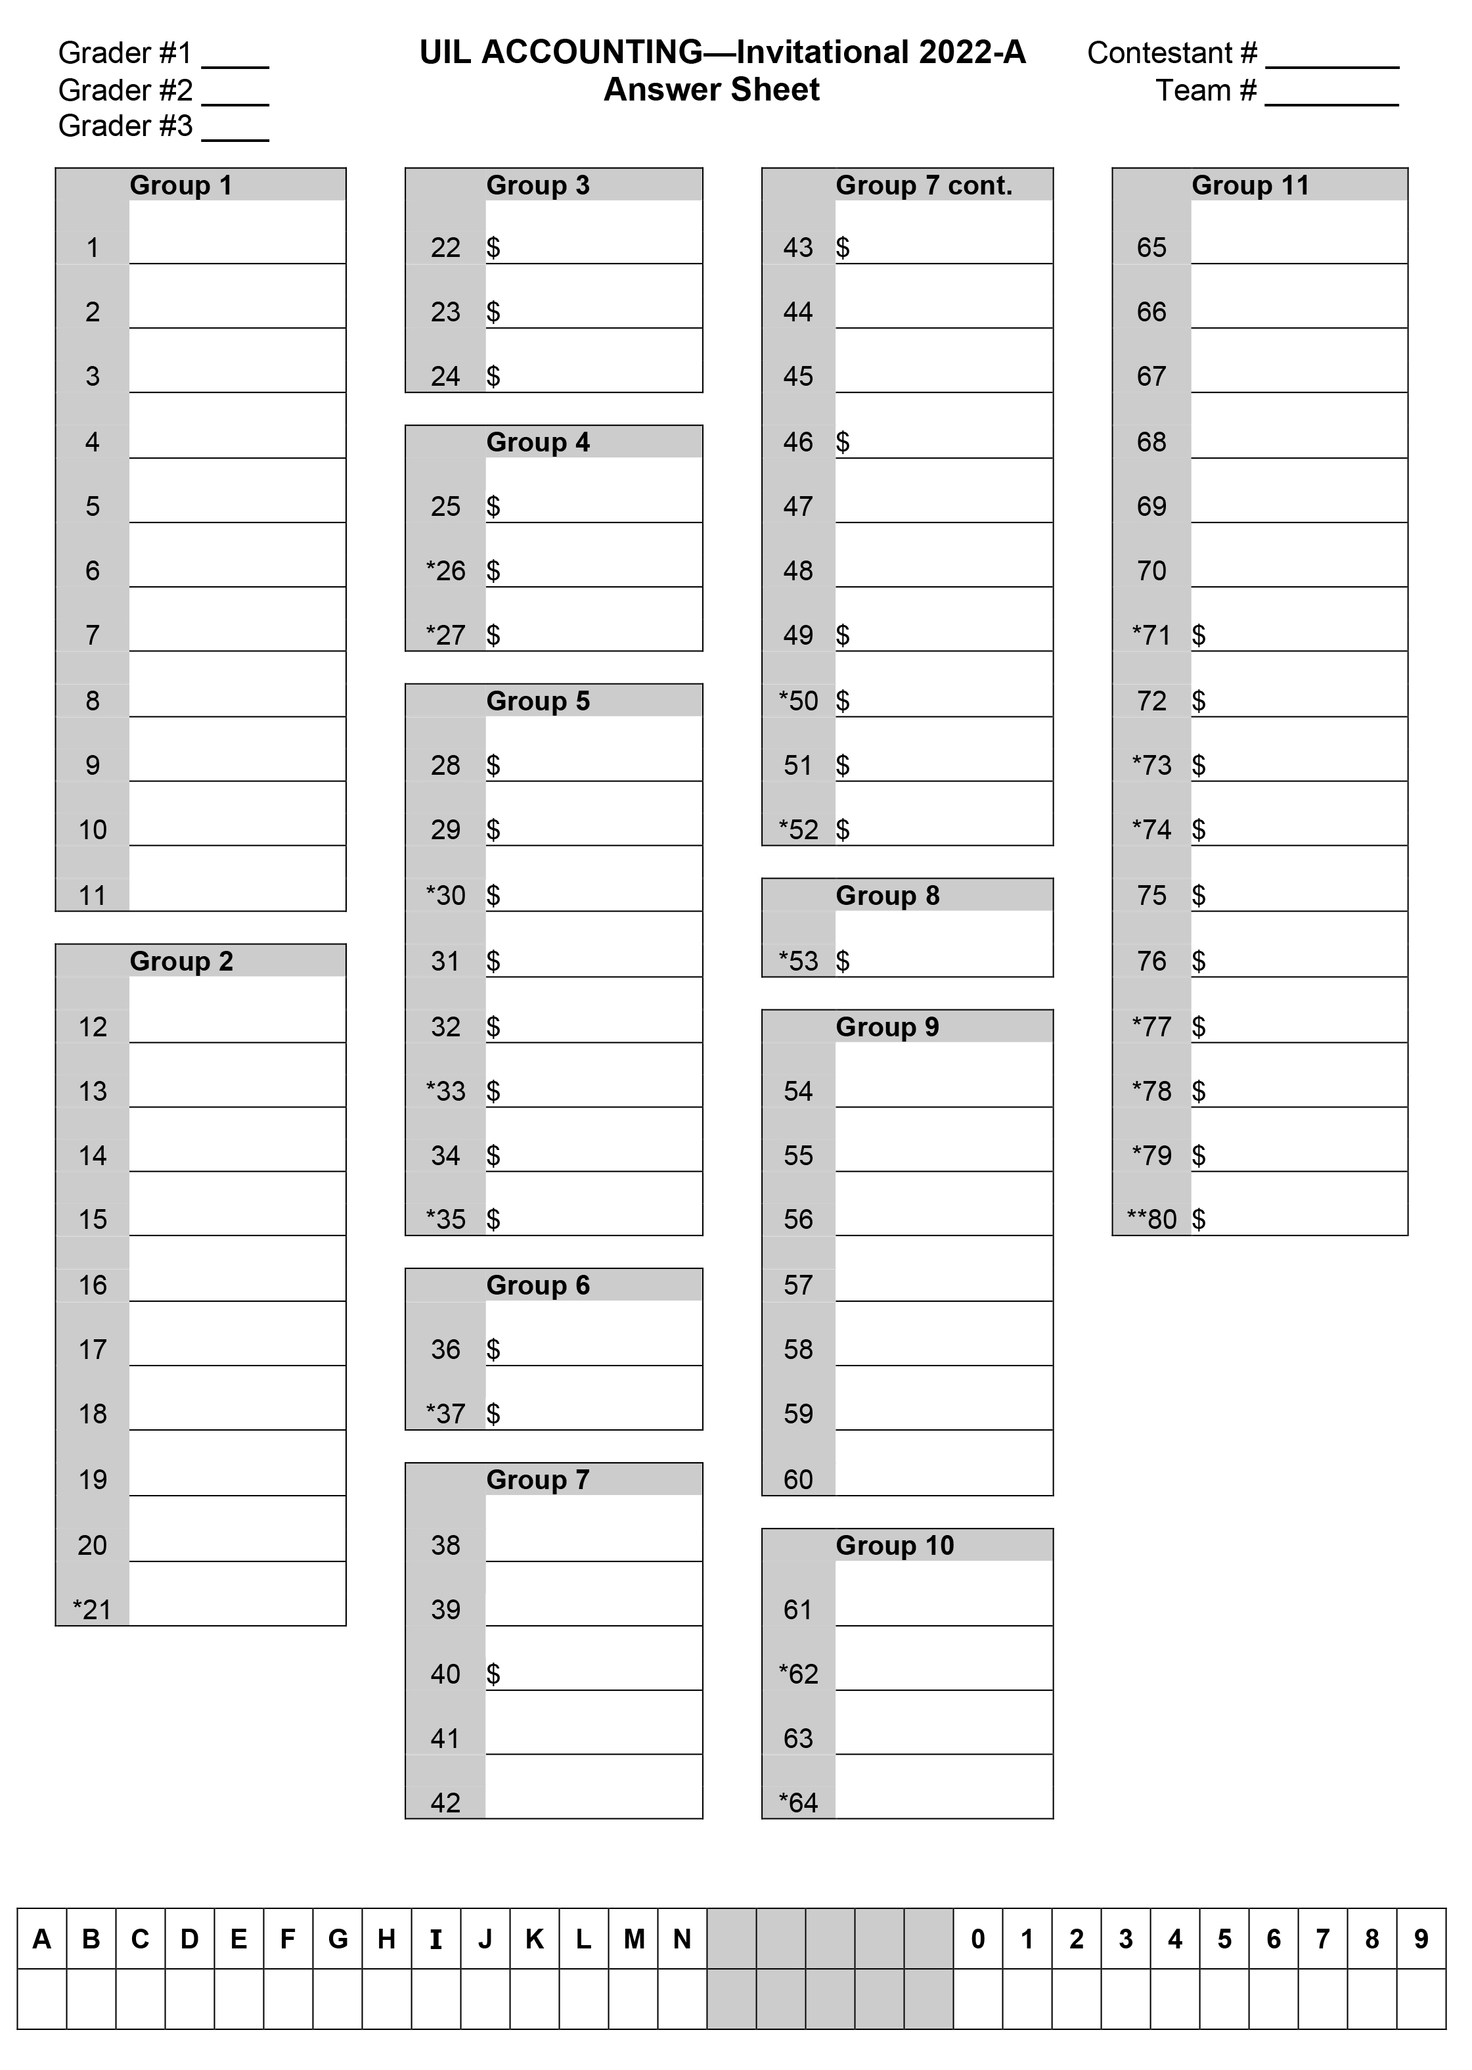
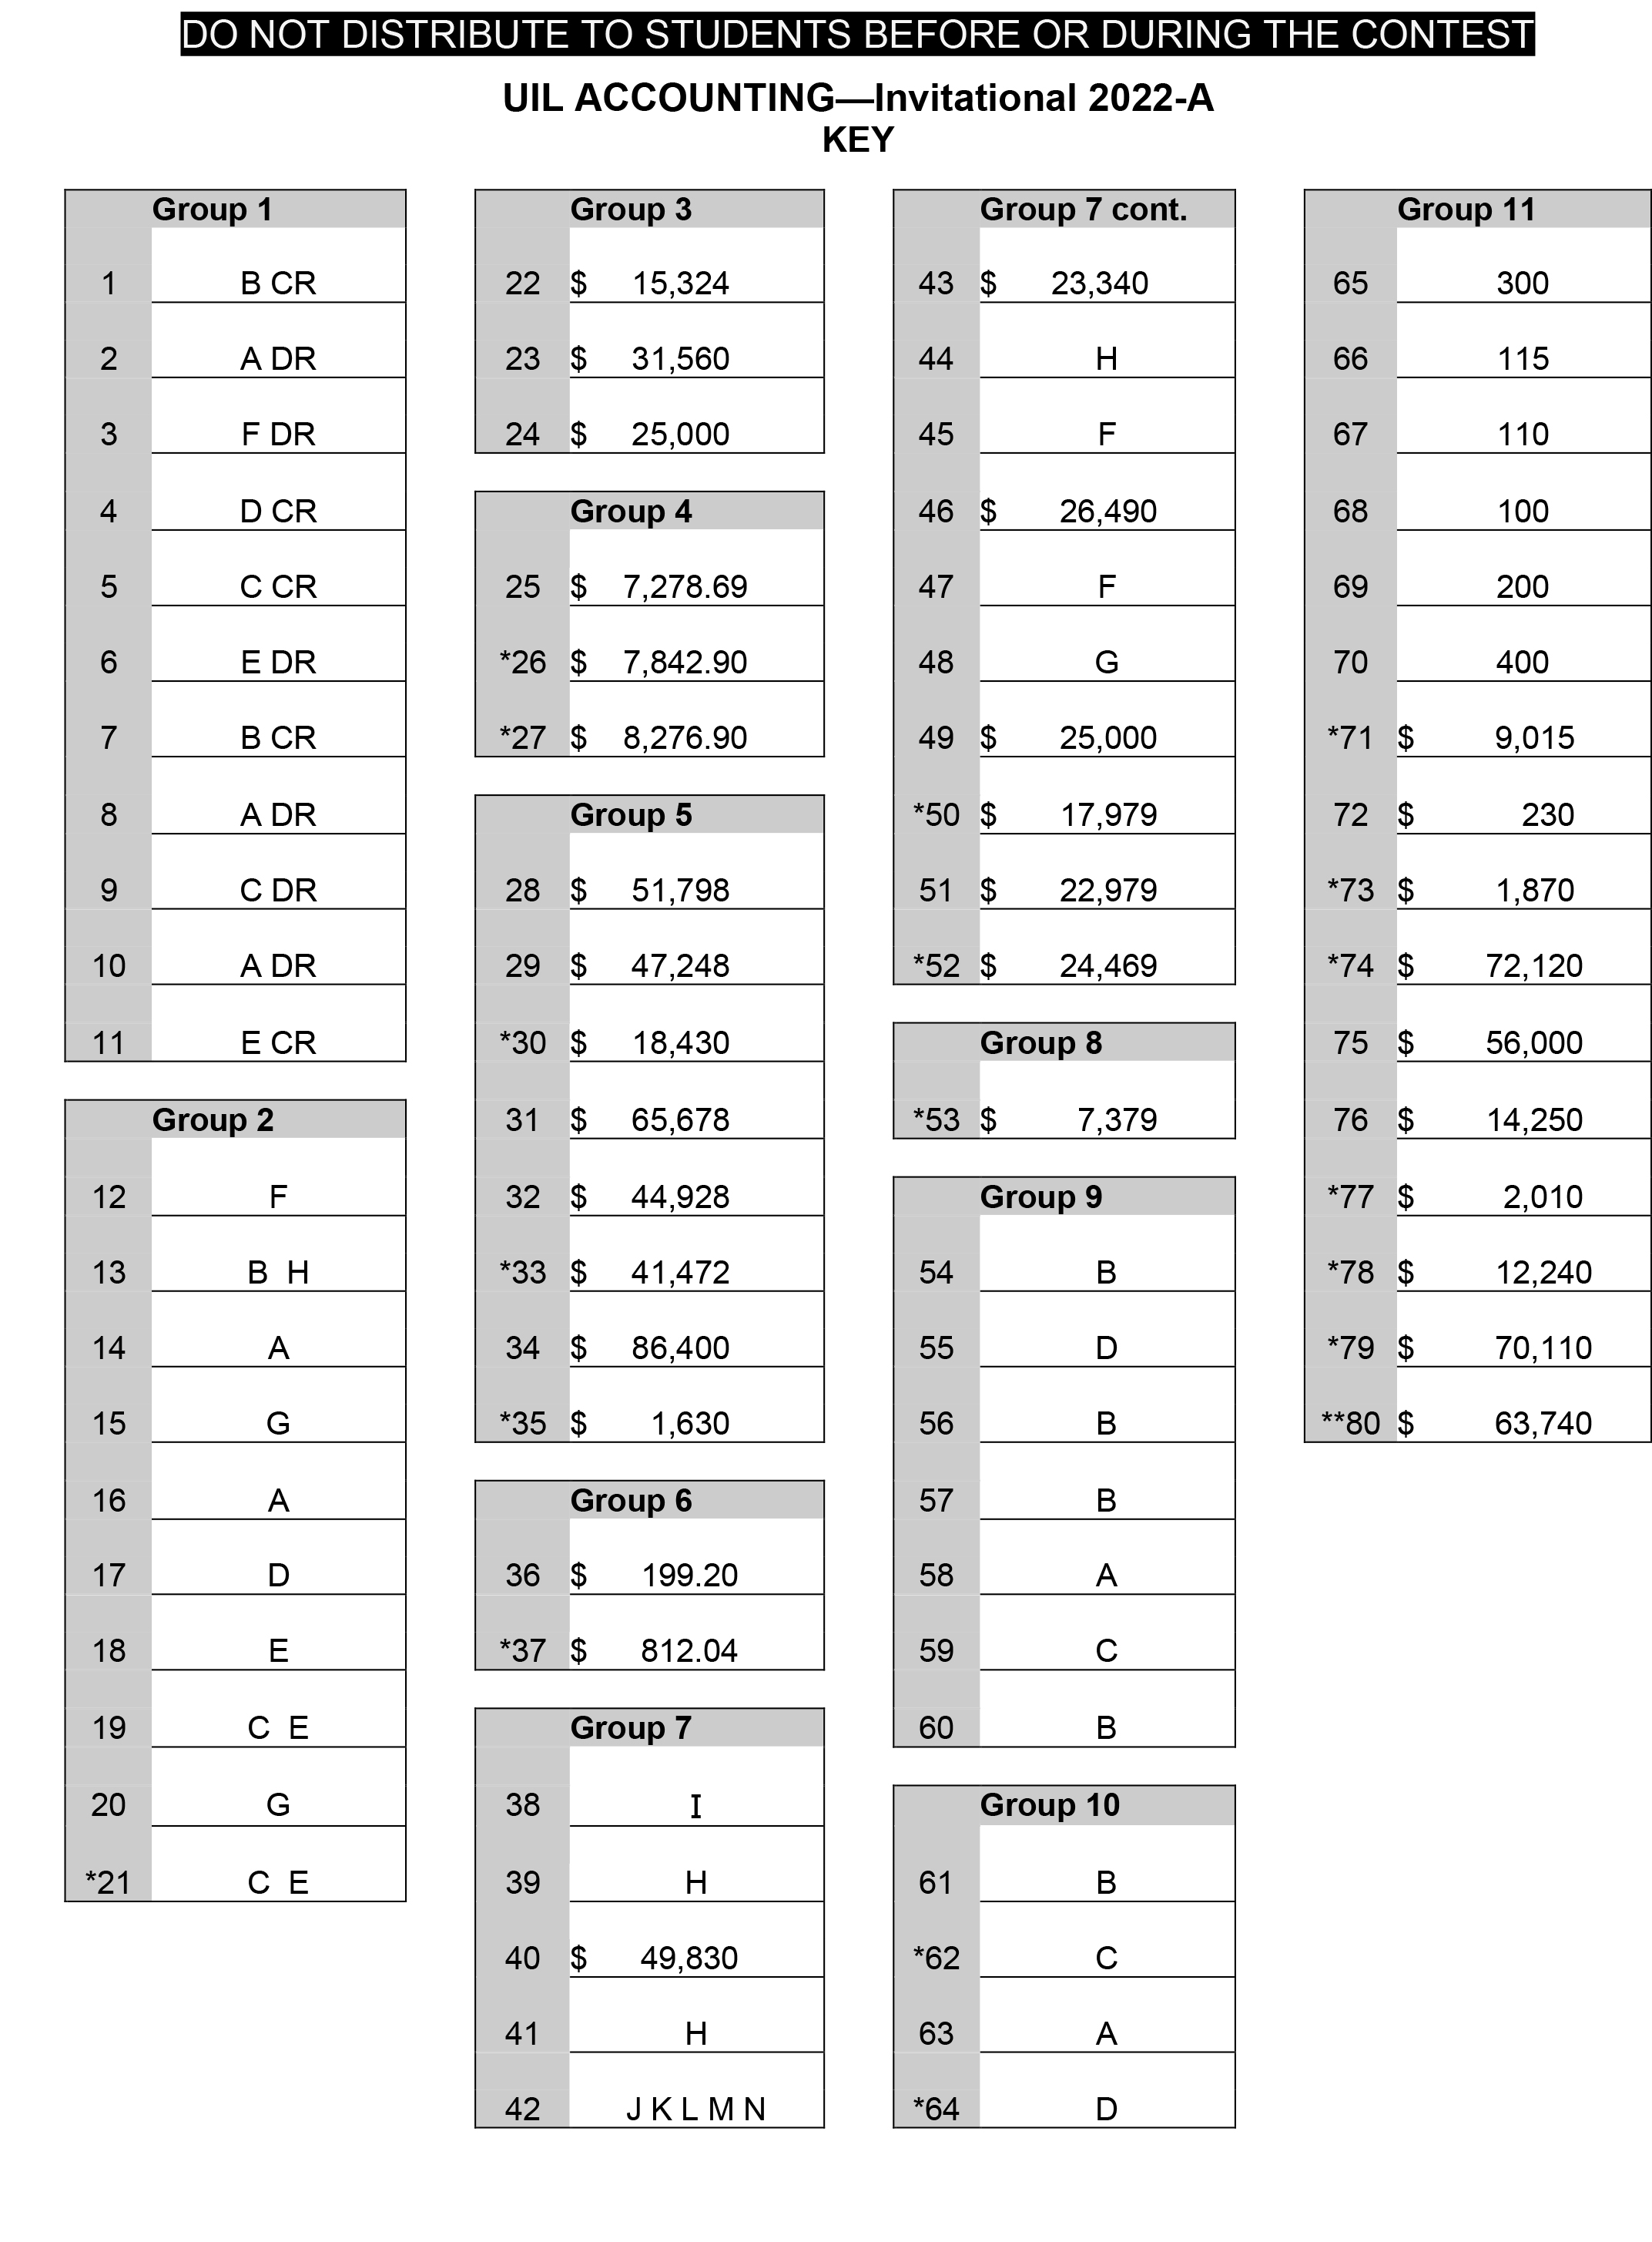

Slide 39
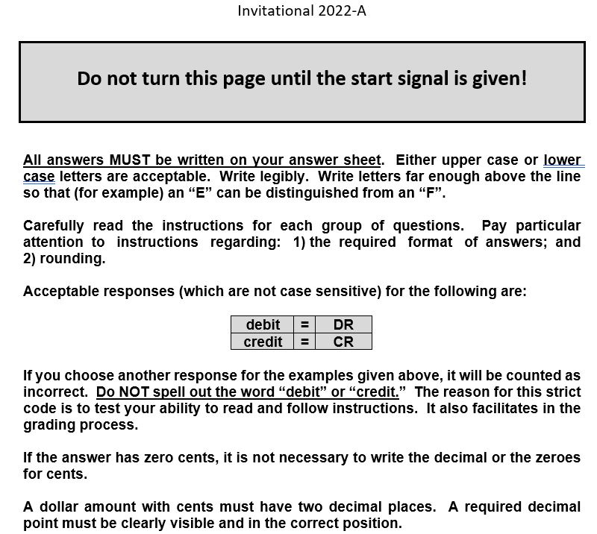

Slide 40
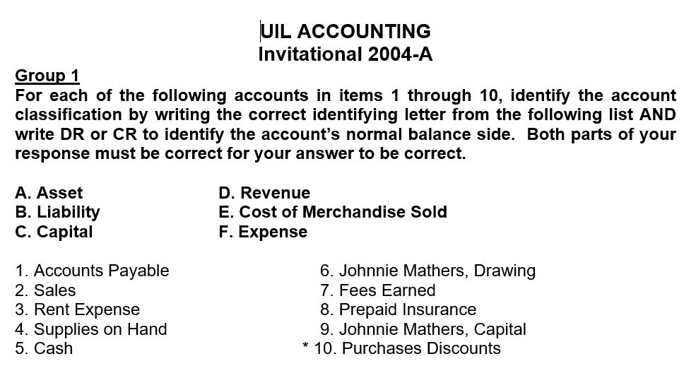

Slide 41
Inv. B - 1998
In items 1 through 10 are listed some of the accounts that appear in the Account Title section of a work sheet. Indicate whether the normal account balance will be entered in the debit or the credit column of the Trial Balance section of the work sheet using the following code: DR = Trial Balance debit column CR = Trial Balance credit column
1. Store Equipment 6. Accounts Receivable
2. Rent Expense 7. Purchases
3. Service Revenue 8. Merchandise Inventory
4. Accounts Payable 9. Office Supplies
5. Barbara Sims, Capital 10. Sales Discounts

Slide 42
Previous (archived) tests are online at this link…
http://www.funderburkcpa.com/uil/exams

Slide 43
Now, let’s practice with this handout …
Accounting Cycle – Steps 1-4
1) Collect source docs
2) Analyze transactions into DR/CR
3) Record in journal
4) Post to ledger
(T-Accounts serve as journal/ledger)

Slide 44
Kellan Moore began business operations on March 1, 2022, designing and building web pages for the public. His March transactions are below. For questions 1-26, indicate the letter of the corresponding accounts that are debited and credited for each transaction.
Acct # | Account Title | Acct # | Account Title
100 | Cash in Bank | 200 | Accounts Payable
105 | Accounts Receivable | 300 | Kellan Moore, Capital
110 | Office/Comp. Supplies | 305 | Kellan Moore, Drawing
115 | Prepaid Insurance | 400 | Prof. Fees Revenue
120 | Office Furniture | 500 | Telephone Expense
125 | Computer Equipment | 505 | Internet Expense

Slide 45
T1 Kellan used his personal savings of
$3,000 to invest in the business
100 Cash - A
300 K.M., Capital - OE
B+ -
— B+
3,000
More cash
3,000 (1)
More capital
Enter 100 by #1 and 300 by #2

Slide 46
T2 Purchased paper, and various other supplies for $160 with check #101
110 Ofc/Comp Sup -A
100 Cash - A
B+ -
B+ -
(2) 160
More supplies
3,000
160 (2)
Less cash
Enter 110 by #3 and 100 by #4

Slide 47
T3 Invested computer and printer, valued at $1,800, in the business
125 Comp. Eqp-A
300 K.M., Capital - OE
B+ -
, — B+
(3) 1,800
More biz. eqp.
3,000 (1)
1,800 (3)
More capital
Enter 125 by #5 and 300 by #6

Slide 48
T4 Used check #104 to purchase a used computer desk for $75
120 Office Furn. -A
100 Cash - A
B+ -
B+ -
3,000
160 (2)
75 (4)
Less cash
(4) 75
More furniture
Continue entering Acct #’s by Question #’s

Slide 49
T5 Bought a new printer from BJ’s
Computers for $1,200 on account (BOAP)
125 Comp. Eqp-A
201 A/P - BJ’s - L
B+ -
— B+
1,200 (5)
More debt
1,800
(5) 1,200
More biz. eqp.

Slide 50
T6 Withdrew with check #106 $50 for personal use
305 K.M. Drawing - D
100 Cash - A
B+ -
B+ -
(6) 50
More drawing
(less capital)
3,000
160 (2)
75 (4)
50 (6)
Less cash

Slide 51
T7 Paid $100 with check #105 on account to BJ’s Computers (POAP)
100 Cash - A
201 A/P - BJ’s - L
B+ -
— B+
160 (2)
75 (4)
50 (6)
100 (7)
Less cash
100
Less debt
3,000
1,200 (5)

Slide 52
T8 Paid the cellphone bill for the current month, $35 with check #102
100 Cash - A
500 Cellphone Exp -E
B+ -
160 (2)
75 (4)
50 (6)
100 (7)
35 (8)
Less cash
3,000
B+ -
(8) 35
More exp.

Slide 53
T9 Paid L.A. Company a fee of $25 with check #103 for internet access for March
100 Cash - A
505 Internet Exp -E
160 (2)
75 (4)
50 (6)
100 (7)
35 (8)
25 (9)
Less cash
B+ -
3,000
B+ -
(9) 25
More exp.

Slide 54
T10 Billed Steven Parks, a client, $100 to set up a 10-page web site. (SOAR)
105 Accts/Rec. - A
Prof. Fees - Rev
B+ -
— B+
(10) 100
More
future cash
(10)
More revenue

Slide 55
T11 Upon completion of a multilevel website, received $300 from Acme Builders
100 Cash - A
Prof. Fees - Rev
B+ -
160 (2)
75 (4)
50 (6)
100 (7)
35 (8)
25 (9)
(1) 3,000
(11) 300
More cash
— B+
100 (10)
300 (11)
More revenue

Slide 56
T12 Received $100 on account from
Steven Parks. (ROAR)
100 Cash - A
105 Accts/Rec. - A
B+ -
160 (2)
75 (4)
50 (6)
100 (7)
35 (8)
25 (9)
(1) 3,000
(11) 300
(12) 100
More real cash
B+ -
(10) 100
100 (12)
less
future cash

Slide 57
T13 Paid $200 with biz. Debit card for six months of insurance on the last day of March, effective April 1
100 Cash - A
115 Prepaid Ins. -A
B+ -
160 (2)
75 (4)
50 (6)
100 (7)
35 (8)
25 (9)
200 (13)
3,000
(11) 300
(12) 100
B+ -
(13) 200
A prepaid expense is an asset

Slide 58
WOOHOO!
You did it!
(we’re nearly done!)

Slide 59
Now we just need to calculate the balance in each of our accounts
100 Cash - A
B+ -
160 (2)
75 (4)
50 (6)
100 (7)
35 (8)
25 (9)
200 (13)
645 CRs
3,000
(11) 300
100
DRs 3,400
$2,755

Slide 60
Write the balance of each account at the bottom on its B+ side.
105 Accts/Rec. - A
B+ -
100
0
100 (12)

Slide 61
For T-accounts with only one entry, draw a double line to show that is the balance
110 Ofc/Comp Sup. -A
115 Prepaid Ins. -A
B+ -
B+ -
(2) 160
(13) 200

Slide 62
Debit balances are written on the left…
120 Office Furn. -A
125 Comp. Eqp-A
B+ -
B+ -
(4) 75
1,800
(5) 1,200
3,000

Slide 63
Credit balances are written on the right…
201 A/P - BJ’s - L
300 K.M., Capital - OE
— B+
— B+
100
1,200
1,100
3,000 (1)
1,800 (3)
4,800

Slide 64
Temporary capital accounts (RED) only increase during the year so they should have amounts only on their B+ side…
305 K.M. Drawing - D
400 Prof. Fees - R
X
X
B+ -
— B+
(6) 50
100 (10)
300 (11)
400

Slide 65
For T-accounts with only entry, just put a double line to show that is the balance
500 Cellphone Exp -E
505 Internet Exp -E
X
X
B+ -
B+ -
(8) 35
(9) 25

Slide 66
Now, we’ll do a final check to see if our DR balances = our CR balances
Trial Balance
DR CR
Cash 2,755
A/R 0
Supplies 160
PPI 200
Ofc.Furn. 75
Comp.Eqp. 3,000
Drawing 50
Cell Exp 35
Internet Exp 25
Total DRs 6,300
A/P 1,100
Capital 4,800
Fees Rev 400
Total CRs 6,300

Slide 67
Let’s Review:
Assets,
Liabilities & Owner’s Equity accounts
ALOE accounts a/k/a
Balance Sheet
Real
Permanent
Their balances carry over from one year to the next

Slide 68
Revenue
- Expenses
= Net Income temporary Capital accounts
(go off to college— come home at year-end)
REN accounts a/k/a
Income Statement
Nominal
Temporary
Their balances zero out at the end of each year

Slide 69
New concept…
Worksheet
Working paper
Make adjustments
Correct errors
Calculate Net Income (IS cols)
Statement of Position (BS Cols)

Slide 70
Completing the
Worksheet
List accounts & #s in TB
Make sure that DRs = CRs
Extend (transfer) to IS & BS
Calculate column totals
Calculate Net Income

Slide 71
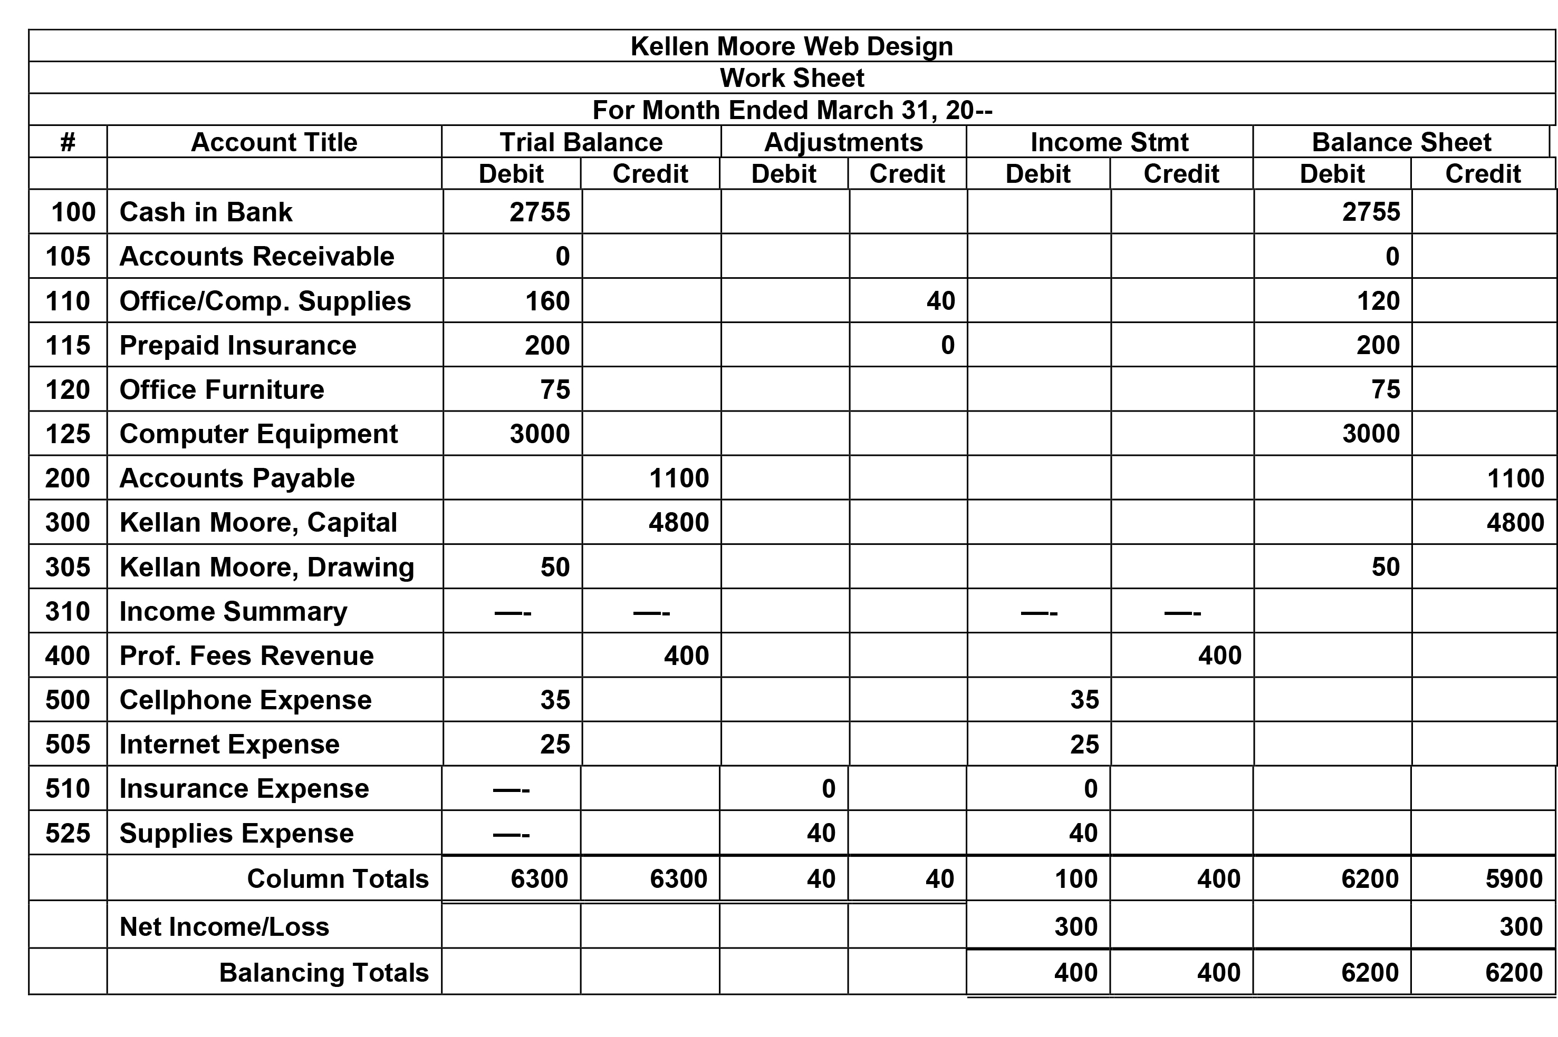
B
I

Slide 72
CAPITAL FORMULA
(the college kids come Home to Capital)
300 K.M., Capital - OE
— B+
0 Beg.
Cap
3,000 + Inv.
1,800 + Inv.
4,800 = COW
300 + NI
5050 End.
Cap.
- DRAW 50
- NL

Slide 73
Now, we’ll do a final check to see if DR = CR
(Perm. Account balances
ONLY)
PCTB - Post Closing
Trial Balance
DR CR
Cash 2,755
A/R 0
Supplies 120
PPI 200
Ofc.Furn. 75
Comp.Eqp. 3,000
Total DRs 6,150
A/P 1,100
Capital 5,050
Total CRs 6,150

Slide 74
Accounting Cycle
C-A-R-P-T-W-F-A-C-T-R
Pronounce it CarpetWFactor
C – Collect source documents
A – Analyze into Drs and Crs
R – Record in Journal
P – Post to General Ledger
T – Trial Balance
W – Worksheet
F – Financial Statements
A – Adjusting Entries
C – Closing Entries
T – Post-closing Trial Balance
R – Reversing entries (state)

Slide 75

SUCCESS!

Slide 76

That’s all for now!

Slide 77
BANK REC. FORMULA
Bank Reconciliation
BK Bal on Stmt CkBk Bal on Stubs
+ Dep in Transit
- O/S Checks
= Rec. Balance
- Bank Chgs
+/- Check Adj.
= Rec. Bal.

Slide 78
CAPITAL FORMULA
Capital - OE
— B+
BCap
+ Inv
= COW
+ NI
– NL
– D
= ECap
Beg. Capital
+ Investments
= Cap. On WS (COW)
+ Net Income = End Capital
- Drawing
- Net Loss

Slide 79
SUPPLIES FORMULA
Supplies - A
B+ —
BSupp
+ Bot
= SOT
– Used
= ESupp
Beg. Supplies
+ Bought
= Supp. On TB
(SOT)
= End Supplies
- Supplies Used
(Supplies Exp.)

Slide 80
INSURANCE FORMULA
Prepaid Insurance - A
B+ —
B-PPI
+ Bot
= POT
– Used
= E-PPI
Beg. PPInsurance
+ Bought
= PPI On TB
(POT)
= End PPI
- Insurance Used
(Ins. Exp.)

Slide 81
Income Statement Calculate COGS
Purchases
+ Trans. In
= Cost of Del. Goods
- Purch Discounts
- Purch Ret & Allow
= NET PURCHASES
+ Beg. Inventory
= Cost of Goods Avail.
- End. Inventory
= Cost of Goods Sold
Pur
+ TI
= CODG
- PD
- PRA
= NP
+ BI
= COGA
- EI
= COGS

Slide 82
Income Statement Calculate NI
Sales
- Sales Discounts
- Sales Ret & Allow
= NET SALES
- Cost of Goods Sold
= Gross Profit
- Expenses
= Net Income
Sales
- SD
- SRA
= NS
- COGS
= GP
- Exp
= NI

