Slide 1

UIL Accounting Banking Concepts
Kay Whitton
state contest director
Notes:
Hi, I’m Kay Whitton! Welcome to this lesson banking concepts and reconciling a bank statement…

Slide 2





Cash is no longer the primary medium of exchange Now, checks, debit cards, and EFT
Notes:
In the ‘old’ days, cash was the primary means of exchange. People and businesses used cash for most transactions. But in today’s world, checking accounts are the norm for businesses and individuals alike. They provide many advantages to the account holder

Slide 3
Why use a bank account?
Tracks Cash received by a biz
Records Cash paid out by a biz
Provides monthly statement of
activity on the account
Common acceptance of use
Notes:
Some advantages of a checking account are listed here, the primary reason having a record of transactions for the business each month.

Slide 4
Bank accounts protect businesses from:
Loss
Waste
Theft
Forgery
Embezzlement
Notes:
As stated in the textbook, businesses are protected from these events, although employees often find ways around the controls that a business puts in place to safeguard its funds.

Slide 5

Internal
Controls:
Limit # of persons handling cash
Separate tasks involving cash
Bonding emps. who handle cash
Using a cash register and safe
Depositing cash receipts daily
Use checks, DR cards or EFT
Notes:
Examples of internal controls (ones that the business has control over) are making sure that there is more than one person who works with the cash daily, perhaps using an in-office bookkeeper to count the funds in the cash register, or separating duties, even making sure that all employees have a backup when they go on vacation, etc. The more safeguards in place, the better protected a business is financially from fraud or theft.

Slide 6
External
Controls:
Banks maintain funds for biz’s
Banks monitor authorized sigs.
Cameras at after hours locations
Cameras at ATMs
Any activity not controlled by the biz. itself
Notes:
External controls are those put in place by the bank, which include these shown: watching for suspicious activity, verifying signatures, cameras at ATMs and at cashier stations, etc.

Slide 7
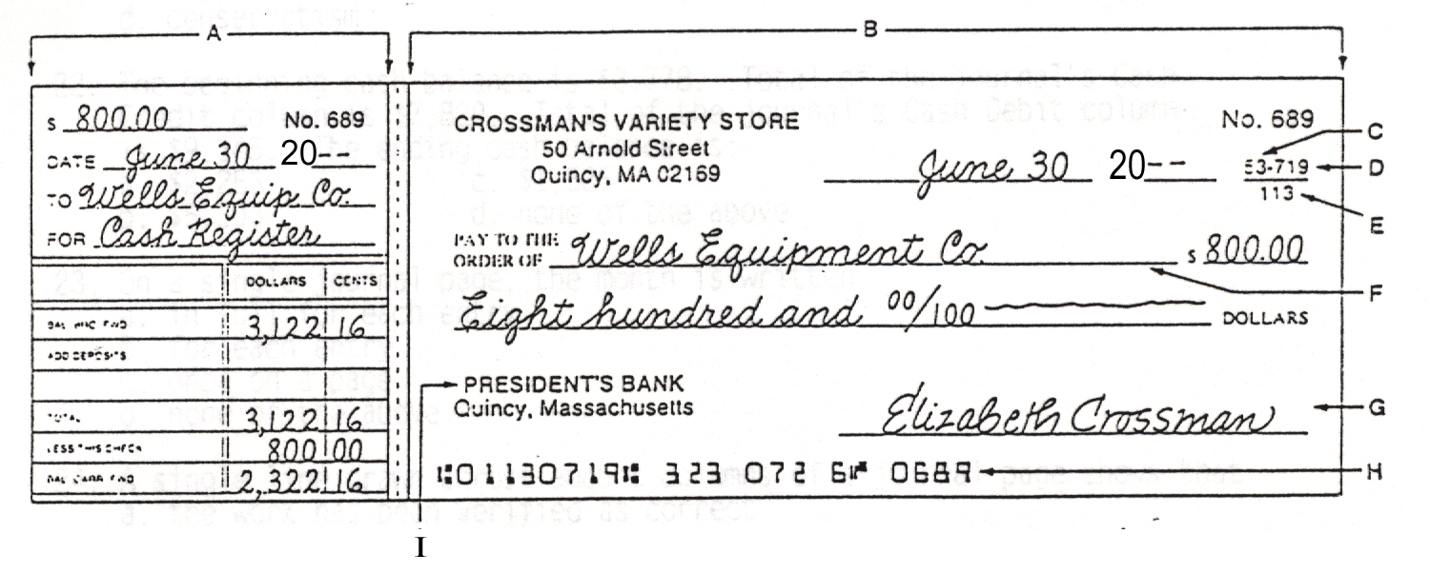
Elements of a completed check and checkstub:
A: Checkstub E. Fed Reserve District Code
B. Check portion F. Payee
C. City code G. Drawer
D. Bank Code H. MICR encoded number
I. Drawee
Notes:
Here is an example of a completed check and its associated checkstub. A is the checkstub, B is the check, the ABA number is shown in the fractional numbers printed below the check number (and also represented by H the MICR encoded number that lists the Federal Reserve Code, the bank code, the account number and the check number. Computers recognize and process the magnetic ink characters much quicker than those input by hand in earlier decades.

Slide 8
Mnemonic Device to remember…
PAYEE follows the word ‘PAY’
DRAWER signs the checks at the bottom right like
an artist
or ‘drawer’
$ is drawn out of the bank so it’s the ‘DRAWEE’
Notes:
Three banking terms you’ll need to know are payee, drawer and drawee. It’s simple if you remember that you Pay the PAYEE, the DRAWER signs their name in the bottom right corner, just as an artist or drawer would do, and since the money is being drawn from the bank, it is the DRAWEE

Slide 9

All cash received by a business would have ‘cleared’ the bank by month end.
All cash paid out by a business would have ‘cleared’ the bank by month end.
&
End. Bank Balance = End. Checkbook Bal.
Notes:
In a perfect world, all cash would be received by and all checks would be cleared by the bank at month end…

Slide 10


Deposits are made after banks close on the last day of the month…
Checks are often held by payees long after a month ends
(think fundraisers)
&
End. Bank Balance End. Checkbook Bal.
Notes:
For the reasons shown, though, this is not the case. If you wrote a check for a school fundraiser, that check might not be taken to the bank for a month or two or more. And since the close of business is 3 pm still for many banks, a deposit for the end of the month would likely not be processed until the next month.

Slide 11
Reasons Bank Statement Bal.
Checkbook Balance
Outstanding checks
(not presented to bank yet)
(Outstanding) deposits in transit
Bank service charges
Deposits not honored due to NSF
Difference in check amounts
(check ‘cleared’ for different amount than stub)
Misc. info provided on statement
Notes:
For the reasons shown on this slide, you can see why a bank statement balance will rarely = the checkbook balance, so the two balances must be reconciled or brought into agreement with each other to assure accurate balances for the cash account.

Slide 12
Information included on a monthly bank statement:
Beg. checking account balance
List of deposits made by the biz.
List of all checks paid by the bank
Bank service charges
NSF, EFT, debit card, stop payt…
Ending account balance
Notes:
This slide could be easily converted to a formula: Take the beginning checking account balance, Add the deposits (or credits) received during the month, Subtract all checks that cleared the bank, subtract the service charge that covers the bank’s costs of maintaining the account; subtract other transactions, such as NSF, EFT, etc. Those will be explained more fully later.

Slide 13

Bank Reconciliation Formula
Bank Side Checkbook Side
End Bal from
Bank Statement
+ DIT
- O/S Checks
= Reconciled Balance
Checkstub Bal
+/- check adj’s
- Service Charge
- NSF checks & fees
= Reconciled Balance
Notes:
Here is a sample bank rec you might want to memorize for working this type of problem. Keep in mind that the goal of a bank rec is to bring the bank’s balance into agreement with the checkbook balance. Basically, transactions that the bank doesn’t know about yet (outstanding checks and deposits) will adjust the bank statement balance, but most miscellaneous transactions will affect the checkbook side, since the business is theoretically finding out about that data from the bank statement itself.

Slide 14
Sample Bank Reconciliation Problem
For questions 41 and 42, write the correct amount on your answer sheet.
Data:
    Bank Service Charge for January is $15
Deposits in transit on January 31 are $1,870
Reconciled bank balance on January 31 is $3,080
An error on Ck #167 was discovered. It cleared the bank as $205 but was recorded in the accounting records as $250.
Outstanding checks on January 31 are $3,440
Notes:
Here is an actual problem from an old UIL test. Notice that the error on Ck 167 discovered that it cleared the bank for $205, but $250 was subtracted in the checkstubs. Whatever amount the check clears the bank for is considered the accurate amount for our purposes.

Slide 15
Bank Reconciliation
Bank Side Checkbook Side
End Bal 4650
+ DIT + 1870
- O/S Checks - 3440
= RB 3080
EB 3050
+ ck 167 Diff + 45
- SC <15>
NSF checks & fees
= RB 3080
Notes:
Using the data given in the previous slide, we add the $3,080 in the RB (reconciled balance) area, since those numbers must equal. Then we simply write the other data given by its descriptor. I like to draw rectangles whenever I’m solving, so that I remember what calculations need to be made.

Slide 16
Answering the test questions…
41. Given the above facts, what was the amount that was printed on the bank
statement as the closing balance for January 31?
Since we’re given the reconciled balance of $3,080, we work ‘bottom to top’ to calculate the ending balance on the statement of $4,650
42. What was the balance in the cash account in the accounting records prior to reconciling the bank statement?
Since we’re given the reconciled balance of $3,080, we work ‘bottom to top’ to calculate the ending balance in the checkbook of $3,050
Notes:
Since we’re given the reconciled balance of $3,080, we work ‘bottom to top’ to calculate the ending balance on the statement of $4,650
Since we’re given the reconciled balance of $3,080, we work ‘bottom to top’ to calculate the ending balance in the checkbook of $3,050

Slide 17
Don’t forget to journalize adjustments to cash and record changes in the checkstubs :
Journal Entry to Record bank service charge:
  DR Bank Service Charges 15
  CR Cash 15
  2. Journal Entry to Record check adjustment:
  DR Cash 45
  CR the Expense that was used for Ck 167 45
  3. Record any adjustments to cash in the check stubs to reflect the new balance
Notes:
A final step to reconciling is adjusting the cash account in the ledger by journalizing any adjustments, changes, or missing transactions. In this case, an entry would be made for the $15 service charge as shown, and the $45 adjustment would be journalized if the incorrect $250 was initially journalized. Otherwise, it would be a simple matter of correcting the math on the check stubs.

Slide 18
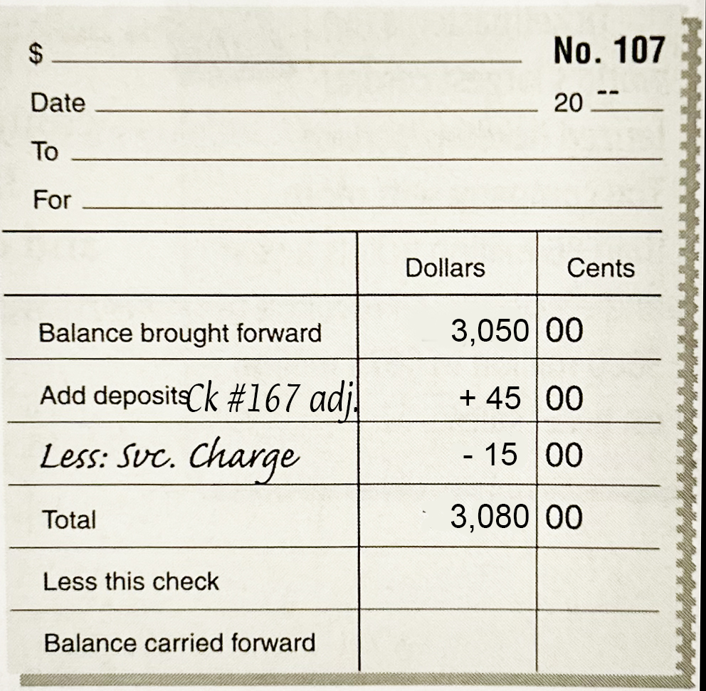
Adjustments recorded in the check stubs
Notes:
On this check stub, you can see the balance we started with ($3,050) and the two adjustments, with the reconciled balance being the new total of $3,080.

Slide 19
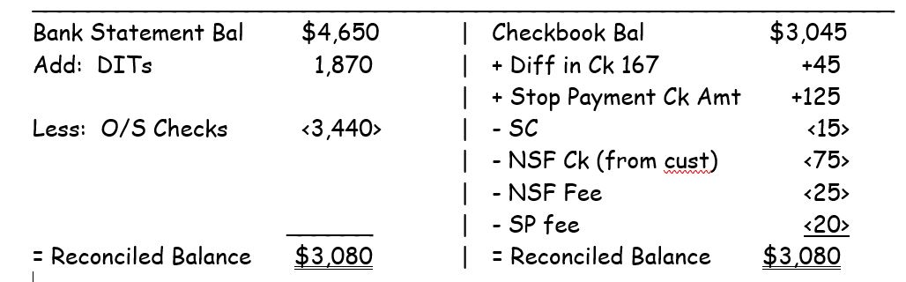
A More Advanced
Bank Reconciliation
Notes:
This bank rec has other miscellaneous adjustmnets, including a stop payment order (which would be added back since it was subtracted when written), as well as a NSF check one of the business’s customers wrote, as well as the associated fees for each that have to be subtracted too.

Slide 20
Banking Terminology
Checking account (allows a business to deposit money in a bank and to write checks against the account balance)
Check (written order from a depositor to the bank to pay a stated amount of cash to the payee)
Internal controls (steps the business itself takes to protect cash and other assets)
External controls (measures and procedures outside the business to protect cash and other assets.)
Notes:
Vocabulary for your memorizing enjoyment!

Slide 21
Depositor (a person or business who has cash on
deposit in a bank)
Signature Card (contains the signatures of the person(s) authorized to write checks on a checking account)
ABA Number (the American Banking Association number printed as a fraction on checks under the check number
Deposit slip (a bank form listing the cash and checks to be deposited)
Proving cash (verifying the balance of cash in the general ledger equals the balance shown in the checkstubs)
Notes:
More vocab to ponder at your leisure…

Slide 22
Outstanding check (checks that have been written by
a depositor but have not yet been received by the bank)
Outstanding deposit (a/k/a ‘Deposits in Transit’ have been deposited and recorded but not yet received by the bank)
Stop payment order (demand by the drawer that the bank not honor a certain check—usually used when lost )
Non-sufficient Funds (NSF) check (when a checking account does not have enough money to cover a check)
Electronic Funds Transfer system (EFTS) (allows banks to transfer fund quickly without the exchange of checks)
Dishonored check (a check the bank refuses to pay: closed acct, NSF, missing signature, pencil, numbers don’t match)
Notes:
Still more…

Slide 23
Canceled check (checks paid by the bank and deducted from the depositor’s account, marked ‘Paid’)
Voided check (VOID is written across a check to indicate it cannot be used; a voided check is attached to the stub)
Bank statement (itemized record of the transactions in a depositor’s account each month)
Reconciling (determining the differences between the bank statement and checkbook balances; making them agree)
Bank service charge (fee charged by the bank to maintain the records and processing bank statement items)
Endorsement (an authorized stamp or signature written on the back of a check, either Blank, Special or Restrictive)
Notes:
And the last slide of vocab. The last term “endorsement” is further explained on the next slide…

Slide 24
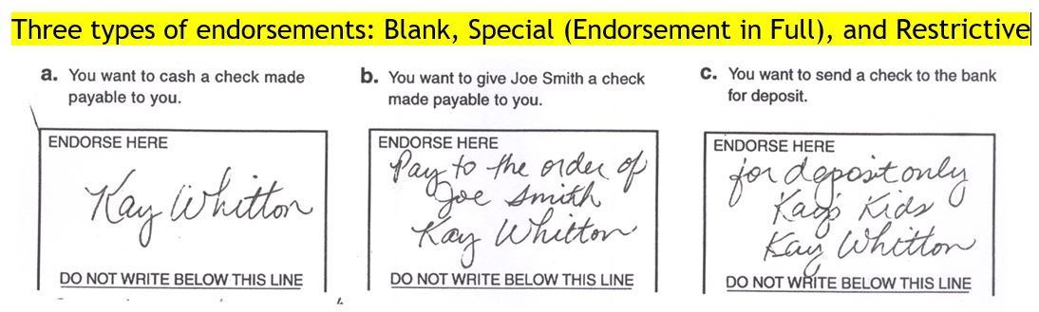
Three Types of Endorsements:
(most BLANK space!
signature only)
(SPECIAL goes to a 3rd party, special to you)
(RESTRICTS the $ to its room…your account)
Notes:
A blank endorsement has the most BLANK SPACE. The special endorsement is a rarely used type transferring ownership of the check to a SPECIAL third party, and the RESTRICTIVE endorsement restricts the check to a specific account, that of the business.

Slide 25

SUCCESS!

